Slide 1
Business Modeling
Lecturer: Ing. Martina Hanová, PhD.

Slide 2
Model, modelling or Modeling
modelling is helping to formalize and solve problems business managers and economists might be facing in their working lives, by application of selected quantitative methods to real economic examples and business applications
each model relies on a number of assumptions, or basic factors that are present in decision situations.
modelling provides a logical abstract template to help organize the analyst's thoughts.

Slide 3
Model - definition
a theoretical construction, that represents economic processes by a set of variables and a set of logical and/or quantitative relationships between them.
an abstract representation of reality. The model is usually presented in mathematical terms and includes a statement of the assumptions used in the functional relationships.

Slide 4
Statisticians - analysts
use their models in problem-solving and problem-analyzing process,
construct and simplify a model, by set of mathematical equations,
to explain how the whole system works,
use the model to calculate and predict what might happen in case that the system continues working in the changed/unchanged given conditions.

Slide 5
Classification of Models
- by Nature of the Environment:
Stochastic - means that some elements of the model are random, having an element of uncertainty.
Deterministic - model parameters are completely defined and the outcomes are certain.
- according to Behavior of Characteristics
Static Models - the impact of changes are independent of time.
Dynamic models - models consider time as one of the important variables.
- according to Relationship between Variables
Linear Models – linear relationship between variables
Nonlinear Models - nonlinear relationship between variables

Slide 6
Deterministic Model - Financial Model
The deterministic model of amortization is a common discounted cash flow application.
Amortization of debt - Loan Repayment model
required inputs:
initial finance loan balance,
amortization period,
interest rate

Slide 7
Deterministic Model - Financial Model
Amortization schedule arguments:
  Dr - the rest of the debt/loan in the r-th period
  D0 - loan amount
  Mr - amount of the principal in the r-th period (the actual reduction in the loan balance)
  ar - the payment made each period - anuity
  ur - amount of the interest in the r-th period
  i - the interest rate per period
  n - number of periods

Slide 8
Amortization loan with constant annuities
Loan of € 5,000 is to be paid with 8 constant annual payments payable by the end of the year. Create a plan for repayment of principal, unless the bank uses an interest rate of 7% p.a. with an annual interest period.

Slide 9
Excel financial function parameters:
Rate – the interest rate per period: p.a. (per annum) p.s. (per semester), p.q. (per quarter), p.m. (per month)
Nper – number of periods in the annuity
(Note: Rate must be consistent with Nper.)
Pmt – the payment made each period.
PV – the present value you want to owned right now
FV – the future value you want to have after the last payment made
Type – indicates when payments are made
omitted or 0 – payments are made at the end of each period
1 - payments are made at the beginning of each period

Slide 10
1. The periodic payment for a loan assuming constant payment and constant interest rate:
ar =PMT(Rate; Nper; Pv; Fv; Type)
Interest + Principal = Total payment
2. The amount of interest paid each month:
ur =IPMT(Rate;Per; Nper; Pv; Fv; Type)
Monthly interest_{r} = Interest rate * Ending balace_{r-1}
3. The amount of balance paid down each month – the payment on the principal:
Mr =PPMT(Rate;Per; Nper; Pv; Fv; Type)
4. Ending balance for each month:
Dr =PV(Rate; Nper; Pmt; Fv; Type)
Ending balance_{t} = Beginning balance_{t} – Monthly principal_{t}

Slide 11
Period | Monthly Payment | Interest | Principal | Ending Balance
r = 0,n | ar | ur | Mr | Dr | i | n
0 | - | - | - | € 5 000 | 7,0% | 8
1 | € 837 | € 350 | € 487 | € 4 513
2 | € 837 | € 316 | € 521 | € 3 991
3 | € 837 | € 279 | € 558 | € 3 433
4 | € 837 | € 240 | € 597 | € 2 836
5 | € 837 | € 199 | € 639 | € 2 197
6 | € 837 | € 154 | € 684 | € 1 514
7 | € 837 | € 106 | € 731 | € 783
8 | € 837 | € 55 | € 783 | € 0
Suma | € 6 699 | € 1 699 | € 5 000

Slide 12
Determination of the number of constant annuities and the last payment of the loan
Loan of € 5,000 is to be paid with constant annuities with amount of € 900 payable by the end of the year. Create a plan, unless the bank uses an interest rate of 7% p.a. with an annual interest period.

Slide 13
Sensitivity Analysis: What-If Analysis
is an important aspect of planning and managing any business.
understanding the implications of changes in the factors that influence your business
is often used to compare different scenarios and their potential outcomes based on changing input values.
The main goal of sensitivity analysis is to gain insight into which assumptions are critical, i.e., which assumptions affect choice.

Slide 14
Sensitivity Analysis: What-If Analysis
Model - deterministic :
Loan of 20 000 €, over 60 months at an interest rate 6.8% p.a. Monthly repayment?

Slide 15
What is What-if Analysis? sensitivity analysis
How much money you could borrow if the repayments were only 350€ per month?
Suppose you want to see the effect of different loan amounts from 15000 to 30000€.
Comparing two different input variables – loan amount and duration of the loan –Terms in months – from 3 to 12 years (36 to 144 months)

Slide 19
threshold values
Example:
Predetermined inputs
unit price 29€
units sold 700 units
unit variable costs 8€
fixed costs 12 000€
Final value the corresponding Net Cash Flows
NCF = US*(UP-UVC)-FC

Slide 20
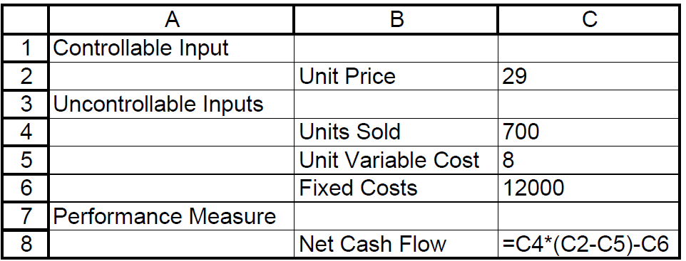

Slide 21
Goal seek:
How many units must I sell to be better?
Net cash flow = 4300 €
Breakeven Point:
The sales volume at which contribution to profit and overhead equals to fixed cost?
Net cash flow = 0 €

Slide 22
Classification of Models
- by Nature of the Environment:
Stochastic - means that some elements of the model are random. So called Probabilistic models developing for real-life systems having an element of uncertainty.
Deterministic - model parameters are completely defined and the outcomes are certain. In other words, deterministic models represent completely closed systems and the results of the models assume single values only.

Slide 23
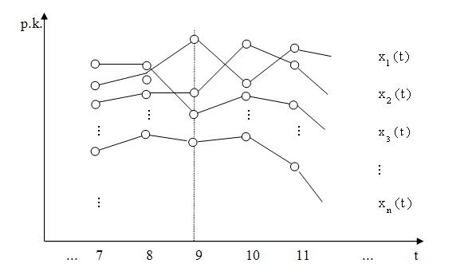
Stochastic Modeling
Stochastic Process
Xj(t) j = 1, 2, ...n - the realization stochastic process
Results of a random experiment, which independently
repeated m times - random phenomena, we call them
states of a system and denote them E1, E2, .... Em.

Slide 24
Markov model
Markov property
the distribution for the variable depends only on the distribution of the previous state
(The future depends on the presence, does not depend on the past.)
Markov Chain is the most important class of stochastic models due to their powerful modeling features, numerical tractability, and applicability to a wide range of real-life systems.

Slide 25
Markov chains in terms Analysis the development of systems
probability that the system is on the k-th step in the state Ej, if on the k-1-step was in a state Ei is called a transition probability - p_{ij}^{k}
transition matrix of conditional probabilities after k-steps:
States: transient, recurrent, absorbent

Slide 26

A very simple weather model
The probabilities of weather conditions (modeled as either rainy or sunny),
given the weather on the previous day, can be represented by a transition matrix:
The matrix P represents the weather model in which a sunny day is 90% likely to be followed by another sunny day, and a rainy day is 50% likely to be followed by another rainy day.

Slide 27

Predicting the weather
The weather on day 0 (today) is known to be sunny. This is represented by a vector in which the "sunny" entry is 100%, and the "rainy" entry is 0%:
The weather on day 1 (tomorrow) can be predicted by:
Thus, there is a 90% chance that tomorrow will also be sunny.

Slide 28
Model of business policy decision-making
Company placed on the market a new product and explores its success, in terms of sales which can be characterized as follows:
- product is considered to be successful if in specified time sells more than 70% of the production
- product is deemed to have failed, if in specified time sell less than 70% of production.

Slide 29
E1 - the product is successful
E2 - the product is unsuccessful
Changes to the success of the product examine after months, or step = 1 month.
Suppose that it is a finite Markov chain with states E1, E2, ... Em.

Slide 30
Markov chain
If the product is successful in the first month, with probability 0.5 and remain successful in the next month. If not, with probability 0.2 will become successful in the next month.
Transition matrix:
E1 E2

Slide 31
Markov chains
At the beginning in the first month, found 75% of the success of the product

Slide 32

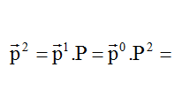
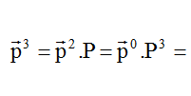
vector of the absolute probabilities after 1-month:
vector of the absolute probabilities after 2-month:
vector of the absolute probabilities after 3-month:

Slide 33
Asymptotic behavior of the ergodic Markov chains

Slide 34
Markov chains with alternatives
Enterprise started an advertising campaign. Successfulness of successful product in the first month increase to 80%. On the other hand, if the sale was at the beginning unsuccessful, its success is increased just to 30%. The task is to determine the optimal alternatives that lead to the highest expected revenues. Input data are as follows:
State i | Alternativ
 | h |  | E₁ | E₂ | E₁ | E₂
E₁ (succesfull) | 1 | no advertising | 0,5 | 0,5 | 10 | 4
 | 2 | advertising | 0,8 | 0,2 | 14 | 2
E₂ (unsuccessful) | 1 | no advertising | 0,2 | 0,8 | 3 | -1
 | 2 | advertising | 0,3 | 0,7 | 2 | -3

Slide 35
Markov chains with alternatives
Final step: determine the optimal path vector of corresponding alternatives
From the results we can see that after 3th step the process is stabilized, so that optimal decision is uses the second alternative - advertising. For the enterprise is optimal decision to implement an advertising campaign to increase the success of a new product.
k→ | 0 | 1 | 2 | 3 | 4 | 5
 | 0 | 11,6 | 20,84 | 28,664 | 35,756 | 42,482
 | 0 | -0,2 | 1,96 | 6,124 | 11,386 | 17,197
 |  | 2 | 2 | 2 | 2 | 2
 |  | 1 | 1 | 2 | 2 | 2

