Slide 1
Business Modeling
Lecturer: Ing. Martina Hanová, PhD.

Slide 2
Econometrics
„Econometrics may be defined as the social science in which the tools of economic theory, mathematics, and statistical inference are applied to the analysis of economic phenomena.“
(Arthur S. Goldberger)

Slide 3
Econometric Theory
Econometrics - uses a variety of techniques, including regression analysis to compare and test two or more variables.
Econometrics is a mixture of economic theory, mathematical economics, economic statistics, and mathematical statistics.
Econometrics
Statistics
Mathematics
Economics

Slide 4
Methodology of Econometrics
Traditional or classical methodology
1. Statement of theory or hypothesis
2. Specification of the mathematical model
3. Specification of the statistical, or econometric model
4. Obtaining the data
5. Estimation of the parameters of the econometric model
6. Hypothesis testing
7. Forecasting or prediction
8. Using the model for control or policy purposes.

Slide 5
1. Theory or hypothesis
A theory should have a prediction – hypothesis
(in statistics and econometrics)
Keynesian theory of consumption:
Keynes stated - men are disposed to increase their consumption as their income increases, but not as much as the increase in their income.
marginal propensity to consume (MPC) - is greater than zero but less than 1.

Slide 6
2. Mathematical Model
Mathematical equation:
Y = β₁ + β₂X
β₁ intercept and β₂ a slope coefficient.
THEORY:
Return to schooling is positive
Y = wage
X = number of years in school
Keynesian consumption function:
Y = consumption expenditure
X = income
β2 measures the MPC 0 < β2 < 1

Slide 7
3. Specification of the Econometric Model
Mathematical model - deterministic relationship between variables
Y = β₁ + β₂X + u
Econometric model – random or stochastic relationship between variables
Y = β1 + β2X + ε
u or ε - disturbance, error term, or random (stochastic) variable
- represents other non-quantifiable, unknown factors that affect Y, also represents mismeasurements
EXAMLE: relationship between Crop yield vs. Rain fall

Slide 8
4. Obtain Data
observational data non-experimental data,
experimental data
Types of Data
time series data
cross-section data
pooled data
Measurement of Scale
Ratio scale
Interval scale
Ordinal scale
Nominal scale

Slide 9
5. Estimation of the model
to estimate the parameters of the function, β1 and β2,
Regression analysis - statistical technique - the single most important tool at the econometrician’s disposal
Ŷ = −184.08 + 0.7064X
Ŷ - is an estimate of consumption

Slide 10
6. Hypothesis Testing
Statistical inference (hypothesis testing)
We can use the information in the sample to make inferences about the population.
We will have two hypotheses that go together,
H₀: the null hypothesis
H₁:the alternative hypothesis
The null hypothesis is the statement or the statistical hypothesis that is actually being tested. The alternative hypothesis represents the remaining outcomes of interest.

Slide 11
7. Forecasting
forecast, variable Y on the basis of known or expected future value(s) of the explanatory, or predictor, variable X.
8. Use for Policy Recommendation

Slide 12
TERMINOLOGY AND NOTATION
Dependent variable
Explained variable
Predictand
Regressand
Response
Endogenous
Outcome
Controlled variable
Independent variable
Explanatory variable
Predictor
Regressor
Stimulus
Exogenous
Covariate
Control variable
two-variable (simple) regression analysis
multiple regression analysis
multivariate regression vs. multiple regression

Slide 13
Determining the Regression Coefficients
Finding a Line of Best Fit
We can use the general equation for a straight line, to get the line that best “fits” the data.

Slide 14
Ordinary Least Squares (OLS)
The most common method used to fit a line to the data is known as OLS (ordinary least squares).
Actual and Fitted Value

Slide 15
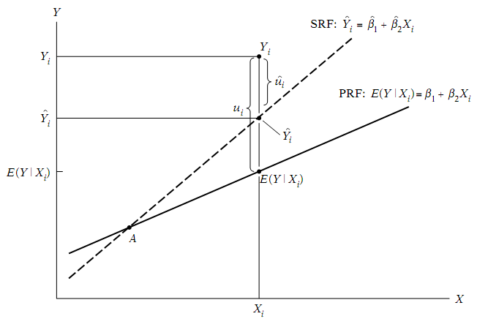
The Theory of OLS
E(Y_{i}⏐X_{i}) = β_{o} + β₁X_{i} population regression line (PRF)
Ŷ_{i}= b_{o} + b₁X_{i} sample regression equation (SRF)
min Σ e_{i}² = e₁² + e₂² + e₃² +.........+ e_{n}²

Slide 16
How does OLS get estimates of the coefficients?
Excel Tools/data analysis/ regression
Matrix form
Formula – mathematical function

Slide 17
RESULTS
Interpretation of the regression output:
R Square –
Multiple R –
Intercept –
Regression Coefficient –

Slide 18
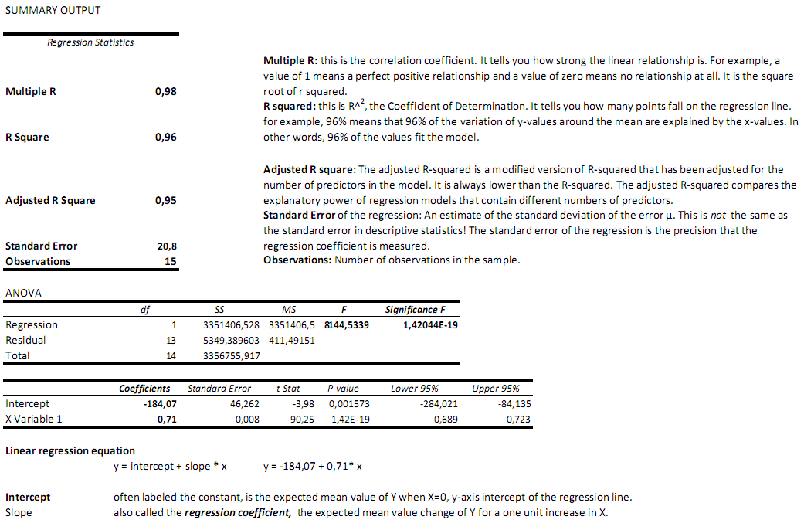

Slide 19
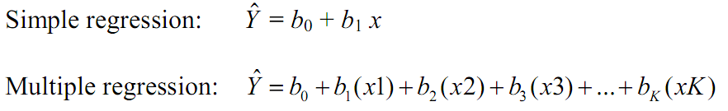
multiple regression model

Slide 20
Verification of the statistical significance of the model
F-test
test the statistical significance of the model
Significance F < α - significance level (5%)
we reject the null hypothesis at the α level,
we say that the model is statistically significant.

Slide 21
Verification of the statistical significance of parameters
T-test
test the statistical significance of the estimated regression parameters
P-value < α - significance level (5%)
we reject the null hypothesis at the α level,
we say that the parameter is statistically significant.

Slide 22
Assumption of Ordinary Least Squares
Linearity:
The true relationship between the mean of the response variable E(Y) and the
explanatory variables X1, ... Xn is a straight line.
In order to use OLS, we need a model which is linear in the parameters (α and β ). It does not necessarily have to be linear in the variables
(y and x).
Linear in the parameters means that the parameters are not multiplied together, divided, squared or cubed etc.
Some models can be transformed to linear ones by a suitable substitution or manipulation, e.g. the exponential regression model

Slide 23

The log-log transformation
Cobb–Douglas production function
Y = total production (the monetary value of all goods produced in a year)
L = labor input
K = capital input
A = total factor productivity
α and β – output elasticities

Slide 24

Log – log model
B1 and B2 - elasticities of labor and capital. These values are constants determined by available technology.
Elasticity - percentage change in Y for a given (small) percentage change in X

Slide 25
Semi-log transformation
Log – Lin model
Lin – Log model
Log-Lin model - measure the growth rate

Slide 26
Dummy variables
Examples:
dummy for gender – e.g. 1 for female, 0 for male.
dummy for years in which there was some unusual circumstance, e.g. war– would equal 1 in war years, 0 otherwise.
set of seasonal dummies – e.g. dummies for the four quarters of the year, each equal to 1 in its own quarter, 0 otherwise.
set of category dummies – e.g. for different industries – Manufacturing dummy = 1 for manufacturing firms, 0 otherwise, retail dummy =1 for retail firms, 0 otherwise, etc.

Slide 27
LINEAR PROGRAMMING
the process of taking various linear inequalities relating to some situation, and finding the "best" value obtainable under those conditions.
in "real life", is part of a very important area of quantitative analysis called "optimization techniques„.
this field of study (or at least the applied results of it) are used every day in the organization and allocation of resources.

Slide 28
Linear programming problem
the problem of maximizing or minimizing a linear function subject to linear constraints.
the constraints may be equalities or inequalities.
Typical example – Product mix model:
taking the limitations of materials and labor, and then determining the "best" production levels for maximal profits under those conditions.

Slide 29
Linear Programming Model
Formulate LP models - identify the basic concepts:
Decision variables - are the elements of the model that the decision maker controls and those values determine the solution of the model.
Objective function - where you specify the goal you are trying to achieve. The goal can either be to maximize or to minimize the value of the objective function.
Constraints - are the real world limitations on the decision variables. A constraint restricts or constrains the possible values which the variable can take, example: certain resources.
to optimize the model – to find optimal solution

Slide 30
A Simple Product-Mix Model
The Nitra Firm (NrF) produce two kinds of product. The markets for the Product 1 (P1) and Product 2 (P2) are endless. Every unit of P1 sold brings an income of 5 cents and each unit of P2 brings a profit of 8 cents. There is a fixed cost of running the NrF of 4000 Euros per month, regardless of the amount of products. The NrF is divided into two departments: cutting and soldering, with limited capacity in both departments. In the cutting department there are ten big cutters, each with a capacity of 140 cutting sheets per day. It is possible to produce ten units of P1 in each of these cutting sheets, or five of the P2. You can make any combination of the two products on the cutting sheets. Just keep in mind that each P2 unit takes twice the space of P1 unit. The soldering department can solder up to 8000 units of P1 per day and 5000 units of P2. There are two separate automatic solders so there is no conflict between making the two kinds of products. Since the market for both types of products is unlimited, the management of NrF has decided to find the best product mix. The question is how many units of each type of product should be produced each day to bring the highest profit, given the physical limitations of the NrF.

Slide 31
How Do I Define the LP Model?
1 step: define decision variables – unknowns variables
Xi i = 1,n
What are we going to calculate?
The numbers of loaves of each type made daily.
X1 = the number of loaves of WB produced per day
X2 = the number of loaves of DB produced per day

Slide 32
2 step: define the Objective Function
What is the goal of the problem?
The goal is to maximize the daily profit of NrB:
income on each loaf of the i-th kind of bread (5 cents per WB, 8 cents per LDB)
“multiply by”
Xi - the number of i-th kind of bread loves
=
Total income for the i-th kind of bread
“subtract”
Fixed costs (4000 eur per month/ 30 days)
“equal”
Total profit of the NrB
OF: 0.05*x1 + 0.08*x2 – 4000/30→ max

Slide 33
3 step: define the Constraints
Baking department - an interaction between the bread types. It is possible to put either 10 WB or 5 DB on each baking sheet.
1/10* units of WB + 1/5 * units of DB
=
the total usage of baking sheets
10 ovens, each with a capacity of 140 baking sheets per day
1/10*x1 + 1/5*x2 <= 10 x 140

Slide 34
3 step: define the Constraints
Mixing department - two separate automatic mixers, each with capacity: up to 8000 loaves of WB and 5000 loaves of LDB per day.
x1 <= 8000
x2 <= 5000
Non negativity constrain – production quantity must be non negative
x1, x2 >= 0
Integer restriction constrain – a whole loaf of bread x1, x2 = integer

Slide 35
Tool for Solving a LP model
SOLVER tool in Excel:
to solve linear and nonlinear optimization problems
allows integer or binary restrictions to be placed on decision variables

