Slide 1
Data Preparation
(Data pre-processing)

Slide 2
Data Preparation
Introduction to Data Preparation
Types of Data
Outliers
Data Transformation
Missing Data
2

Slide 3
Why Prepare Data?
Data need to be formatted for a given software tool
Data need to be made adequate for a given method
Data in the real world is dirty
  incomplete: lacking attribute values, lacking certain attributes of interest, or containing only aggregate data
    e.g., occupation=“”
  noisy: containing errors or outliers
    e.g., Salary=“-10”, Age=“222”
  inconsistent: containing discrepancies in codes or names
    e.g., Age=“42” Birthday=“03/07/1997”
    e.g., Was rating “1,2,3”, now rating “A, B, C”
    e.g., discrepancy between duplicate records
3

Slide 4
Major Tasks in Data Preparation
Data discretization
  Part of data reduction but with particular importance, especially for numerical data
Data cleaning
  Fill in missing values, smooth noisy data, identify or remove outliers, and resolve inconsistencies
Data integration
  Integration of multiple databases, data cubes, or files
Data transformation
  Normalization and aggregation
Data reduction
  Obtains reduced representation in volume but produces the same or similar analytical results
4

Slide 5
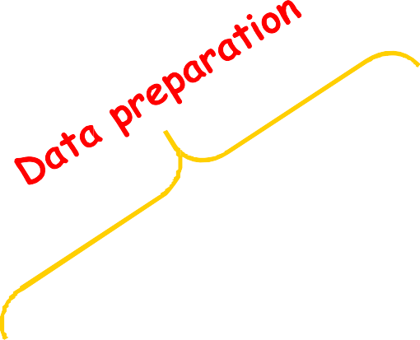
Data Preparation as a step in the Knowledge Discovery Process
Knowledge
Evaluation and Presentation
Data Mining
Selection and Transformation
Cleaning and Integration
DW
DB
5

Slide 6
TYPES OF DATA
6

Slide 7
Types of Measurements
Nominal (categorical) scale
Ordinal scale
Interval scale
Ratio scale
More information content
Qualitative
Quantitative
Discrete or Continuous
7

Slide 8
Types of Measurements: Examples
Nominal:
  ID numbers, Names of people
  eye color, zip codes (categorical)
Ordinal:
  rankings (e.g., taste of potato chips on a scale from 1-10), grades, height in {tall, medium, short}
Interval:
  calendar dates, temperatures in Celsius or Fahrenheit, GRE (Graduate Record Examination) and IQ scores
Ratio:
  temperature in Kelvin, length, time, counts, weight
8

Slide 9
Data Conversion
Some tools can deal with nominal values but other need fields to be numeric
Convert ordinal fields to numeric to be able to use “>” and “<“ comparisons on such fields.
A → 4.0
A- → 3.7
B+ → 3.3
B → 3.0
Multi-valued, unordered attributes with small no. of values
  e.g. Color=Red, Orange, Yellow, …, Violet
  for each value v create a binary “flag” variable C_v , which is 1 if Color=v, 0 otherwise
20

Slide 10
Conversion: Nominal, Many Values
Examples:
  US State Code (50 values)
  Profession Code (7,000 values, but only few frequent)
Ignore ID-like fields whose values are unique for each record
For other fields, group values “naturally”:
  e.g. 50 US States → 3 or 5 regions
  Profession – select most frequent ones, group the rest
  Aggregation
Create binary flag-fields for selected values

Slide 11
OUTLIERS

Slide 12
Outliers
Outliers are values thought to be out of range.
  “An outlier is an observation that deviates so much from other observations as to arouse suspicion that it was generated by a different mechanism”
  Can be detected by standardizing observations and label the standardized values outside a predetermined bound as outliers
  Outlier detection can be used for fraud detection or data cleaning
Approaches:
  do nothing
  enforce upper and lower bounds – it is not precisely agreed
  let binning handle the problem

Slide 13
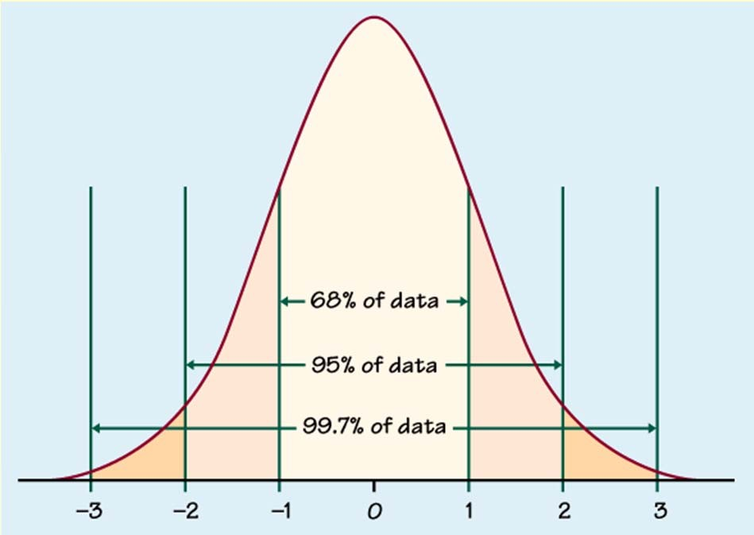
Outlier detection
Univariate
  Compute mean and std. deviation. For k=2 or 3, x is an outlier if outside limits (normal distribution assumed)
(x − ks, x + ks)

Slide 14
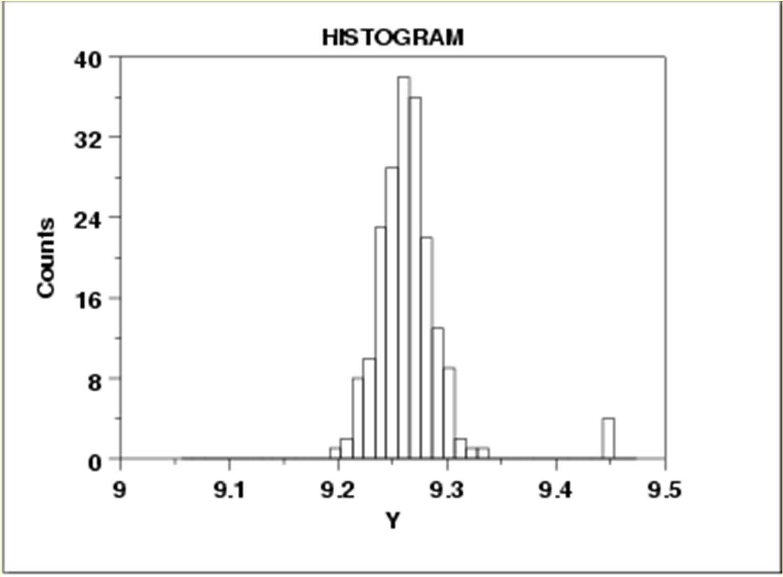

Slide 15
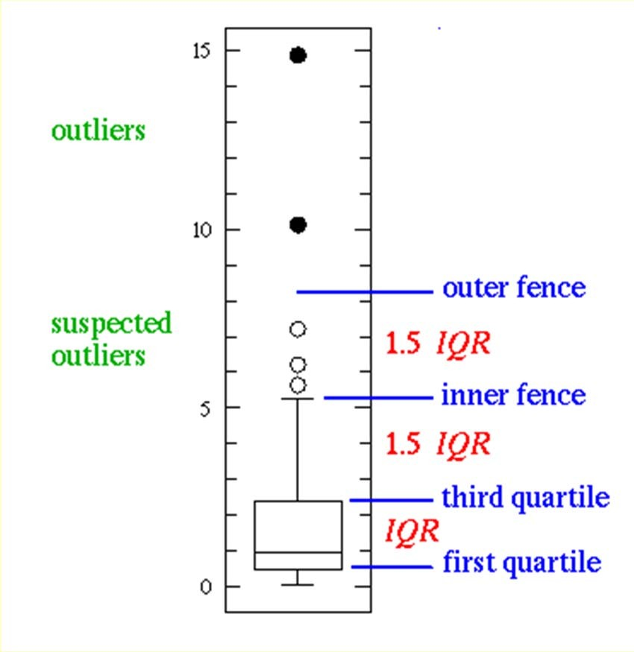
Outlier detection
Univariate
  Boxplot: An observation is an extreme outlier if
(Q1-3×IQR, Q3+3×IQR), where IQR=Q3-Q1
(IQR = Inter Quartile Range)
and declared a mild outlier if it lies outside of the interval
(Q1-1.5×IQR, Q3+1.5×IQR).
http://www.physics.csbsju.edu/stats/box2.html
44

Slide 16
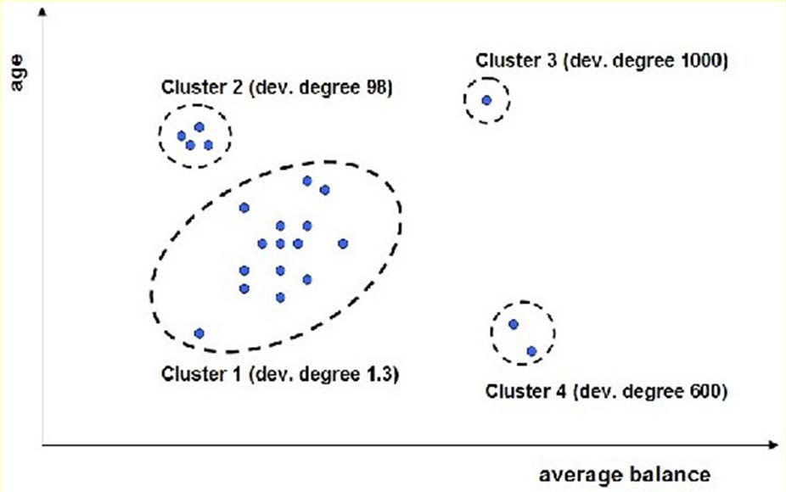
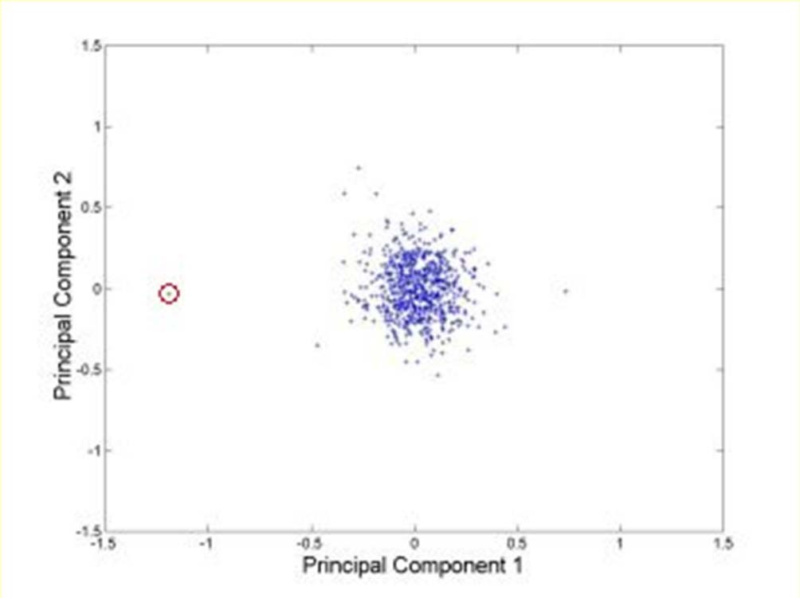
Outlier detection
Multivariate
  Clustering
    Very small clusters are outliers
http://www.ibm.com/developerworks/data/li brary/techarticle/dm-0811wurst/

Slide 17
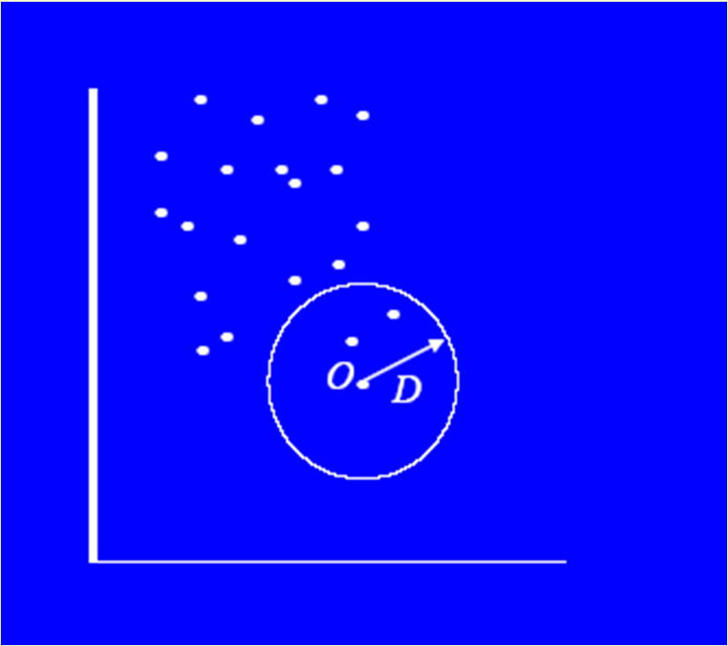
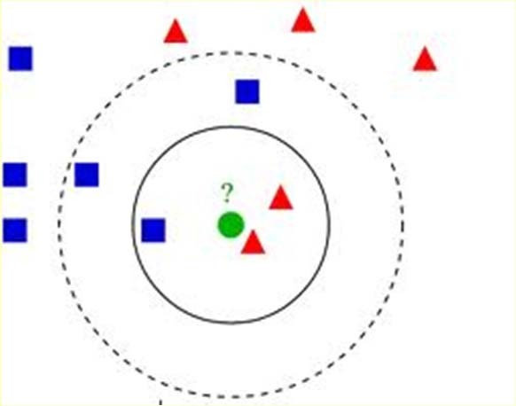
Outlier detection
Multivariate
  Distance based
    An instance with very few neighbors within D is regarded as an outlier
Knn algorithm

Slide 18
DATA TRANSFORMATION

Slide 19
Normalization vs. Standardization
For distance-based methods, normalization/standardization helps to prevent that attributes with large ranges out-weight attributes with small ranges
Normalization usually means to scale a variable to have a values between 0 and 1, while standardization transforms data to have a mean of zero and a standard deviation of 1
  min-max normalization
  z-score standardization (does not eliminate outliers)
  normalization by decimal scaling

Slide 20
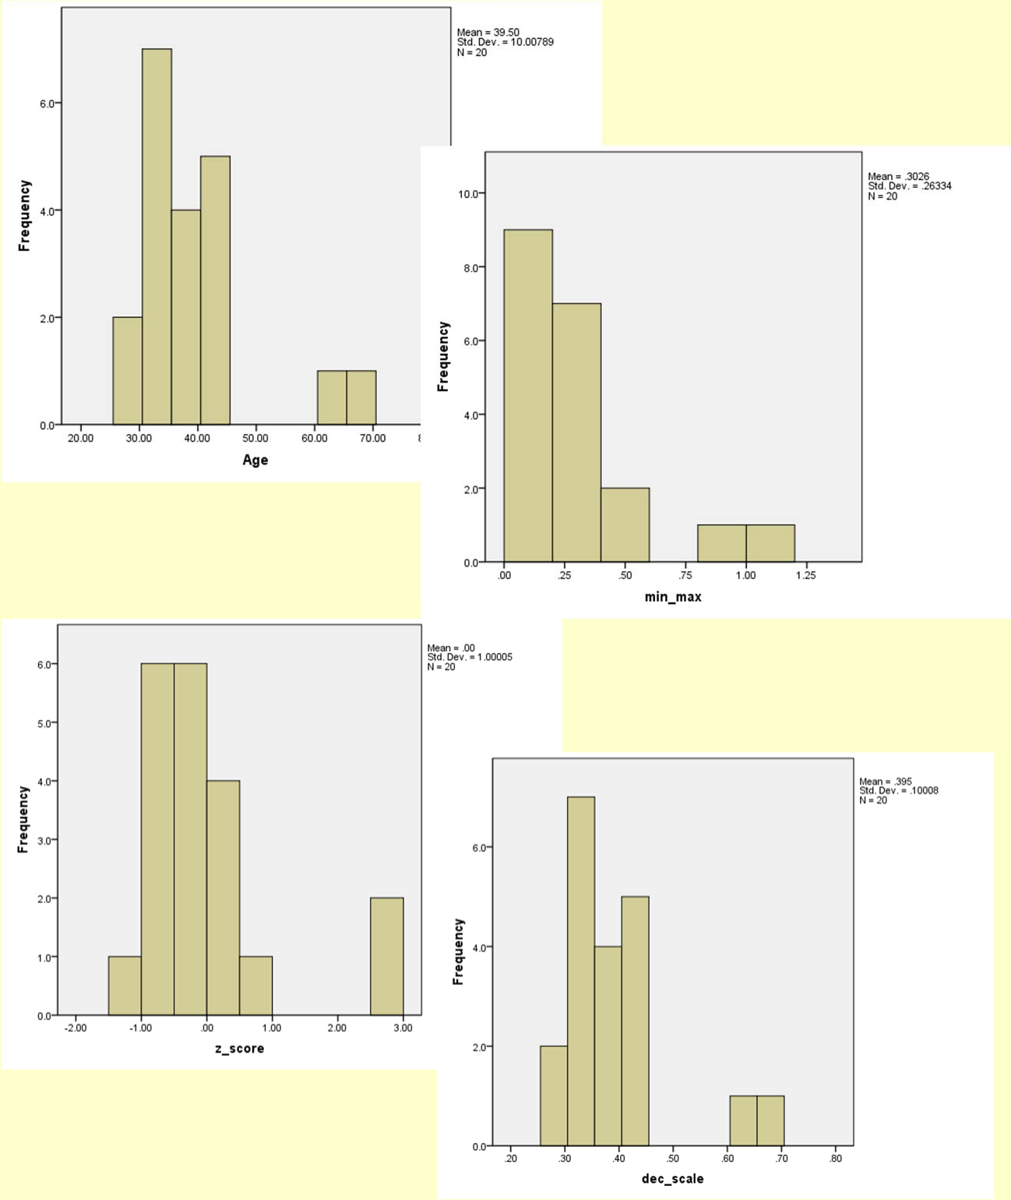
Age | min‐max (0‐1) | z‐score | dec. scaling
44 | 0.421 | 0.450 | 0.44
35 | 0.184 | ‐0.450 | 0.35
34 | 0.158 | ‐0.550 | 0.34
34 | 0.158 | ‐0.550 | 0.34
39 | 0.289 | ‐0.050 | 0.39
41 | 0.342 | 0.150 | 0.41
42 | 0.368 | 0.250 | 0.42
31 | 0.079 | ‐0.849 | 0.31
28 | 0.000 | ‐1.149 | 0.28
30 | 0.053 | ‐0.949 | 0.3
38 | 0.263 | ‐0.150 | 0.38
36 | 0.211 | ‐0.350 | 0.36
42 | 0.368 | 0.250 | 0.42
35 | 0.184 | ‐0.450 | 0.35
33 | 0.132 | ‐0.649 | 0.33
45 | 0.447 | 0.550 | 0.45
34 | 0.158 | ‐0.550 | 0.34
65 | 0.974 | 2.548 | 0.65
66 | 1.000 | 2.648 | 0.66
38 | 0.263 | ‐0.150 | 0.38
28 | minimun
66 | maximum
39.50 | avgerage
10.01 | standard deviation
53

Slide 21
MISSING DATA

Slide 22
Missing Data
Data is not always available
Missing data may be due to
  equipment malfunction
  inconsistent with other recorded data and thus deleted
  data not entered due to misunderstanding
  certain data may not be considered important at the time of entry
  not register history or changes of the data
Missing data may need to be inferred.
Missing values may carry some information content: e.g. a credit application may carry information by noting which field the applicant did not complete

Slide 23
Missing Values
There are always MVs in a real dataset
MVs may have an impact on modelling, in fact, they can destroy it!
Some tools ignore missing values, others use some metric to fill in replacements
Replacing missing values without elsewhere capturing that information removes information from the dataset

Slide 24
Pattern of misssing data why data goes missing
Missing Completely at Random (MCAR): The fact that a certain value is missing has nothing to do with its hypothetical value and with the values of other variables.
Missing at Random (MAR): Missing at random means that the propensity for a data point to be missing is not related to the missing data, but it is related to some of the observed data. (A better name would actually be Missing Conditionally at Random, because the missingness is conditional on another variable. )
Missing not at Random (MNAR): Two possible reasons are that the missing value depends on the hypothetical value (e.g. People with high salaries generally do not want to reveal their incomes in surveys) or missing value is dependent on some other variable’s value.

Slide 25
How to Handle Missing Data?
Ignore records (use only cases with all values)
  Usually done when class label is missing as most prediction methods do not handle missing data well
  Not effective when the percentage of missing values per attribute varies considerably as it can lead to insufficient and/or biased sample sizes
Ignore attributes with missing values
  Use only features (attributes) with all values (may leave out important features)
Fill in the missing value manually
  tedious + infeasible?

Slide 26
How to Handle Missing Data?
Use a global constant to fill in the missing value
  e.g., “unknown”. (May create a new class!)
Use the attribute mean to fill in the missing value
  It will do the least harm to the mean of existing data
  If the mean is to be unbiased
  What if the standard deviation is to be unbiased?
Use the attribute mean for all samples belonging to the same class to fill in the missing value

Slide 27
How to Handle Missing Data?
Use the most probable value to fill in the missing value
  Inference-based such as Bayesian formula or decision tree
  Identify relationships among variables
    Linear regression, Multiple linear regression, Nonlinear regression
  Nearest-Neighbour estimator
    Finding the k neighbours nearest to the point and fill in the most frequent value or the average value
    Finding neighbours in a large dataset may be slow

Slide 28
How to Handle Missing Data?
Note that, it is as important to avoid adding bias and distortion to the data as it is to make the information available.
  bias is added when a wrong value is filled-in
No matter what techniques you use to conquer the problem, it comes at a price. The more guessing you have to do, the further away from the real data the database becomes. Thus, in turn, it can affect the accuracy and validation of the mining results.

Slide 29
Summary
Every real world data set needs some kind of data pre-processing
  Deal with missing values
  Correct erroneous values
  Select relevant attributes
  Adapt data set format to the software tool to be used

Slide 30
References
‘Data preparation for data mining’, Dorian Pyle, 1999
‘Data Mining: Concepts and Techniques’, Jiawei Han and Micheline Kamber, 2000
‘Data Mining: Practical Machine Learning Tools and Techniques with Java Implementations’, Ian H. Witten and Eibe Frank, 1999
‘Data Mining: Practical Machine Learning Tools and Techniques second edition’, Ian H. Witten and Eibe Frank, 2005
DM: Introduction: Machine Learning and Data Mining, Gregory Piatetsky-Shapiro and Gary Parker
(http://www.kdnuggets.com/data_mining_course/dm1-introduction-ml-data-mining.ppt)
ESMA 6835 Mineria de Datos (http://math.uprm.edu/~edgar/dm8.ppt)

