Slide 1
Introduction to Econometrics

Slide 2
Econometrics
„Econometrics may be defined as the social science in which the tools of economic theory, mathematics, and statistical inference are applied to the analysis of economic phenomena.“
(Arthur S. Goldberger)

Slide 3
Econometric Theory
Econometrics - uses a variety of techniques, including regression analysis to compare and test two or more variables.
Econometrics is a mixture of economic theory, mathematical economics, economic statistics, and mathematical statistics.
Econometrics
Statistics
Mathematics
Economics

Slide 4
Types of Econometrics

Slide 5
Methodology of Econometrics
Classical methodology - steps
1. Statement of theory or hypothesis
2. Specification of the mathematical model
3. Specification of the statistical, or econometric model
4. Obtaining the data
5. Estimation of the parameters of the econometric model
6. Hypothesis testing
7. Forecasting or prediction
8. Using the model for control or policy purposes.

Slide 6
1. Theory or hypothesis
A theory should have a prediction – hypothesis
(in statistics and econometrics)
Keynesian theory of consumption:
Keynes stated - men are disposed to increase their consumption as their income increases, but not as much as the increase in their income.
marginal propensity to consume (MPC) - is greater than zero but less than 1.

Slide 7
2. Mathematical Model
Mathematical equation:
Y = β₁ + β₂X
β₁ intercept and β₂ a slope coefficient.
Keynesian consumption function:
Y = consumption expenditure
X = income
β2 measures the MPC 0 < β2 < 1

Slide 8
3. Specification of the Econometric Model
Mathematical model - deterministic relationship between variables
Econometric model – random or stochastic relationship between variables
Y = β₁ + β₂X + u Y = β1 + β2X + ε
u or ε - disturbance, error term, or random (stochastic) variable
- represents other non-quantifiable, unknown factors that affect Y.
measurement errors
reporting errors
computing errors
other influence,

Slide 9
4. Obtain Data
observational data non-experimental data,
experimental data
Types of Data
time series data
cross-section data
pooled data
Measurement of Scale
Ratio scale
Interval scale
Ordinal scale
Nominal scale

Slide 10
5. Estimation of the model
to estimate the parameters of the function, β1 and β2,
Statistical technique - regression analysis
Ŷ = −184.08 + 0.7064X
Ŷ - is an estimate of consumption

Slide 11
6. Hypothesis Testing
statistical inference (hypothesis testing)
7. Forecasting
forecast, variable Y on the basis of known or expected future value(s) of the explanatory, or predictor, variable X.
8. Use for Policy Recommendation

Slide 12
TERMINOLOGY AND NOTATION
Dependent variable
Explained variable
Predictand
Regressand
Response
Endogenous
Outcome
Controlled variable
Independent variable
Explanatory variable
Predictor
Regressor
Stimulus
Exogenous
Covariate
Control variable
two-variable (simple) regression analysis
multiple regression analysis
multivariate regression vs. multiple regression

Slide 13
Ordinary Least Squares (OLS)
Method of Least Squares (MLS)
A. Theory
B. Estimation of parameters

Slide 14
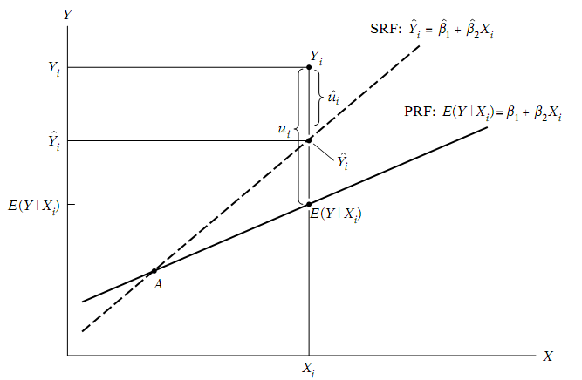
The Theory of OLS
E(Y_{i}⏐X_{i}) = β_{o} + β₁X_{i} population regression line (PRF)
Ŷ_{i}= b_{o} + b₁X_{i} sample regression equation (SRF)
min Σ e_{i}² = e₁² + e₂² + e₃² +.........+ e_{n}²

Slide 15
How does OLS get estimates of the coefficients?
Formula – mathematical function

Slide 17
multiple regression model

Slide 18
multiple regression model
1) Calculation of predicted values of Y, residuals, sum of residuals, comparison of real (actual) and predicted values of Y.
Standardized Residual

Slide 19
multiple regression model
2) Calculation of residual variance, variances of parameters and their standard deviations.

Slide 20
3) Calculation of correlation coefficient, coefficient of determination and corrected coefficient of determination.

Slide 21
4) Calculation of confidence interval for estimated parameters

Slide 22
5) test the statistical significance of the estimated regression parameters
Verification of the statistical significance of parameters by using T-test

Slide 23
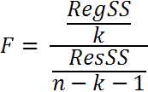
6) test the statistical significance of the model as a whole
Verification of the statistical significance of the model by using F-test

Slide 24
7) Calculation of standardized coefficients or beta coefficients
βj adj. = βj * R² *100 [%]

