Slide 1
econometrics

Slide 2
Assumption of Ordinary Least Squares
Linearity:
The true relationship between the mean of the response variable E(Y) and the explanatory variables X1, ... Xn is
a straight line.
the mean of the response is not a linear function of the predictors/ transforming the response and/or predictor variables
unequal error variances/ transforming the response and/or predictor variables or use "weighted least squares regression.„

Slide 3
DATA TRANSFORMATION
To introduce basic ideas behind
data transformations we first consider
a simple linear regression model in which:
We transform the predictor (x) values only.
We transform the response (y) values only.
We transform both the predictor (x) values and response (y) values.

Slide 4
Examples of logarithmic transformations
Simple regression equation: Y = a + b*X
Meaning: A unit increase in X is associated with an average of b units increase in Y.
Equation: Y = a*e^{bX} log(Y) = c + b*X
Meaning: A unit increase in X is associated with an average of 100*b% increase in Y.
Equation: Y = a*X^{b} log(Y) = c + b*log(X)
Meaning: A 1% increase in X is associated with a b% increase in Y.
Equation: Y = a + b*log(X)
Meaning: A 1% increase in X is associated with an average b/100 units increase in Y.

Slide 5
The log-log transformation
From taking the log of both sides of the equation:
Cobb–Douglas production function
Y = total production (the monetary value of all goods produced in a year)
L = labor input
K = capital input
A = total factor productivity
α and β – output elasticities

Slide 6
Log – log model
The coefficients in a log-log model represent the elasticity
of Y variable with respect to Xi variables.
The coefficient is the estimated percent change in Y
for a percent change in your Xi.

Slide 7
Log-transforming Only the Response
Log-lin model
ln Y = β0 + β1 * X + ε
Log-Linear Trend Models
Y = e^(β0 + β1 * t) + ε
ln Y = β0 + β1 * t + ε
B1 provides the instantaneous rate of growth for your dependent variable associated with a unit change in your independent variable
The compounded growth rate is considered to be a more accurate estimate of the impact of X.
compounded growth rate = e^B1-1

Slide 8
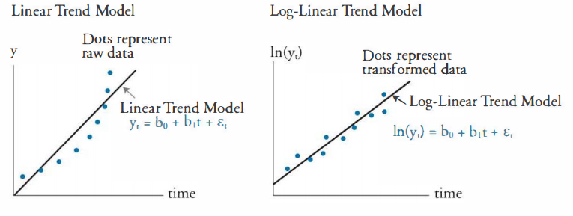

Slide 9
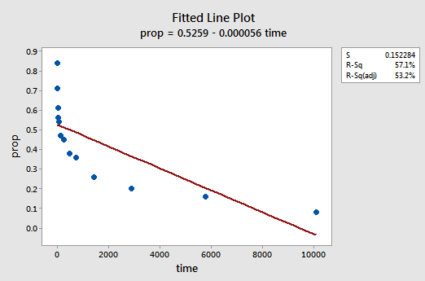
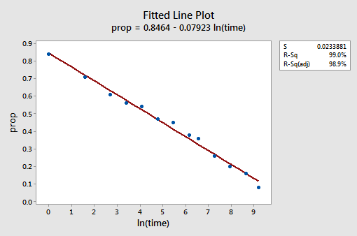
Log-transforming Only the Predictor
Lin-log model
Y = β0 + β1 *ln X + ε
Y = β0 + β1 *ln (time) + ε
B1 coefficients represent the estimated unit change in your dependent variable for a percentage change in your independent variable.

