Slide 1
Econometrics
Assumptions of Classical Linear Regression Model

Slide 2
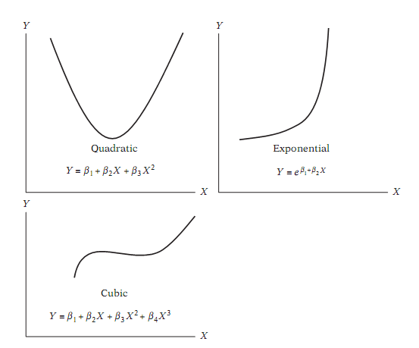
Assumption 1
Model is linear in parameters

Slide 3
Polynomial Models
Linear
Parabolic
Cubic & higher order polynomials
All may be estimated with OLS – simply square, cube, etc. the independent variable.

Slide 4
Power Functions
Simple exponents of the Independent Variable
Estimated with

Slide 5
Exponential Functions
Common Growth Curve Formula
Estimated with
Note that the error terms are now no longer normally distributed!

Slide 6
LRM
NRM

Slide 7
ASSUMPTION 1
Zero mean value of disturbances - ui.

Slide 8
ASSumption 2
Equal variance of disturbences - ui
Errors have constant variance “homoskedasticity”
Errors have non-constant variance “heteroskedasticity”

Slide 9
ASSumption 3
No autocorrelation between the disturbances
The data are a random sample of the population

Slide 10
Assumption 4
The errors are normally distributed
Normal Probability Plot

Slide 11
ASSumption 5
Zero covariance between ui and Xi

Slide 12
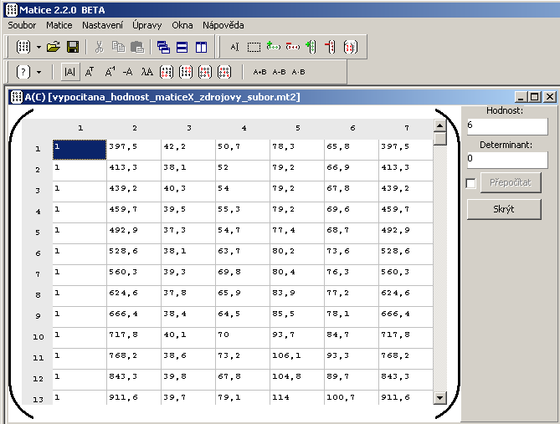
ASSumption 6
the number of >= the number of
observations explanatory variables

Slide 13
model specification

Slide 14
Ramsey's RESET Test
Ramsey Regression Equation Specification Error Test (RESET) test
Regression Specification Error Test
RESET test is a general specification test for the linear regression model. More specifically, it tests whether non-linear combinations of the fitted values help explain the response variable.
Types of specification errors:
• Omitted variables
• Incorrect functional form
• Correlation between X and e,

Slide 15
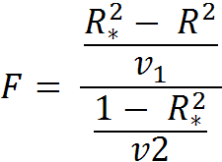
RESET test
RESET test does not offer what to omit /add into the model - we need to specify new model and test it again.
H0: Model is correctly specified.

Slide 16
Verification of the model specification
Akaike information criterion
Bayesian information criterion (BIC) or Schwarz criterion (also SBC, SBIC). A lower AIC or BIC value indicates a better fit.

