Slide 1
Non-parametric test

Slide 2
Non-parametric test
Most of the statistical methods referred to as parametric require the use of interval- or ratio-scaled data.
Nonparametric methods are often the only way to analyze nominal or ordinal data and draw statistical conclusions.
Nonparametric methods analyse interval- or ratio-scaled data when normal distribution is missing.
Nonparametric methods require no assumptions about the population probability distributions.
Nonparametric methods are often called distribution-free methods.

Slide 3
Non-parametric test ordinal data

Slide 4
List of tests
Kolmogor-Smirnov test
Mann-Whitney U test
Wilcoxon test
Kruskal-Wallis

Slide 5
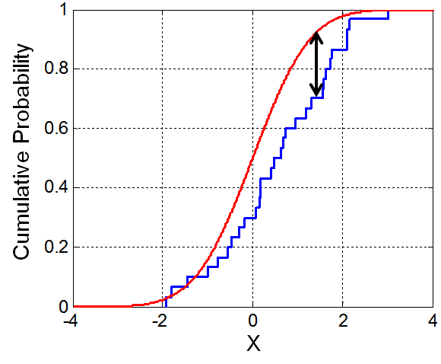
Kolmogorov-Smirnov test
The Kolmogorov-Smirnov test (KS-test) is a nonparametric test of the equality of continuous one-dimensional probability distributions that can be used to compare a sample with a reference probability distribution.
The KS test can be used to compare a sample with a reference probability distribution (Test of Normality in SAS), or to compare two independent samples.
The KS-test has the advantage of making no assumption about the distribution of data. (Technically speaking it is non-parametric and distribution free.)
In a typical experiment, data collected in one situation is compared to data collected in a different situation with the aim of seeing if the first situation produces different results from the second situation.
P-values report if the numbers differ significantly.
Notes:
http://www.physics.csbsju.edu/stats/KS-test.html

Slide 6
List of tests
Kolmogor-Smirnov test
Mann-Whitney (Wilcoxon) U test
Wilcoxon test
Kruskal-Wallis

Slide 7
Mann-Whitney (Wilcoxon) U test
The Mann-Whitney U test is a nonparametric test that allows two groups or conditions or treatments to be compared without making the assumption that values are normally distributed. So, for example, one might compare the speed at which two different groups of people can run 100 metres, where one group has trained for six weeks and the other has not.
Requirements
Two random, independent samples
The data is continuous - in other words, it must, in principle, be possible to distinguish between values
Scale of measurement should be ordinal, interval or ratio
For maximum accuracy, there should be no ties, though this test - like others - has a way to handle ties
equivavelent to the parametric two independent sample t-test
Null Hypothesis
The null hypothesis asserts that the medians of the two samples are identical.
In SAS ANOVA – Analyze – ANOVA – Non parametric One-Way ANOVA (Analysis Wilcoxon)
Notes:
http://www.socscistatistics.com/tests/mannwhitney/

Slide 8
List of tests
Kolmogor-Smirnov test
Mann-Whitney U test
Wilcoxon test
Kruskal-Wallis

Slide 9
Wilcoxon test
The Wilcoxon test is a nonparametric test designed to evaluate the difference between two treatments or conditions where the samples are correlated. In particular, it is suitable for evaluating the data from a repeated-measures design in a situation where the prerequisites for a dependent samples t-test are not met. So, for example, it might be used to evaluate the data from an experiment that looks at the reading ability of children before and after they undergo a period of intensive training.
Requirements
Matched data
The dependent variable is continuous - in other words, it must, in principle, be possible to distinguish between values
For maximum accuracy, there should be no ties, though this test - like others - has a way to handle ties
equivavelent to the parametric two dependent (paired) sample t-test
Null Hypothesis
The null hypothesis asserts that the medians of the two samples are identical, or difference is 0.
In SAS Describe – Distribution Analysis – Tables – Tests for location (H0: Mu=0)

Slide 10
Wilcoxon test
The Wilcoxon test might be used also to test just one sample with the constant
(equivavelent to the parametric one sample t-test)
In SAS Describe – Distribution Analysis – Tables – Tests for location
(H0: Mu=constant)

Slide 11
List of tests
Kolmogor-Smirnov test
Mann-Whitney U test
Wilcoxon test
Kruskal-Wallis test

Slide 12
Kruskal-Wallis test
The Kruskal-Wallis H test (sometimes also called the "one-way ANOVA on ranks„ and in SAS Nonparametric One-Way ANOVA) is a rank-based nonparametric test that can be used to determine if there are statistically significant differences between two or more groups of an independent variable on a continuous or ordinal dependent variable. It is considered the nonparametric alternative to the one-way ANOVA, and an extension of the Mann-Whitney U test to allow the comparison of more than two independent groups.
For example, you could use a Kruskal-Wallis H test to understand whether exam performance, measured on a continuous scale from 0-100, differed based on test anxiety levels (i.e., your dependent variable would be "exam performance" and your independent variable would be "test anxiety level", which has three independent groups: students with "low", "medium" and "high" test anxiety levels).

Slide 13
Non-parametric test Nominal data

Slide 14
Chi-Square Goodness of Fit Test
Chi-Square goodness of fit test is a non-parametric test that is used to find out how the observed value of a given phenomena is significantly different from the expected value.
In Chi-Square goodness of fit test, the term goodness of fit is used to compare the observed sample distribution with the expected probability distribution.
A. Null hypothesis: In Chi-Square goodness of fit test, the null hypothesis assumes that there is no significant difference between the observed and the expected value.
B. Alternative hypothesis: In Chi-Square goodness of fit test, the alternative hypothesis assumes that there is a significant difference between the observed and the expected value.
In SAS Describe – One-Way Frequencies

Slide 15
Chi-Square Test of Independence
The Chi-Square test of Independence is used to determine if there is a significant relationship between two nominal (categorical) variables.
The frequency of one nominal variable is compared with different values of the second nominal variable.
For example, a researcher wants to examine the relationship between gender (male vs. female) and empathy (high vs. low).
The chi-square test of independence can be used to examine this relationship. If the null hypothesis is accepted there would be no relationship between gender and empathy.
If the null hypotheses is rejected the implication would be that there is a relationship between gender and empathy (e.g. females tend to score higher on empathy and males tend to score lower on empathy).
In SAS Describe – Table Analysis

Slide 16
Data comparisons you are making | Data are normally distributed | Data are not normally-distributed, or are ranks or scores | Data are Nominal /Binomial (Possess 2 possible values)
Compare one set of data to a hypothetical value | One-sample t-test | Wilcoxon test | χ² test
Compare two sets of independently-collected (unpaired) data | Unpaired t-test | Mann-Whitney (Wilcoxon) test | χ² test or Fisher test
Compare two sets of data from the same subjects under different circumstances (paired) | Paired t-test | Wilcoxon test Sign test | McNemar’s test
Compare three or more sets of data | One-way ANOVA | Kruskal-Wallis test | χ² test
Look for a relationship between two variables | Pearson Correlation coefficient | Spearman correlation coefficient | Contingency Correlation coefficients
Look for a linear relationship between two variables | Linear regression | Nonparametric linear regression | Simple logistic regression
Look for a non-linear relationship between two variables | Non-linear regression | Nonparametric non-linear regression

