Slide 1

Questionnaire and Sampling Methods
Department of Statistics and Operation Research
RESEARCH METHODS

Slide 2

What Is a Questionnaire?
A questionnaire is a research instrument consisting of a series of questions designed to gather information from respondents. Think of it as a written interview — conducted face to face, by telephone, computer, or post.
Cost-Effective
Time-Efficient
Provides large amounts of information from a large sample at relatively low cost and effort.
Data can be collected quickly — the researcher doesn't need to be present when respondents complete the form.
Scalable
Ideal for large populations where individual interviews would be logistically impractical.

Slide 3
What Questionnaires Measure
Questionnaires are an effective means of measuring behavior, attitudes, preferences, opinions, and intentions from relatively large numbers of subjects — more cheaply and quickly than most other methods. A key design decision is choosing between open-ended and closed questions.
Closed Questions
Open Questions
Yield quantitative data — structured, categorical, easy to analyze statistically.
Yield qualitative data — expressive, detailed, and rich in personal meaning.
Most well-designed questionnaires use both question types, allowing researchers to capture the breadth of quantitative patterns alongside the depth of qualitative insight.

Slide 4
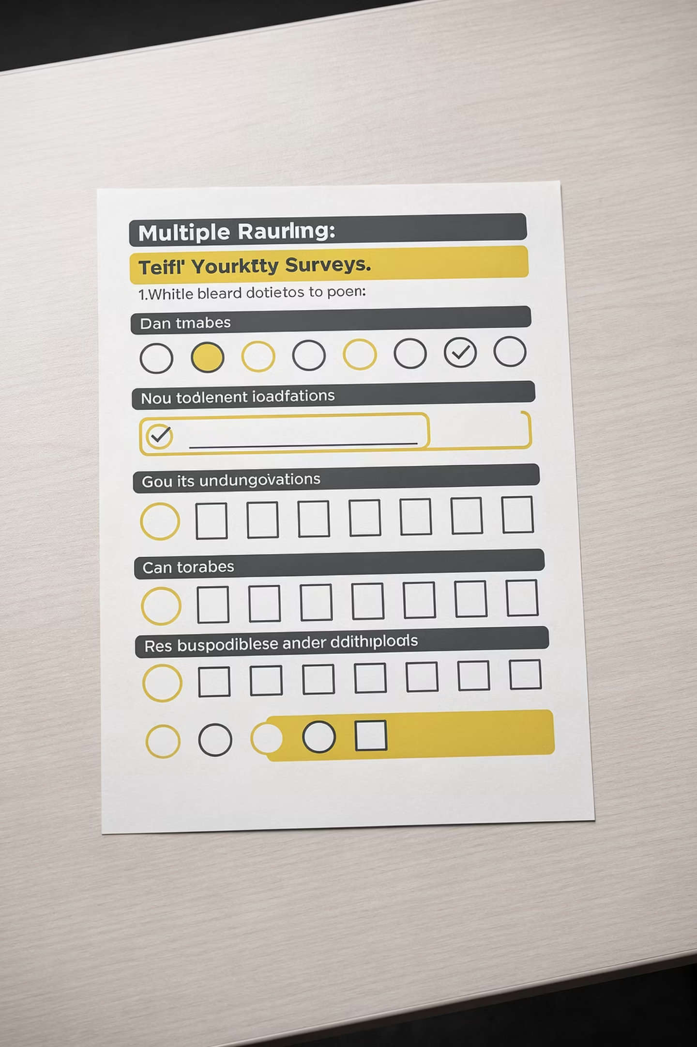
Closed Questions
Closed questions structure the answer by allowing only responses that fit into pre-decided categories. Data placed into a category is called nominal data.
Dichotomous
1
Limited to two options only — e.g., Yes / No or Male / Female. Simple and easy to analyze.
Polytomous
2
Offers a complex list of alternatives from which the respondent selects one or more choices.
Ordinal / Rating Scale
3
Captures ranked data measuring attitude strength — e.g., Strongly Agree / Agree / Neutral / Disagree / Strongly Disagree.

Slide 5



Closed Questions — Strengths
Economical
Quantifiable
Standardized & Replicable
Provide large amounts of research data at relatively low cost, enabling large, representative sample sizes from which researchers can generalize.
Responses can be easily converted to quantitative data — simply count the number of each response — making statistical analysis straightforward.
All respondents are asked the exact same questions in the same order, making it easy to replicate the study and verify reliability across different samples.

Slide 6
Closed Questions — Limits
The primary limitation of closed questions is that they lack depth and nuance. Because the available responses are fixed and pre-determined, respondents have little room to elaborate or provide answers that truly reflect the complexity of their feelings, experiences, or opinions on a topic.
Key Takeaway
Closed questions trade richness for efficiency. Use them when standardization and statistical analysis are priorities — not when exploring complex attitudes.
This can result in data that is superficially accurate but fundamentally incomplete — capturing what category a person fits into, but not why they feel that way. For research requiring insight into motivation, context, or lived experience, closed questions alone are insufficient.

Slide 7


Open Questions
Open questions allow respondents to express their thoughts in their own words, with no pre-set answer options. For example: "Can you tell me how happy you feel right now?"
Freedom of Expression
Respondents can answer in as much detail as they like, capturing personal nuance and lived experience that closed questions miss.
Best for Complex Topics
Ideal when a question cannot be meaningfully answered within a few simple categories and requires more detailed discussion or explanation.
In-Depth Insight
When you need to understand why respondents hold certain views — not just what they believe — open questions are the better choice.

Slide 8
Open Questions — Strengths
Rich Qualitative Data
When to Use Open Questions
The primary strength of open questions is the depth of data they produce. Respondents can elaborate freely, providing context, emotion, and reasoning behind their answers.
Exploratory research where you don't yet know the range of possible answers
Sensitive or complex topics that require personal elaboration
Follow-up probes after closed questions to explain responses
Studies focused on understanding experience, meaning, or process
This enables researchers to understand not just what people think, but why — uncovering attitudes, motivations, and nuances that no pre-set category could capture.

Slide 9
Open Questions — Limits
Time-Consuming to Collect
Difficult to Analyze
Not Suitable for All Respondents
Open questions take longer for respondents to complete. This can reduce participation rates and result in a smaller, potentially less representative sample size.
Qualitative responses must be read, interpreted, and coded into categories — a process that is often subjective and time-intensive. Smith (1992) dedicated an entire book to thematic content analysis, outlining 14 different scoring systems for open-ended questions.
Open questions demand strong writing skills and the ability to articulate feelings verbally. They may disadvantage less educated respondents or those uncomfortable expressing themselves in writing.

Slide 10

Designing a Questionnaire — Part 1
Most problems with questionnaire analysis can be traced back to design flaws. Well-defined goals are the best foundation for good questionnaire design.
01
02
Define Clear Goals
Ask Only What Matters
Express study goals in a few concise sentences. Decide how you'll use the results before designing a single question. Commit these goals to writing.
Ask only questions that directly address your study goals. Resist the temptation to include questions just because they seem "interesting to know."
03
Keep It Short
Long questionnaires get fewer responses. Response rate is the single most important indicator of result confidence. Shortening the questionnaire is one of the most effective ways to maximize it.

Slide 11
Designing a Questionnaire — Part 2
Involve Experts
Plan Your Analysis
Use a Clear Title
Include other experts and relevant decision-makers in the design process. Their input improves the questionnaire and increases their confidence in the results.
Formulate a statistical analysis plan during the design stage. Know how every question will be analyzed and plan for handling missing data. If you can't specify how a question will be used, remove it.
Give your questionnaire a short, meaningful title. A titled questionnaire is perceived as more credible. Include clear, concise instructions using short sentences and basic vocabulary.

Slide 12
Designing a Questionnaire — Part 3
Start Strong
Use Simple, Direct Language
Leave Space for Comments
Begin with non-threatening, interesting items. Respondents scan the first few questions before deciding whether to continue — put your most engaging questions first and place the most important items in the first half.
Keep wording simple and sentences short. Avoid uncommon vocabulary. Emphasize crucial words using bold, italics, or underlining to reduce misunderstandings and improve completion rates.
Adequate white space for open comments captures valuable information beyond fixed categories — and makes the questionnaire look less intimidating, increasing response rates.

Slide 13
Designing a Questionnaire — Part 4
🧪 Pilot Testing Is Essential
Maintain Interest
Make It Visually Appealing
Always pretest your questionnaire on representatives of the target audience. Problems almost always surface here. If possible, be present during the pilot and encourage respondents to ask for clarification — their questions reveal hidden flaws in your design.
Vary the type of items used to prevent "response sets" — the tendency to answer automatically. Group items into coherent categories so the questionnaire flows smoothly from one topic to the next.
Be creative — try different colored inks and paper. The goal is to make your questionnaire stand out and look professional, increasing the likelihood of completion.

Slide 14
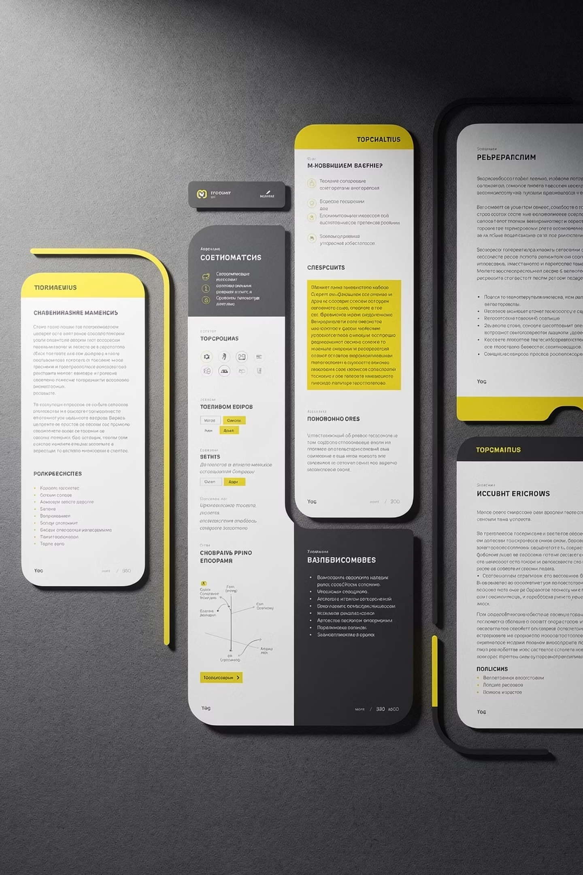



Order of the Questions
Group Logically
Items should be grouped into logically coherent sections. Similar questions together make the questionnaire easier to complete and more comfortable for respondents.
Ensure Smooth Transitions
Each question should follow comfortably from the previous one. Questionnaires that jump between unrelated topics feel disjointed and produce lower response rates.
General vs. Specific
It is unclear whether placing general questions before specific ones (or vice versa) affects responses. This ordering decision is left to the researcher's judgment.

Slide 15
Length of a Questionnaire
As a general rule, long questionnaires get fewer responses than short ones. However, length alone is not the only factor — question relevance matters more. A respondent who is genuinely interested in the topic is more likely to complete a longer survey.
The Golden Rule
Ask only what you need. Every unnecessary question increases respondent burden and reduces your response rate — the most important indicator of result quality.
Questions should always be meaningful and interesting to the respondent. Irrelevant filler questions are more damaging than length itself.
Online Surveys: A Special Note
For Internet surveys, keep pages short enough to appear on a single screen with minimal scrolling. Responses are only recorded when the submit button is pressed — if a page is too long and left incomplete, those answers are lost entirely.

Slide 16

Question Wording
Research confirms that slight changes in wording can significantly affect how people respond. Word choice is one of the most impactful — and most overlooked — elements of questionnaire design.
❌ High-Variability Words to Avoid
✅ Low-Variability Words to Prefer
These terms mean different things to different people and introduce ambiguity:
These produce more consistent, shared understanding across respondents:
most, numerous, a substantial majority, a minority of, a large proportion of, a significant number of, many, a considerable number of, several
lots, almost all, virtually all, nearly all, a majority of, a consensus of, a small number of, not very many of, almost none, hardly any, a couple, a few
Words like usually, often, sometimes, occasionally, seldom, and rarely are commonly used in surveys — yet they do not mean the same thing to all respondents. Use precise, shared-meaning language whenever possible.

Slide 17

Sampling Methods
Sampling methods are classified as either probability or nonprobability.
Probability Sampling
Each member of the population has a known, non-zero probability of being selected. The key advantage: sampling error can be calculated. Results are reported plus or minus the sampling error, allowing inference to the broader population.
Nonprobability Sampling
Members are selected from the population in a nonrandom manner. The degree to which the sample differs from the population remains unknown, making generalization more difficult and risky.

Slide 18

Two Branches of Sampling
All sampling techniques fall into one of two major categories: Probability sampling, where every element has a known chance of selection, and Nonprobability sampling, where selection is based on judgment or convenience.
Probability Sampling
Nonprobability Sampling
Simple random sampling
Systematic sampling
Stratified sampling
Cluster sampling
Convenience sampling
Judgement sampling
Quota sampling
Snowball sampling

Slide 19
Simple Random Sampling
Simple random sampling is a foundational probability technique in which every population element has a known, equal, and nonzero chance of being selected into the sample.
How It Works
Real-World Example
Each member of the population is assigned a unique number. Researchers then use a table of random numbers, random digit dialing, or other random selection tools to determine which individuals are included — ensuring true impartiality.
Suppose a washing machine brand wants to survey all 1,000 female buyers. Each buyer is labeled and placed in a pool. Every owner has an equal chance of selection — regardless of the pool size, the probability remains equal and nonzero.
Key advantage: No bias is introduced by the researcher during the selection process, making results highly generalizable.

Slide 20

Simple Random Sampling at a Glance
Equal Probability
Random Selection Tools
Every unit in the population has the same nonzero likelihood of being chosen — no favoritism, no bias.
Researchers rely on random number tables, digital randomizers, or random digit dialing to maintain integrity.
Scalable Method
Whether the population is 100 or 100,000, each member retains an equal and nonzero chance of inclusion.

Slide 21
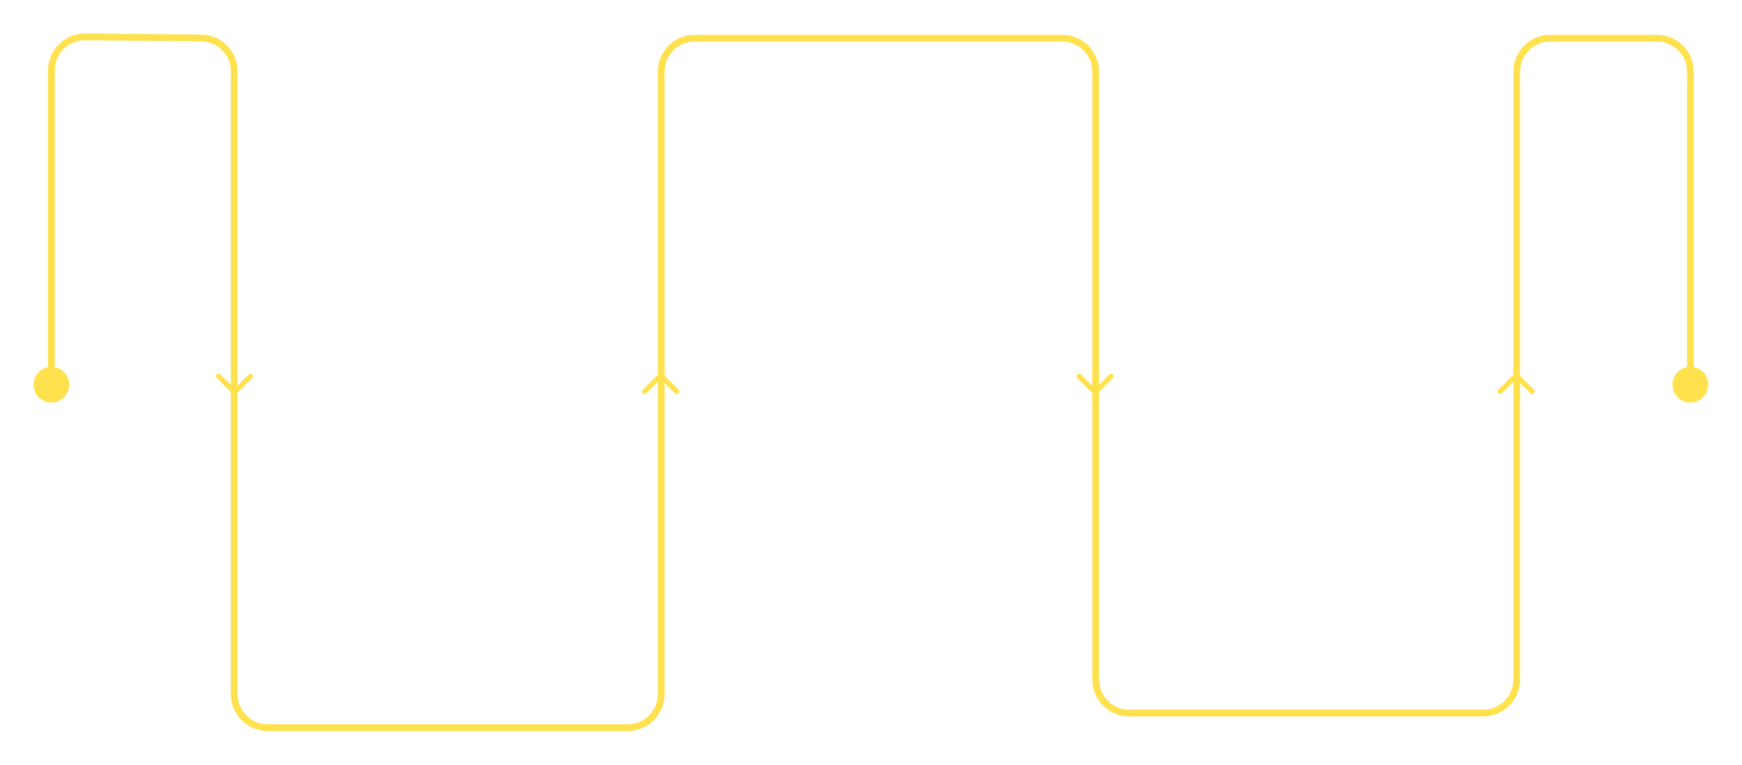
Systematic Random Sampling
Systematic random sampling selects elements from a population list at regular, fixed intervals — starting from a randomly chosen point. It combines the rigor of probability sampling with the simplicity of a structured list.
Choose start
Randomly pick between 1 and i
Select elements
Compute interval
Pick every ith item until n reached
i = N ÷ n
For example, if 10,000 washing machine owners exist and a sample of 100 is needed, the interval i = 100. A researcher picks a random start (e.g., 50), then selects elements 50, 150, 250, 350… and so on throughout the list.

Slide 22
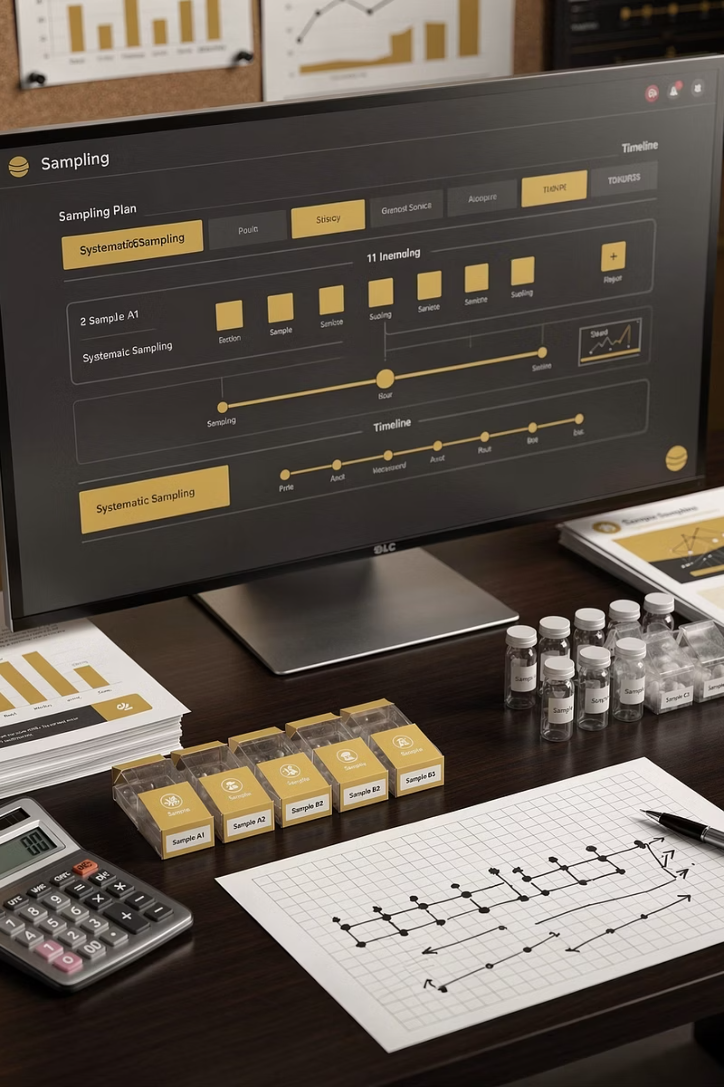
Systematic Sampling: Strengths & Limitations
✔ Strengths
✘ Limitations
Easy to implement using customer lists, membership rolls, or tax records
Ensures randomness while maintaining a structured approach
Saves time, effort, and cost compared to pure random sampling
Works well for large, ordered populations
Requires the target population to be ordered in some way
Hidden patterns in data may skew results — e.g., if every 10th person on a list shares a trait
Potential small loss in representativeness, though usually offset by efficiency gains

Slide 23
Comparing Probability Sampling Methods
Each probability technique offers a different balance of rigor, practicality, and representativeness. Choosing the right method depends on the research objective, available resources, and population structure.
Simple Random Sampling
Systematic Random Sampling
Best for homogeneous populations with a complete list. Highest statistical purity — every unit has equal probability. Ideal when no prior structure exists.
Best when a population list is available. More practical than pure random selection, with minimal sacrifice to representativeness. Watch for hidden periodicity in data.
Stratified Sampling
Cluster Sampling
Divides the population into subgroups (strata) before sampling. Ensures proportional representation across key segments — ideal for heterogeneous populations.
Divides the population into clusters and randomly selects entire clusters. Cost-effective for geographically dispersed populations where individual listing is impractical.

Slide 24




Key Takeaways
Understanding sampling techniques is fundamental to designing credible research. The choice of method shapes the validity, efficiency, and generalizability of your findings.
Probability = Fairness
Systematic = Efficiency
Match Method to Goal
Every element has a calculable chance of selection, minimizing researcher bias and maximizing statistical validity.
Fixed-interval selection from ordered lists offers a practical shortcut without compromising the core principles of probability sampling.
No single technique fits all research contexts. Evaluate population structure, budget, and required precision before selecting your approach.
Next: We will explore nonprobability sampling techniques — including convenience, judgement, quota, and snowball sampling — and when each is most appropriately applied.

Slide 25


Nonprobability Methods — Convenience & Judgment
Convenience Sampling
Judgment Sampling
The sample is selected simply because it is easy to access. Common in exploratory research to get a quick, inexpensive approximation of results — without the cost or time of random sampling. Useful for preliminary estimates, but limited in generalizability.
The researcher uses expert judgment to select a sample believed to be representative of the population. For example, drawing the entire sample from one "representative" city. The researcher must be confident the chosen sample truly reflects the broader population.

Slide 26


Nonprobability Methods — Quota & Snowball
Quota Sampling
Snowball Sampling
The nonprobability equivalent of stratified sampling. The researcher identifies strata and their proportions in the population, then uses convenience or judgment to fill each stratum with the required number of subjects — unlike stratified sampling, which fills strata by random selection.
Used when the desired characteristic is rare or hard to reach. Initial subjects refer additional subjects, dramatically lowering search costs. However, this introduces bias — the sample is unlikely to represent a true cross-section of the population.

Slide 27
Validity and Reliability Testing
For a questionnaire to be regarded as acceptable, it must possess two critical qualities: validity and reliability.
Validity
Reliability
Expresses the degree to which a measurement measures what it purports to measure — the accuracy of the questionnaire. Do the results agree with the real world? Assessed using factor analysis.
Refers to the degree to which results can be replicated — the consistency of the questionnaire. Would the same questionnaire produce the same results under the same conditions? Assessed using Cronbach's alpha and item-total correlation. A reliability coefficient of at least 0.8 is required.
Remember: A questionnaire can be reliable without being valid — but it cannot be valid without being reliable. Both qualities are necessary for credible research.

