Slide 1
Analysis of multivariate time series
In this presentation, we study the inter-relationships between several multivariate time series regression methods to provide guidance on when to use what method, and how to implement it in SAS, R, or Matlab.

Slide 2
Vector AutoRegressive
(VAR)
AutoRegressive Distributed Lag Model
(ARDL)
Multivariate time series
Vector Error Correction Model (VECM)
Error Correction Model
(ECM)

Slide 3
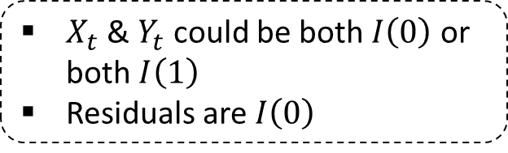
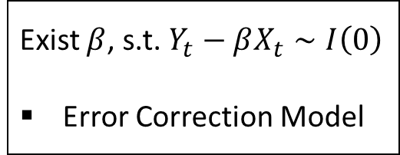
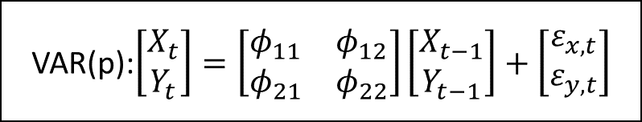
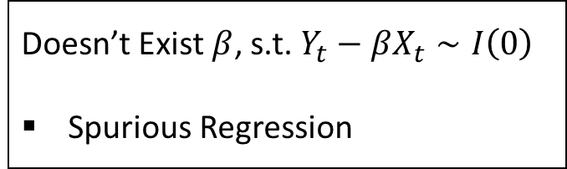

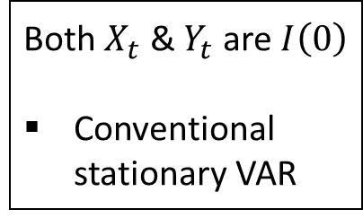
VAR(p):$\left[\begin{aligned}X_{t} \\ Y_{t}\end{aligned}\right]=\left[\begin{matrix}φ_{11} & φ_{12} \\ φ_{21} & φ_{22}\end{matrix}\right]\left[\begin{aligned}X_{t−1} \\ Y_{t−1}\end{aligned}\right]+\left[\begin{aligned}ε_{x,t} \\ ε_{y,t}\end{aligned}\right]$
$X_{t}$ & $Y_{t}$ could be both $I\left(0\right)$ or both $I\left(1\right)$
Residuals are $I\left(0\right)$
Reduced form
Structural form
ARDL
Both $X_{t}$ & $Y_{t}$ are $I\left(0\right)$
Conventional stationary VAR
Both $X_{t}$ & $Y_{t}$ are $I\left(1\right)$
PCA
interpretation
Doesn’t Exist $β$, s.t. $Y_{t}−βX_{t}∼I\left(0\right)$
Spurious Regression
Exist $β$, s.t. $Y_{t}−βX_{t}∼I\left(0\right)$
Error Correction Model
Only one cointegration relation
Engle Granger test
> one cointegration relation
VECM and Johansen test

Slide 4

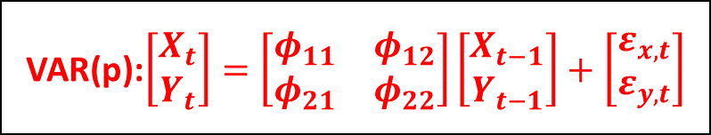
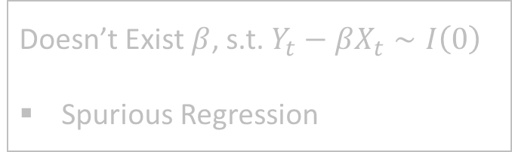

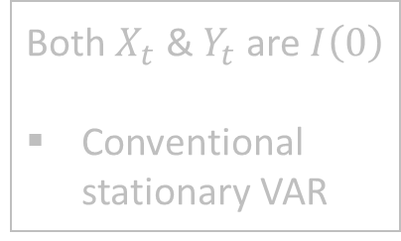
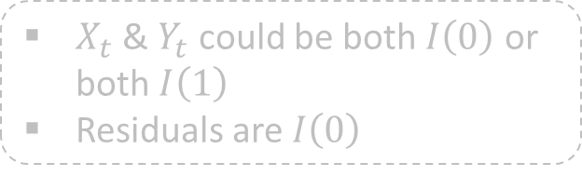
VAR(p):$\left[\begin{aligned}X_{t} \\ Y_{t}\end{aligned}\right]=\left[\begin{matrix}φ_{11} & φ_{12} \\ φ_{21} & φ_{22}\end{matrix}\right]\left[\begin{aligned}X_{t−1} \\ Y_{t−1}\end{aligned}\right]+\left[\begin{aligned}ε_{x,t} \\ ε_{y,t}\end{aligned}\right]$
$X_{t}$ & $Y_{t}$ could be both $I\left(0\right)$ or both $I\left(1\right)$
Residuals are $I\left(0\right)$
Reduced form
Structural form
ARDL
Both $X_{t}$ & $Y_{t}$ are $I\left(0\right)$
Conventional stationary VAR
Both $X_{t}$ & $Y_{t}$ are $I\left(1\right)$
PCA
interpretation
Doesn’t Exist $β$, s.t. $Y_{t}−βX_{t}∼I\left(0\right)$
Spurious Regression
Exist $β$, s.t. $Y_{t}−βX_{t}∼I\left(0\right)$
Error Correction Model
Only one cointegration relation
Engle Granger test
> one cointegration relation
VECM and Johansen test

Slide 5



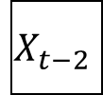




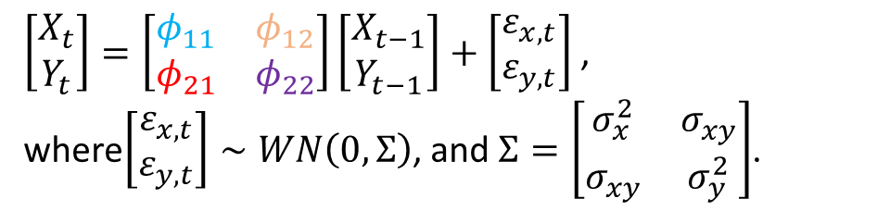


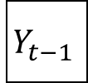

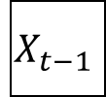

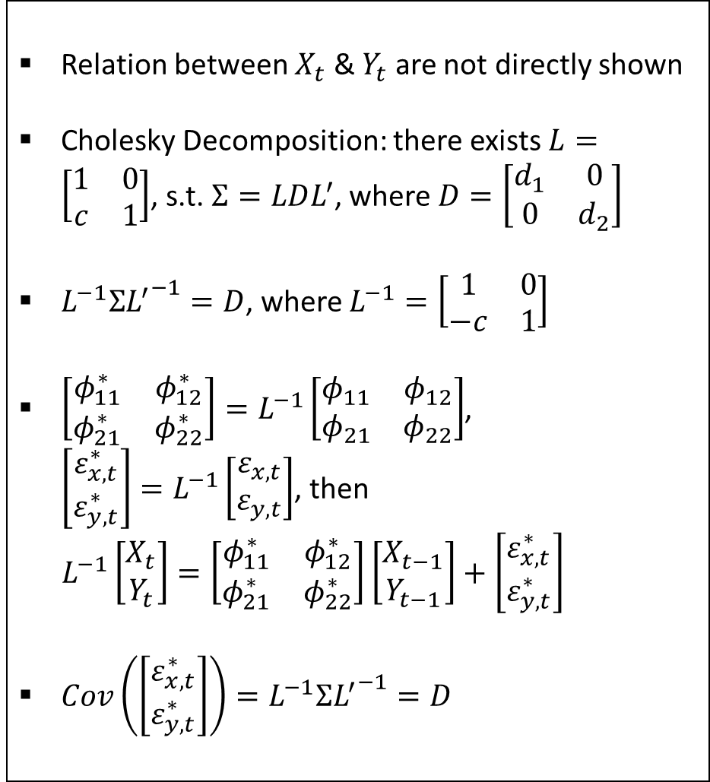


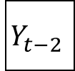



Reduced form of VAR
Relation between $X_{t}$ & $Y_{t}$ are not directly shown
Cholesky Decomposition: there exists $L=\left[\begin{matrix}1 & 0 \\ c & 1\end{matrix}\right]$, s.t. $Σ=LDL^{′}$, where $D=\left[\begin{matrix}d_{1} & 0 \\ 0 & d_{2}\end{matrix}\right]$
$L^{−1}Σ{L^{′}}^{−1}=D$, where $L^{−1}=\left[\begin{matrix}1 & 0 \\ −c & 1\end{matrix}\right]$
$\left[\begin{matrix}φ_{11}^{∗} & φ_{12}^{∗} \\ φ_{21}^{∗} & φ_{22}^{∗}\end{matrix}\right]=L^{−1}\left[\begin{matrix}φ_{11} & φ_{12} \\ φ_{21} & φ_{22}\end{matrix}\right]$, $\left[\begin{aligned}ε_{x,t}^{∗} \\ ε_{y,t}^{∗}\end{aligned}\right]=L^{−1}\left[\begin{aligned}ε_{x,t} \\ ε_{y,t}\end{aligned}\right]$, then
$L^{−1}\left[\begin{aligned}X_{t} \\ Y_{t}\end{aligned}\right]=\left[\begin{matrix}φ_{11}^{∗} & φ_{12}^{∗} \\ φ_{21}^{∗} & φ_{22}^{∗}\end{matrix}\right]\left[\begin{aligned}X_{t−1} \\ Y_{t−1}\end{aligned}\right]+\left[\begin{aligned}ε_{x,t}^{∗} \\ ε_{y,t}^{∗}\end{aligned}\right]$
$Cov\left(\left[\begin{aligned}ε_{x,t}^{∗} \\ ε_{y,t}^{∗}\end{aligned}\right]\right)=L^{−1}Σ{L^{′}}^{−1}=D$
$\left[\begin{aligned}X_{t} \\ Y_{t}\end{aligned}\right]=\left[\begin{matrix}φ_{11} & φ_{12} \\ φ_{21} & φ_{22}\end{matrix}\right]\left[\begin{aligned}X_{t−1} \\ Y_{t−1}\end{aligned}\right]+\left[\begin{aligned}ε_{x,t} \\ ε_{y,t}\end{aligned}\right]$ ,
where$\left[\begin{aligned}ε_{x,t} \\ ε_{y,t}\end{aligned}\right]∼WN\left(0,Σ\right)$, and $Σ=\left[\begin{matrix}σ_{x}^{2} & σ_{xy} \\ σ_{xy} & σ_{y}^{2}\end{matrix}\right]$.
$$ε_{x,t−2}$$
$$ε_{x,t−1}$$
$$ε_{x,t}$$
$$X_{t−2}$$
$$φ_{11}$$
$$X_{t−1}$$
$$φ_{11}$$
$$X_{t}$$
$$φ_{12}$$
$$φ_{12}$$
$$φ_{21}$$
$$φ_{21}$$
$$Y_{t−2}$$
$$Y_{t−1}$$
$$Y_{t}$$
$$φ_{22}$$
$$φ_{22}$$
$$ε_{y,t−2}$$
$$ε_{y,t−1}$$
$$ε_{y,t}$$

Slide 6
VAR(p):$\left[\begin{aligned}X_{t} \\ Y_{t}\end{aligned}\right]=\left[\begin{matrix}φ_{11} & φ_{12} \\ φ_{21} & φ_{22}\end{matrix}\right]\left[\begin{aligned}X_{t−1} \\ Y_{t−1}\end{aligned}\right]+\left[\begin{aligned}ε_{x,t} \\ ε_{y,t}\end{aligned}\right]$
$X_{t}$ & $Y_{t}$ could be both $I\left(0\right)$ or both $I\left(1\right)$
Residuals are $I\left(0\right)$
Reduced form
Structural form
ARDL
Both $X_{t}$ & $Y_{t}$ are $I\left(0\right)$
Conventional stationary VAR
Both $X_{t}$ & $Y_{t}$ are $I\left(1\right)$
PCA
interpretation
Doesn’t Exist $β$, s.t. $Y_{t}−βX_{t}∼I\left(0\right)$
Spurious Regression
Exist $β$, s.t. $Y_{t}−βX_{t}∼I\left(0\right)$
Error Correction Model
Only one cointegration relation
Engle Granger test
> one cointegration relation
VECM and Johansen test

Slide 7
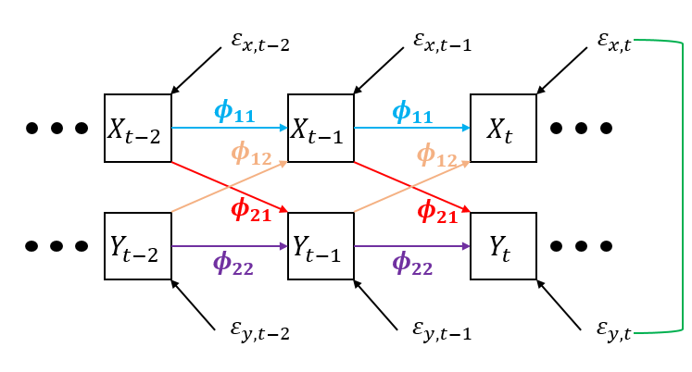



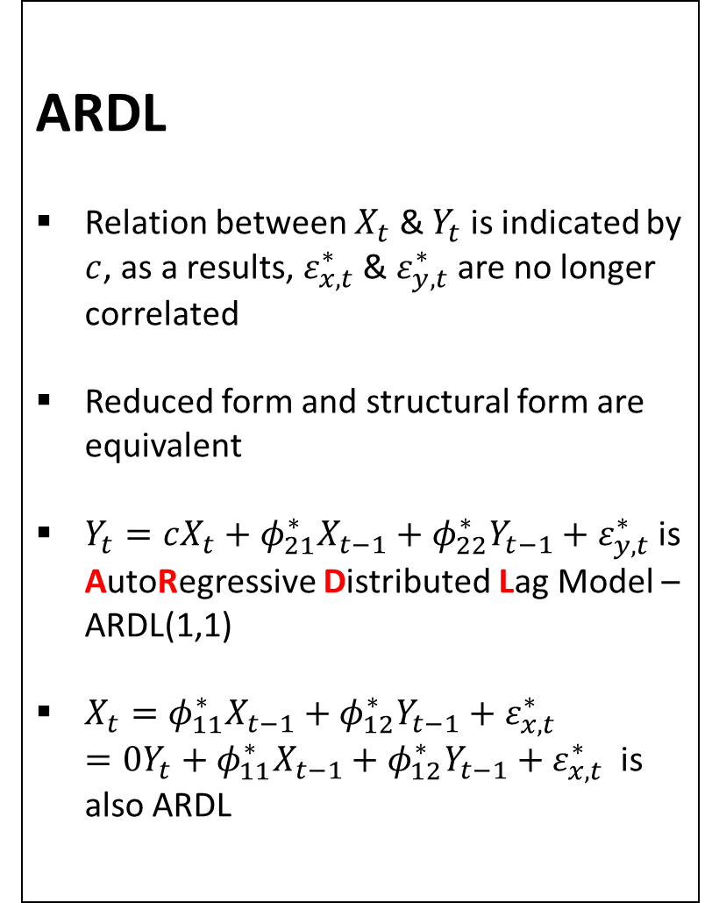
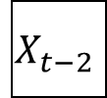





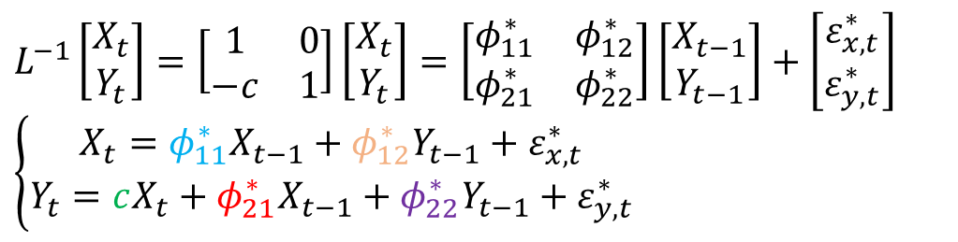


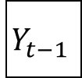











Structural form of VAR
ARDL
Relation between $X_{t}$ & $Y_{t}$ is indicated by $c$, as a results, $ε_{x,t}^{∗}$ & $ε_{y,t}^{∗}$ are no longer correlated
Reduced form and structural form are equivalent
$Y_{t}=cX_{t}+φ_{21}^{∗}X_{t−1}+φ_{22}^{∗}Y_{t−1}+ε_{y,t}^{∗}$ is AutoRegressive Distributed Lag Model –ARDL(1,1)
$X_{t}=φ_{11}^{∗}X_{t−1}+φ_{12}^{∗}Y_{t−1}+ε_{x,t}^{∗}$ $=0Y_{t}+φ_{11}^{∗}X_{t−1}+φ_{12}^{∗}Y_{t−1}+ε_{x,t}^{∗}$ is also ARDL
$L^{−1}\left[\begin{aligned}X_{t} \\ Y_{t}\end{aligned}\right]=\left[\begin{matrix}1 & 0 \\ −c & 1\end{matrix}\right]\left[\begin{aligned}X_{t} \\ Y_{t}\end{aligned}\right]=\left[\begin{matrix}φ_{11}^{∗} & φ_{12}^{∗} \\ φ_{21}^{∗} & φ_{22}^{∗}\end{matrix}\right]\left[\begin{aligned}X_{t−1} \\ Y_{t−1}\end{aligned}\right]+\left[\begin{aligned}ε_{x,t}^{∗} \\ ε_{y,t}^{∗}\end{aligned}\right]$
$\left\{\begin{aligned}X_{t}=φ_{11}^{∗}X_{t−1}+φ_{12}^{∗}Y_{t−1}+ε_{x,t}^{∗} \\ Y_{t}=cX_{t}+φ_{21}^{∗}X_{t−1}+φ_{22}^{∗}Y_{t−1}+ε_{y,t}^{∗}\end{aligned}\right.$
$$ε_{x,t−2}^{∗}$$
$$ε_{x,t−1}^{∗}$$
$$ε_{x,t}^{∗}$$
$$X_{t−2}$$
$$φ_{11}^{∗}$$
$$X_{t−1}$$
$$φ_{11}^{∗}$$
$$X_{t}$$
$$φ_{12}^{∗}$$
$$φ_{12}^{∗}$$
$$c$$
$$c$$
$$c$$
$$φ_{21}^{∗}$$
$$φ_{21}^{∗}$$
$$Y_{t−2}$$
$$Y_{t−1}$$
$$Y_{t}$$
$$φ_{22}^{∗}$$
$$φ_{22}^{∗}$$
$$ε_{y,t−2}^{∗}$$
$$ε_{y,t−1}^{∗}$$
$$ε_{y,t}^{∗}$$

Slide 8
Fitting function of ARDL/ARX:
Matlab:
Spec = vgxset('n',1,'nAR',1,'nX',1,'Constant',false);
estSpec = vgxvarx(Spec,Y(:,2),num2cell(Y(:,1)),[]);
R Univariate: fit = arima(y,c(1,0,0),xreg = x)
R Multivariate: fit = VAR(cbind(y,z),p = 1,type = 'none',exogen = x)
SAS: proc VARMAX;model y = x / p=1 noint;

Slide 9
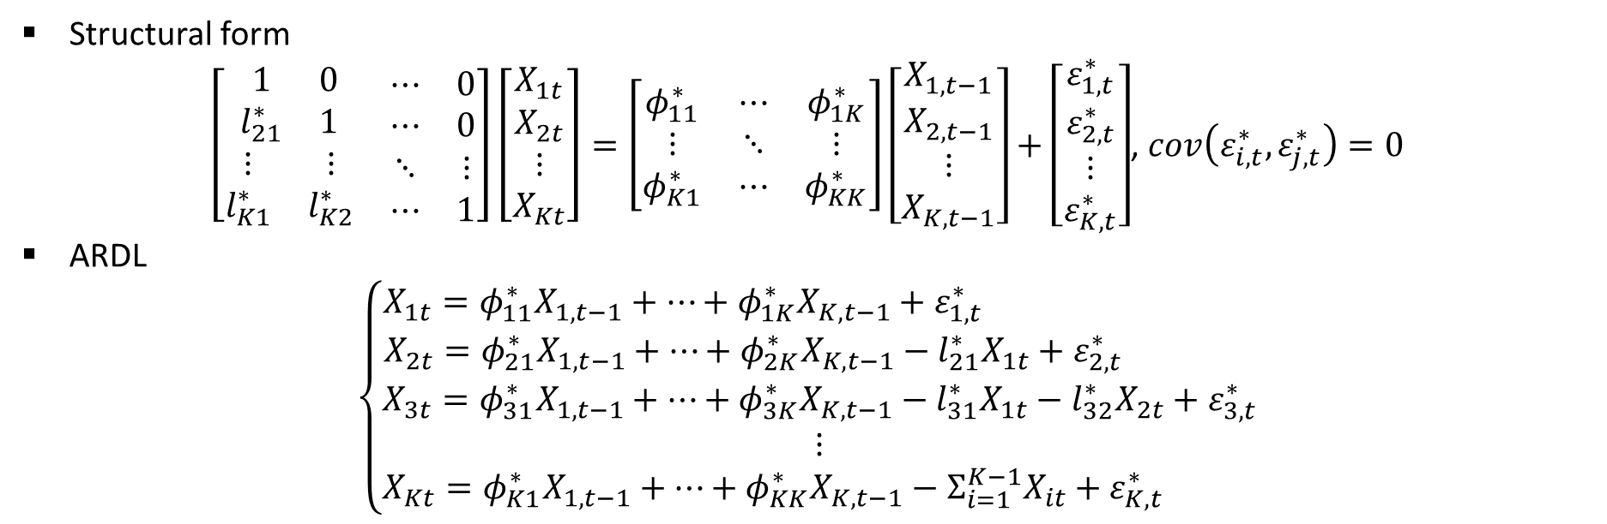
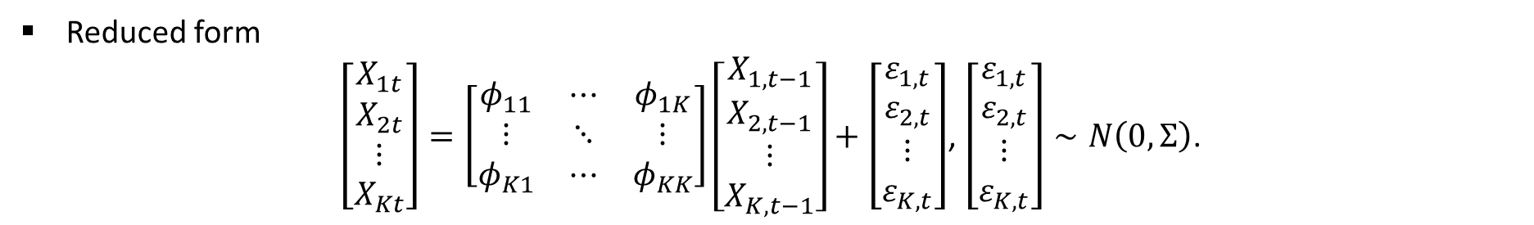
More than two variables
Reduced form
$\left[\begin{aligned}X_{1t} \\ X_{2t} \\ ⋮ \\ X_{Kt}\end{aligned}\right]=\left[\begin{matrix}φ_{11} & ⋯ & φ_{1K} \\ ⋮ & ⋱ & ⋮ \\ φ_{K1} & ⋯ & φ_{KK}\end{matrix}\right]\left[\begin{aligned}X_{1,t−1} \\ X_{2,t−1} \\ ⋮ \\ X_{K,t−1}\end{aligned}\right]+\left[\begin{aligned}ε_{1,t} \\ ε_{2,t} \\ ⋮ \\ ε_{K,t}\end{aligned}\right]$, $\left[\begin{aligned}ε_{1,t} \\ ε_{2,t} \\ ⋮ \\ ε_{K,t}\end{aligned}\right]∼N\left(0,Σ\right)$.
Structural form
$\left[\begin{matrix}\begin{matrix}1 & 0 \\ l_{21}^{∗} & 1\end{matrix} & \begin{matrix}⋯ & 0 \\ ⋯ & 0\end{matrix} \\ \begin{matrix}⋮ & ⋮ \\ l_{K1}^{∗} & l_{K2}^{∗}\end{matrix} & \begin{matrix}⋱ & ⋮ \\ ⋯ & 1\end{matrix}\end{matrix}\right]\left[\begin{aligned}X_{1t} \\ X_{2t} \\ ⋮ \\ X_{Kt}\end{aligned}\right]=\left[\begin{matrix}φ_{11}^{∗} & ⋯ & φ_{1K}^{∗} \\ ⋮ & ⋱ & ⋮ \\ φ_{K1}^{∗} & ⋯ & φ_{KK}^{∗}\end{matrix}\right]\left[\begin{aligned}X_{1,t−1} \\ X_{2,t−1} \\ ⋮ \\ X_{K,t−1}\end{aligned}\right]+\left[\begin{aligned}ε_{1,t}^{∗} \\ ε_{2,t}^{∗} \\ ⋮ \\ ε_{K,t}^{∗}\end{aligned}\right]$, $cov\left(ε_{i,t}^{∗},ε_{j,t}^{∗}\right)=0$
ARDL
$$\left\{\begin{aligned}X_{1t}=φ_{11}^{∗}X_{1,t−1}+⋯+φ_{1K}^{∗}X_{K,t−1}+ε_{1,t}^{∗} \\ X_{2t}=φ_{21}^{∗}X_{1,t−1}+⋯+φ_{2K}^{∗}X_{K,t−1}−l_{21}^{∗}X_{1t}+ε_{2,t}^{∗} \\ X_{3t}=φ_{31}^{∗}X_{1,t−1}+⋯+φ_{3K}^{∗}X_{K,t−1}−l_{31}^{∗}X_{1t}−l_{32}^{∗}X_{2t}+ε_{3,t}^{∗} \\ ⋮ \\ X_{Kt}=φ_{K1}^{∗}X_{1,t−1}+⋯+φ_{KK}^{∗}X_{K,t−1}−Σ_{i=1}^{K−1}X_{it}+ε_{K,t}^{∗} \end{aligned}\right.$$

Slide 10
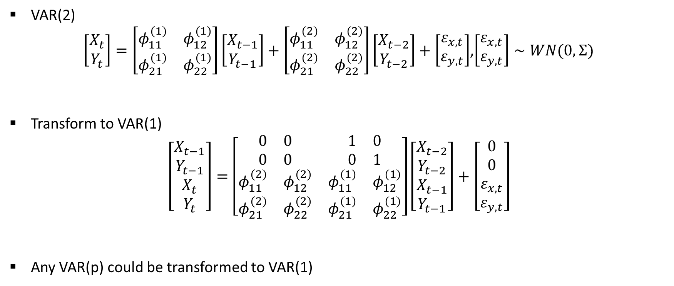
What if VAR(p) instead of VAR(1)?
VAR(2)
$\left[\begin{aligned}X_{t} \\ Y_{t}\end{aligned}\right]=\left[\begin{matrix}φ_{11}^{(1)} & φ_{12}^{(1)} \\ φ_{21}^{(1)} & φ_{22}^{(1)}\end{matrix}\right]\left[\begin{aligned}X_{t−1} \\ Y_{t−1}\end{aligned}\right]+\left[\begin{matrix}φ_{11}^{(2)} & φ_{12}^{(2)} \\ φ_{21}^{(2)} & φ_{22}^{(2)}\end{matrix}\right]\left[\begin{aligned}X_{t−2} \\ Y_{t−2}\end{aligned}\right]+\left[\begin{aligned}ε_{x,t} \\ ε_{y,t}\end{aligned}\right]$,$\left[\begin{aligned}ε_{x,t} \\ ε_{y,t}\end{aligned}\right]∼WN(0,Σ)$
Transform to VAR(1)
$$\left[\begin{aligned}X_{t−1} \\ Y_{t−1} \\ X_{t} \\ Y_{t}\end{aligned}\right]=\left[\begin{matrix}\begin{matrix}0 & 0 \\ 0 & 0\end{matrix} & \begin{matrix}1 & 0 \\ 0 & 1\end{matrix} \\ \begin{matrix}φ_{11}^{(2)} & φ_{12}^{(2)} \\ φ_{21}^{(2)} & φ_{22}^{(2)}\end{matrix} & \begin{matrix}φ_{11}^{(1)} & φ_{12}^{(1)} \\ φ_{21}^{(1)} & φ_{22}^{(1)}\end{matrix}\end{matrix}\right]\left[\begin{aligned}X_{t−2} \\ Y_{t−2} \\ X_{t−1} \\ Y_{t−1}\end{aligned}\right]+\left[\begin{aligned}0 \\ 0 \\ ε_{x,t} \\ ε_{y,t}\end{aligned}\right]$$
Any VAR(p) could be transformed to VAR(1)
Companion matrix

Slide 11
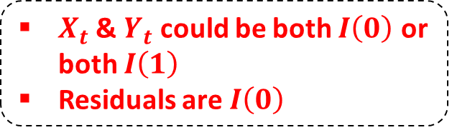
VAR(p):$\left[\begin{aligned}X_{t} \\ Y_{t}\end{aligned}\right]=\left[\begin{matrix}φ_{11} & φ_{12} \\ φ_{21} & φ_{22}\end{matrix}\right]\left[\begin{aligned}X_{t−1} \\ Y_{t−1}\end{aligned}\right]+\left[\begin{aligned}ε_{x,t} \\ ε_{y,t}\end{aligned}\right]$
$X_{t}$ & $Y_{t}$ could be both $I\left(0\right)$ or both $I\left(1\right)$
Residuals are $I\left(0\right)$
Reduced form
Structural form
ARDL
Both $X_{t}$ & $Y_{t}$ are $I\left(0\right)$
Conventional stationary VAR
Both $X_{t}$ & $Y_{t}$ are $I\left(1\right)$
PCA
interpretation
Doesn’t Exist $β$, s.t. $Y_{t}−βX_{t}∼I\left(0\right)$
Spurious Regression
Exist $β$, s.t. $Y_{t}−βX_{t}∼I\left(0\right)$
Error Correction Model
Only one cointegration relation
Engle Granger test
> one cointegration relation
VECM and Johansen test

Slide 12
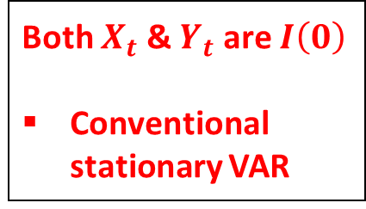
VAR(p):$\left[\begin{aligned}X_{t} \\ Y_{t}\end{aligned}\right]=\left[\begin{matrix}φ_{11} & φ_{12} \\ φ_{21} & φ_{22}\end{matrix}\right]\left[\begin{aligned}X_{t−1} \\ Y_{t−1}\end{aligned}\right]+\left[\begin{aligned}ε_{x,t} \\ ε_{y,t}\end{aligned}\right]$
$X_{t}$ & $Y_{t}$ could be both $I\left(0\right)$ or both $I\left(1\right)$
Residuals are $I\left(0\right)$
Reduced form
Structural form
ARDL
Both $X_{t}$ & $Y_{t}$ are $I\left(0\right)$
Conventional stationary VAR
Both $X_{t}$ & $Y_{t}$ are $I\left(1\right)$
PCA
interpretation
Doesn’t Exist $β$, s.t. $Y_{t}−βX_{t}∼I\left(0\right)$
Spurious Regression
Exist $β$, s.t. $Y_{t}−βX_{t}∼I\left(0\right)$
Error Correction Model
Only one cointegration relation
Engle Granger test
> one cointegration relation
VECM and Johansen test

Slide 13

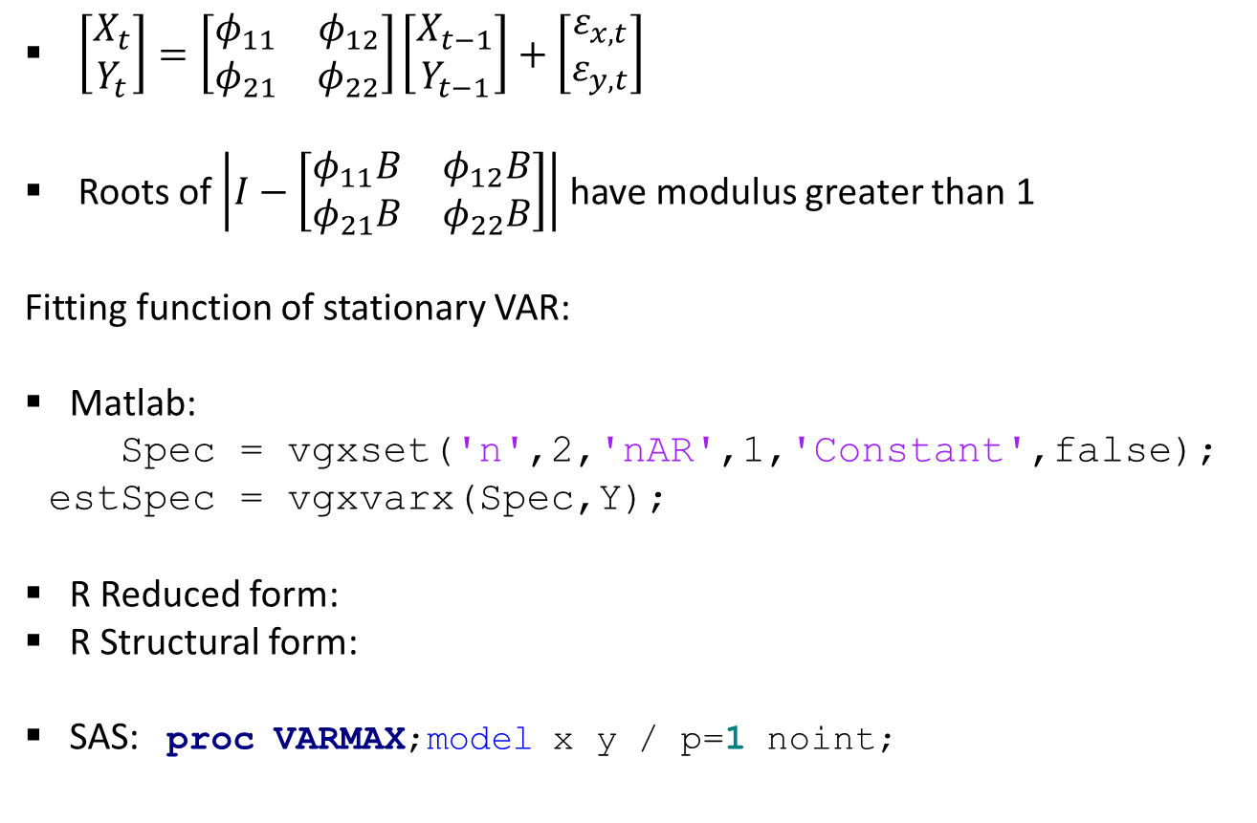
$\left[\begin{aligned}X_{t} \\ Y_{t}\end{aligned}\right]=\left[\begin{matrix}φ_{11} & φ_{12} \\ φ_{21} & φ_{22}\end{matrix}\right]\left[\begin{aligned}X_{t−1} \\ Y_{t−1}\end{aligned}\right]+\left[\begin{aligned}ε_{x,t} \\ ε_{y,t}\end{aligned}\right]$
Roots of $\left|I−\left[\begin{matrix}φ_{11}B & φ_{12}B \\ φ_{21}B & φ_{22}B\end{matrix}\right]\right|$ have modulus greater than 1
Fitting function of stationary VAR:
Matlab:
Spec = vgxset('n',2,'nAR',1,'Constant',false);
estSpec = vgxvarx(Spec,Y);
R Reduced form:
R Structural form:
SAS: proc VARMAX;model x y / p=1 noint;
fit = VAR(cbind(x,y), p = 1, type = 'none')
fit2 = SVAR(fit,Amat = matrix(c(1,0,NA,1),2,2))
$$⇐L=\left(\begin{matrix}1 & 0 \\ c & 1\end{matrix}\right)$$

Slide 14

VAR(p):$\left[\begin{aligned}X_{t} \\ Y_{t}\end{aligned}\right]=\left[\begin{matrix}φ_{11} & φ_{12} \\ φ_{21} & φ_{22}\end{matrix}\right]\left[\begin{aligned}X_{t−1} \\ Y_{t−1}\end{aligned}\right]+\left[\begin{aligned}ε_{x,t} \\ ε_{y,t}\end{aligned}\right]$
$X_{t}$ & $Y_{t}$ could be both $I\left(0\right)$ or both $I\left(1\right)$
Residuals are $I\left(0\right)$
Reduced form
Structural form
ARDL
Both $X_{t}$ & $Y_{t}$ are $I\left(0\right)$
Conventional stationary VAR
Both $X_{t}$ & $Y_{t}$ are $I\left(1\right)$
Engle Granger
test
PCA
interpretation
Doesn’t Exist $β$, s.t. $Y_{t}−βX_{t}∼I\left(0\right)$
Spurious Regression
Exist $β$, s.t. $Y_{t}−βX_{t}∼I\left(0\right)$
Error Correction Model
Only one cointegration relation
Engle Granger test
> one cointegration relation
VECM and Johansen test

Slide 15
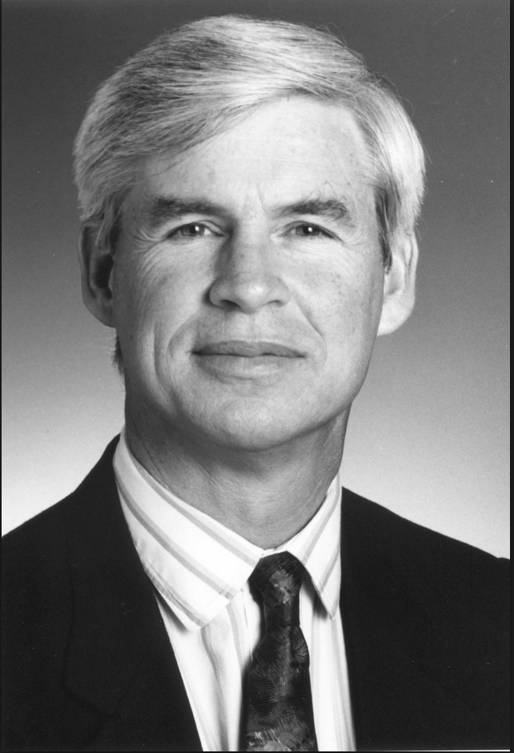
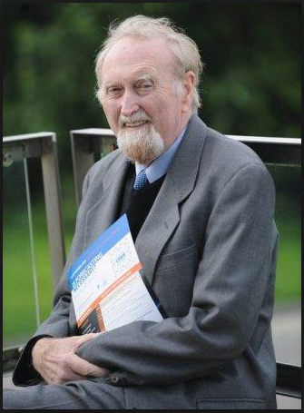
They shared Nobel Memorial Prize in Economic Sciences in 2003 for the methods of ARCH (Engle), and Co-integration (Granger) respectively.
Robert F. Engle (born in 1942)
American economist, currently teaches at New York University, Stern School of Business
Clive Granger (1934 – 2009)
British economist, taught at University of Nottinghan in Britain & University of California, San Diego in US

Slide 16
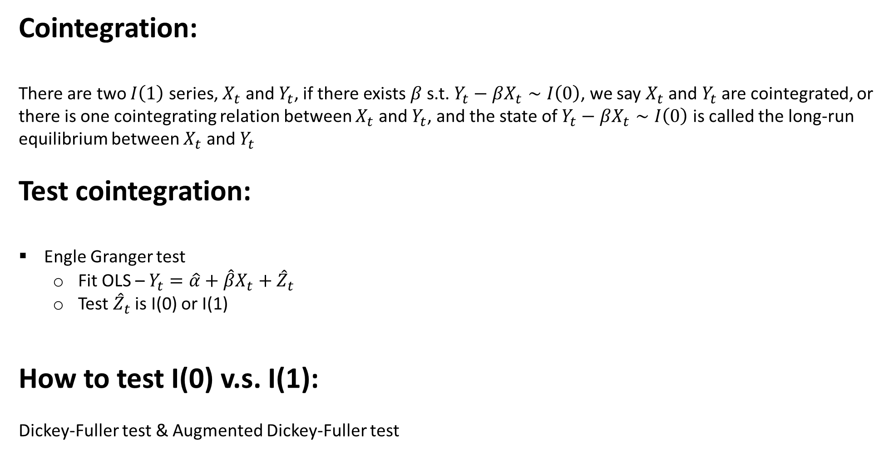
Cointegration:
There are two $I\left(1\right)$ series, $X_{t}$ and $Y_{t}$, if there exists $β$ s.t. $Y_{t}−βX_{t}∼I\left(0\right)$, we say $X_{t}$ and $Y_{t}$ are cointegrated, or there is one cointegrating relation between $X_{t}$ and $Y_{t}$, and the state of $Y_{t}−βX_{t}∼I\left(0\right)$ is called the long-run equilibrium between $X_{t}$ and $Y_{t}$
Test cointegration:
Engle Granger test
  Fit OLS – $Y_{t}=\hat{α}+\hat{β}X_{t}+{\hat{Z}}_{t}$
  Test ${\hat{Z}}_{t}$ is I(0) or I(1)
How to test I(0) v.s. I(1):
Dickey-Fuller test & Augmented Dickey-Fuller test

Slide 17
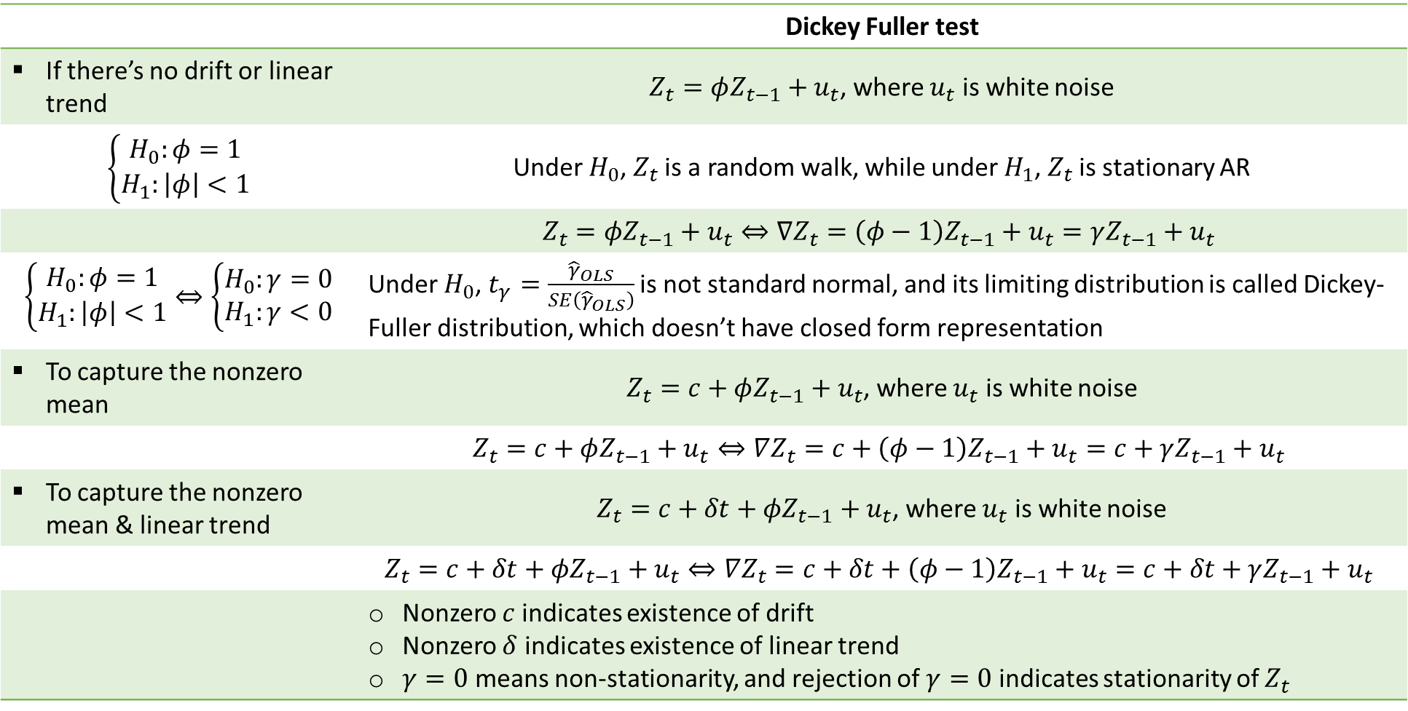
 | Dickey Fuller test
If there’s no drift or linear trend | $Z_{t}=φZ_{t−1}+u_{t}$, where $u_{t}$ is white noise
$\left\{\begin{aligned}H_{0}:φ=1 \\ H_{1}:\left|φ\right|<1\end{aligned}\right.$ | Under $H_{0}$, $Z_{t}$ is a random walk, while under $H_{1}$, $Z_{t}$ is stationary AR
 | $$Z_{t}=φZ_{t−1}+u_{t}⇔∇Z_{t}=\left(φ−1\right)Z_{t−1}+u_{t}=γZ_{t−1}+u_{t}$$
$\left\{\begin{aligned}H_{0}:φ=1 \\ H_{1}:\left|φ\right|<1\end{aligned}\right.⇔\left\{\begin{aligned}H_{0}:γ=0 \\ H_{1}:γ<0\end{aligned}\right.$ | Under $H_{0}$, $t_{γ}=\frac{{\hat{γ}}_{OLS}}{SE\left({\hat{γ}}_{OLS}\right)}$ is not standard normal, and its limiting distribution is called Dickey-Fuller distribution, which doesn’t have closed form representation
To capture the nonzero mean | $Z_{t}=c+φZ_{t−1}+u_{t}$, where $u_{t}$ is white noise
 | $$Z_{t}=c+φZ_{t−1}+u_{t}⇔∇Z_{t}=c+\left(φ−1\right)Z_{t−1}+u_{t}=c+γZ_{t−1}+u_{t}$$
To capture the nonzero mean & linear trend | $Z_{t}=c+δt+φZ_{t−1}+u_{t}$, where $u_{t}$ is white noise
 | $$Z_{t}=c+δt+φZ_{t−1}+u_{t}⇔∇Z_{t}=c+δt+\left(φ−1\right)Z_{t−1}+u_{t}=c+δt+γZ_{t−1}+u_{t}$$
 | Nonzero $c$ indicates existence of drift Nonzero $δ$ indicates existence of linear trend $γ=0$ means non-stationarity, and rejection of $γ=0$ indicates stationarity of $Z_{t}$

Slide 18
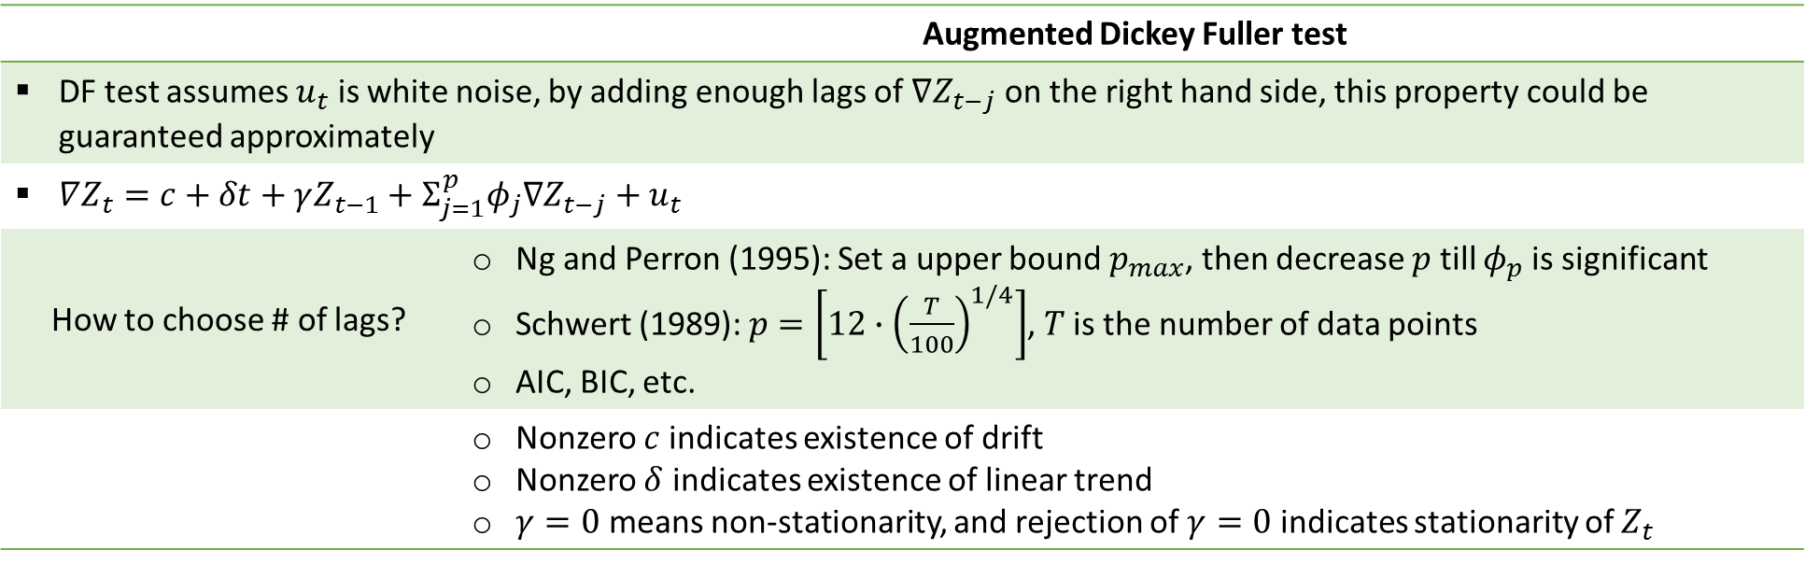
 | Augmented Dickey Fuller test
DF test assumes $u_{t}$ is white noise, by adding enough lags of $∇Z_{t−j}$ on the right hand side, this property could be guaranteed approximately
$∇Z_{t}=c+δt+γZ_{t−1}+Σ_{j=1}^{p}φ_{j}∇Z_{t−j}+u_{t}$
How to choose # of lags? | Ng and Perron (1995): Set a upper bound $p_{max}$, then decrease $p$ till $φ_{p}$ is significant Schwert (1989): $p=\left[12∙{\left(\frac{T}{100}\right)}^{1/4}\right]$, $T$ is the number of data points AIC, BIC, etc.
 | Nonzero $c$ indicates existence of drift Nonzero $δ$ indicates existence of linear trend $γ=0$ means non-stationarity, and rejection of $γ=0$ indicates stationarity of $Z_{t}$

Slide 19
EG test
Matlab:
[h,pvalue,stat,cValue,reg] = egcitest(Y_new,'test','t2','creg','nc');
R: fit5 = egcm(x,y)
SAS: proc AUTOREG; model y = x/ nlag=1 stationarity =(adf=1);

Slide 20
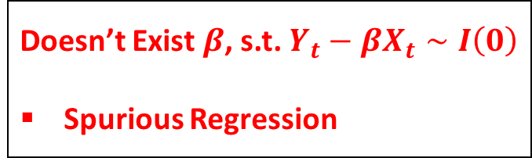
VAR(p):$\left[\begin{aligned}X_{t} \\ Y_{t}\end{aligned}\right]=\left[\begin{matrix}φ_{11} & φ_{12} \\ φ_{21} & φ_{22}\end{matrix}\right]\left[\begin{aligned}X_{t−1} \\ Y_{t−1}\end{aligned}\right]+\left[\begin{aligned}ε_{x,t} \\ ε_{y,t}\end{aligned}\right]$
$X_{t}$ & $Y_{t}$ could be both $I\left(0\right)$ or both $I\left(1\right)$
Residuals are $I\left(0\right)$
Reduced form
Structural form
ARDL
Both $X_{t}$ & $Y_{t}$ are $I\left(0\right)$
Conventional stationary VAR
Both $X_{t}$ & $Y_{t}$ are $I\left(1\right)$
PCA
interpretation
Doesn’t Exist $β$, s.t. $Y_{t}−βX_{t}∼I\left(0\right)$
Spurious Regression
Exist $β$, s.t. $Y_{t}−βX_{t}∼I\left(0\right)$
Error Correction Model
Only one cointegration relation
Engle Granger test
> one cointegration relation
VECM and Johansen test

Slide 21
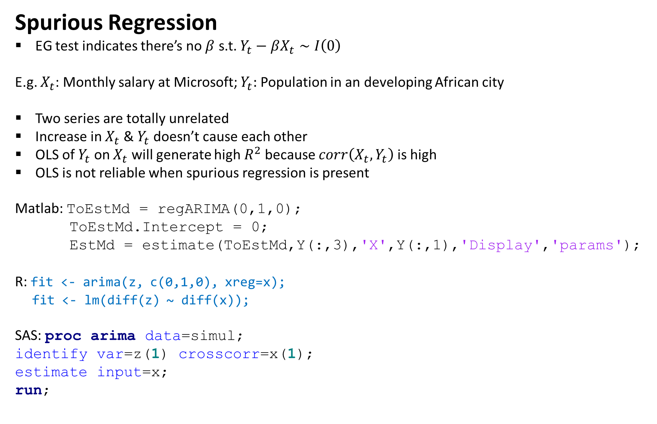
Spurious Regression
EG test indicates there’s no $β$ s.t. $Y_{t}−βX_{t}∼I\left(0\right)$
E.g. $X_{t}$: Monthly salary at Microsoft; $Y_{t}:$ Population in an developing African city
Two series are totally unrelated
Increase in $X_{t}$ & $Y_{t}$ doesn’t cause each other
OLS of $Y_{t}$ on $X_{t}$ will generate high $R^{2}$ because $corr\left(X_{t},Y_{t}\right)$ is high
OLS is not reliable when spurious regression is present
Matlab: ToEstMd = regARIMA(0,1,0);
ToEstMd.Intercept = 0;
EstMd = estimate(ToEstMd,Y(:,3),'X',Y(:,1),'Display','params');
R: fit <- arima(z, c(0,1,0), xreg=x);
fit <- lm(diff(z) ~ diff(x));
SAS: proc arima data=simul;
identify var=z(1) crosscorr=x(1);
estimate input=x;
run;

Slide 22
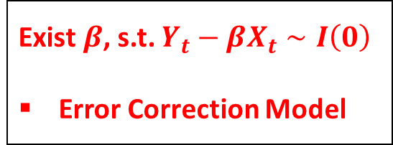
VAR(p):$\left[\begin{aligned}X_{t} \\ Y_{t}\end{aligned}\right]=\left[\begin{matrix}φ_{11} & φ_{12} \\ φ_{21} & φ_{22}\end{matrix}\right]\left[\begin{aligned}X_{t−1} \\ Y_{t−1}\end{aligned}\right]+\left[\begin{aligned}ε_{x,t} \\ ε_{y,t}\end{aligned}\right]$
$X_{t}$ & $Y_{t}$ could be both $I\left(0\right)$ or both $I\left(1\right)$
Residuals are $I\left(0\right)$
Reduced form
Structural form
ARDL
Both $X_{t}$ & $Y_{t}$ are $I\left(0\right)$
Conventional stationary VAR
Both $X_{t}$ & $Y_{t}$ are $I\left(1\right)$
PCA
interpretation
Doesn’t Exist $β$, s.t. $Y_{t}−βX_{t}∼I\left(0\right)$
Spurious Regression
Exist $β$, s.t. $Y_{t}−βX_{t}∼I\left(0\right)$
Error Correction Model
Only one cointegration relation
Engle Granger test
> one cointegration relation
VECM and Johansen test

Slide 23
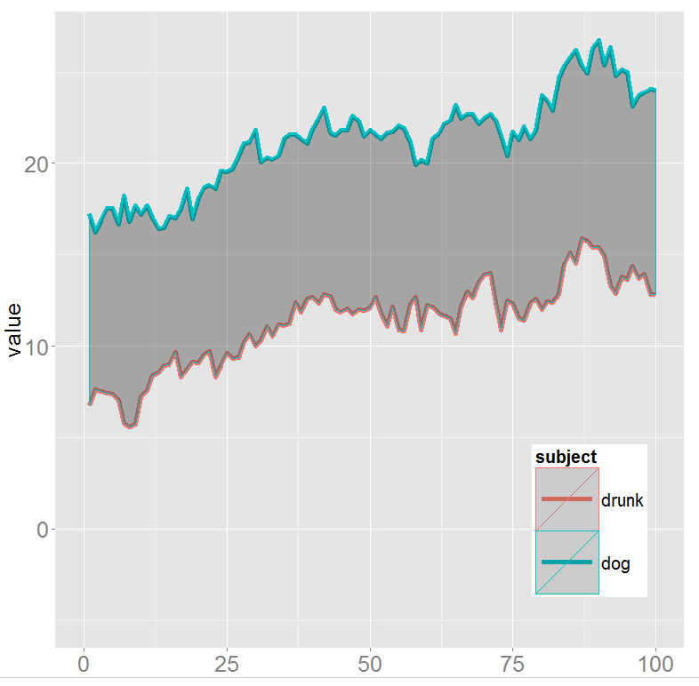
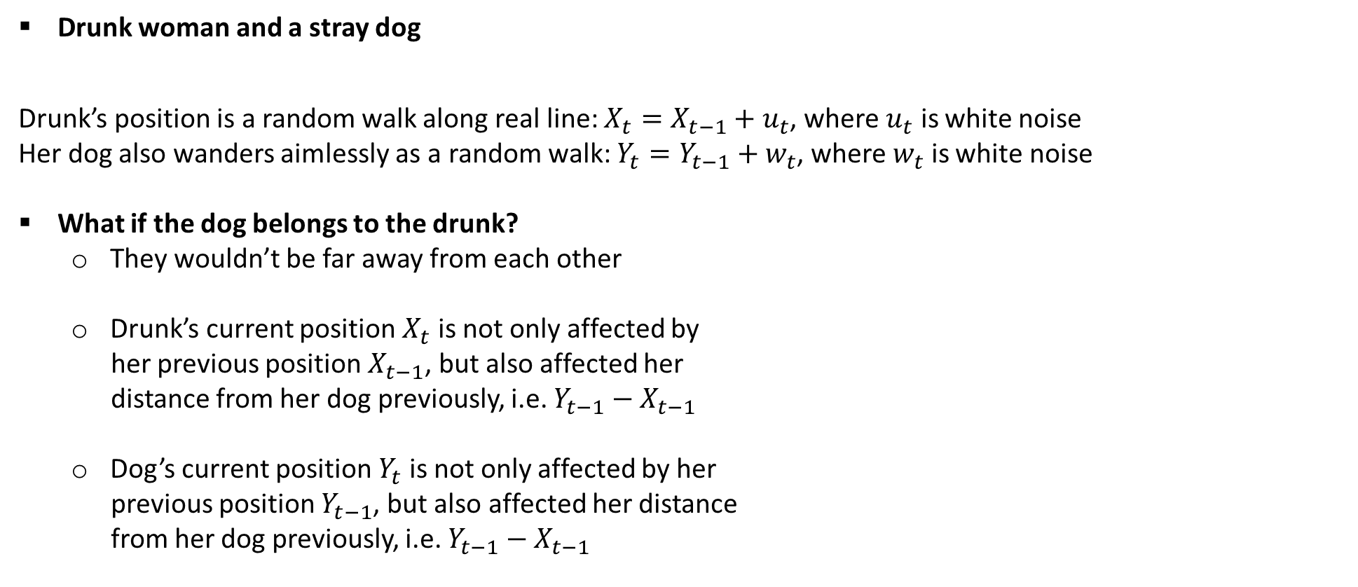
An example of cointegration
Drunk woman and a stray dog
Drunk’s position is a random walk along real line: $X_{t}=X_{t−1}+u_{t}$, where $u_{t}$ is white noise
Her dog also wanders aimlessly as a random walk: $Y_{t}=Y_{t−1}+w_{t}$, where $w_{t}$ is white noise
What if the dog belongs to the drunk?
  They wouldn’t be far away from each other
  Drunk’s current position $X_{t}$ is not only affected by
  her previous position $X_{t−1}$, but also affected her
  distance from her dog previously, i.e. $Y_{t−1}−X_{t−1}$
  Dog’s current position $Y_{t}$ is not only affected by her
  previous position $Y_{t−1}$, but also affected her distance
  from her dog previously, i.e. $Y_{t−1}−X_{t−1}$

Slide 24



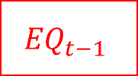








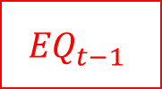





Error Correction Model (ECM)
Reduced: $\left\{\begin{aligned}X_{t}=φ_{11} X_{t−1}+φ_{12}Y_{t−1}+ε_{x,t} \\ Y_{t}=φ_{21} X_{t−1}+φ_{22}Y_{t−1}+ε_{y,t}\end{aligned}\right.$
Substitute $Y_{t}=∇Y_{t}+Y_{t−1}$ and $X_{t}=∇X_{t}+X_{t−1}$
$\left\{\begin{aligned}∇X_{t}=φ_{12}\left(Y_{t−1}+\frac{φ_{11}−1}{φ_{12}}X_{t−1}\right)+ε_{x,t} \\ ∇Y_{t}=\left(φ_{22}−1\right)\left(Y_{t−1}+\frac{φ_{21}}{φ_{22}−1}X_{t−1}\right)+ε_{y,t}\end{aligned}\right.$
Structural: $\left\{\begin{aligned}X_{t}=φ_{11}^{∗}X_{t−1}+φ_{12}^{∗}Y_{t−1}+ε_{x,t}^{∗} \\ Y_{t}=cX_{t}+φ_{21}^{∗}X_{t−1}+φ_{22}^{∗}Y_{t−1}+ε_{y,t}^{∗}\end{aligned}\right.$
Substitute $Y_{t}=∇Y_{t}+Y_{t−1}$ and $X_{t}=∇X_{t}+X_{t−1}$
$\left\{\begin{aligned}∇X_{t}=φ_{12}^{∗}\left(Y_{t−1}+\frac{φ_{11}^{∗}−1}{φ_{12}^{∗}}X_{t−1}\right)+ε_{x,t}^{∗} \\ ∇Y_{t}=c∇X_{t}+\left(φ_{22}^{∗}−1\right)\left(Y_{t−1}+\frac{φ_{21}^{∗}}{φ_{22}^{∗}−1}X_{t−1}\right)+ε_{y,t}^{∗}\end{aligned}\right.$
If roots of $\left|I−\left[\begin{matrix}φ_{11}B & φ_{12}B \\ φ_{21}B & φ_{22}B\end{matrix}\right]\right|=0$ are all outside of unit circle – stationary
$\left|I−\left[\begin{matrix}φ_{11} & φ_{12} \\ φ_{21} & φ_{22}\end{matrix}\right]\right|=0$, meaning $\left(1−φ_{11}\right)\left(1−φ_{22}\right)=φ_{12}φ_{21}$
From which it could be proven that $\frac{φ_{11}−1}{φ_{12}}=\frac{φ_{21}}{φ_{22}−1}=\frac{φ_{11}^{∗}−1}{φ_{12}^{∗}}=\frac{φ_{21}^{∗}}{φ_{22}^{∗}−1}$
$$φ_{12}$$
$$∇X_{t}$$
$$ε_{x,t}$$
$$φ_{12}^{∗}$$
$$∇X_{t}$$
$$ε_{x,t}^{∗}$$
$${EQ}_{t−1}$$
$${EQ}_{t−1}$$
$$c$$
$$φ_{22}−1$$
$${∇Y}_{t}$$
$$ε_{y,t}$$
$$φ_{22}^{∗}−1$$
$$∇Y_{t}$$
$$ε_{y,t}^{∗}$$

Slide 25
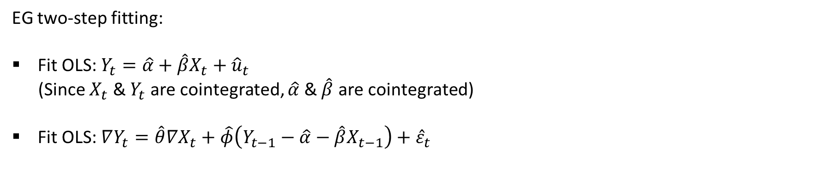
How to fit ECM model?
EG two-step fitting:
Fit OLS: $Y_{t}=\hat{α}+\hat{β}X_{t}+{\hat{u}}_{t}$
(Since $X_{t}$ & $Y_{t}$ are cointegrated, $\hat{α}$ & $\hat{β}$ are cointegrated)
Fit OLS: $∇Y_{t}=\hat{θ}∇X_{t}+\hat{φ}\left(Y_{t−1}−\hat{α}−\hat{β}X_{t−1}\right)+{\hat{ε}}_{t}$

Slide 26
VAR(p):$\left[\begin{aligned}X_{t} \\ Y_{t}\end{aligned}\right]=\left[\begin{matrix}φ_{11} & φ_{12} \\ φ_{21} & φ_{22}\end{matrix}\right]\left[\begin{aligned}X_{t−1} \\ Y_{t−1}\end{aligned}\right]+\left[\begin{aligned}ε_{x,t} \\ ε_{y,t}\end{aligned}\right]$
$X_{t}$ & $Y_{t}$ could be both $I\left(0\right)$ or both $I\left(1\right)$
Residuals are $I\left(0\right)$
Reduced form
Structural form
ARDL
Both $X_{t}$ & $Y_{t}$ are $I\left(0\right)$
Conventional stationary VAR
Both $X_{t}$ & $Y_{t}$ are $I\left(1\right)$
PCA
interpretation
Doesn’t Exist $β$, s.t. $Y_{t}−βX_{t}∼I\left(0\right)$
Spurious Regression
Exist $β$, s.t. $Y_{t}−βX_{t}∼I\left(0\right)$
Error Correction Model
Only one cointegration relation
Engle Granger test works
> one cointegration relation
VECM and Johansen test

Slide 27
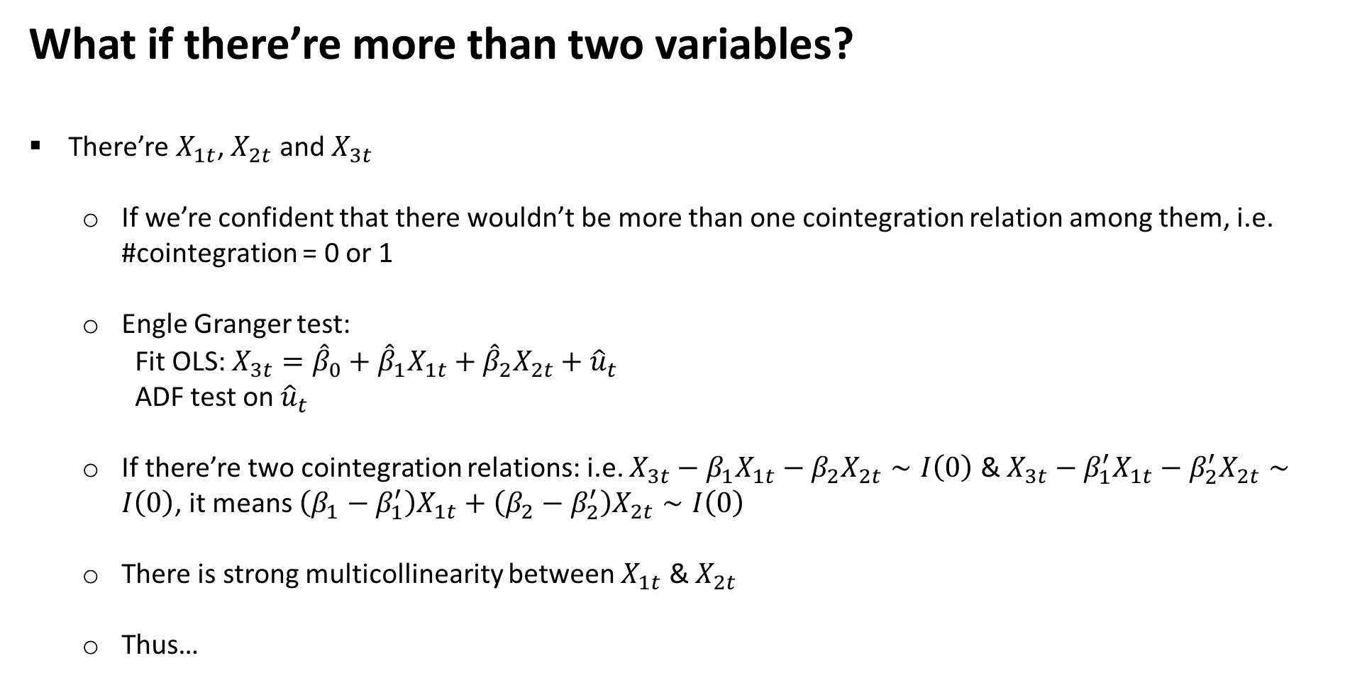
What if there’re more than two variables?
There’re $X_{1t}$, $X_{2t}$ and $X_{3t}$
  If we’re confident that there wouldn’t be more than one cointegration relation among them, i.e. #cointegration = 0 or 1
  Engle Granger test:
    Fit OLS: $X_{3t}={\hat{β}}_{0}+{\hat{β}}_{1}X_{1t}+{\hat{β}}_{2}X_{2t}+{\hat{u}}_{t}$
    ADF test on ${\hat{u}}_{t}$
  If there’re two cointegration relations: i.e. $X_{3t}−β_{1}X_{1t}−β_{2}X_{2t}∼I\left(0\right)$ & $X_{3t}−β_{1}^{′}X_{1t}−β_{2}^{′}X_{2t}∼I\left(0\right)$, it means $\left(β_{1}−β_{1}^{′}\right)X_{1t}+\left(β_{2}−β_{2}^{′}\right)X_{2t}∼I\left(0\right)$
  There is strong multicollinearity between $X_{1t}$ & $X_{2t}$
  Thus…

Slide 28
VAR(p):$\left[\begin{aligned}X_{t} \\ Y_{t}\end{aligned}\right]=\left[\begin{matrix}φ_{11} & φ_{12} \\ φ_{21} & φ_{22}\end{matrix}\right]\left[\begin{aligned}X_{t−1} \\ Y_{t−1}\end{aligned}\right]+\left[\begin{aligned}ε_{x,t} \\ ε_{y,t}\end{aligned}\right]$
$X_{t}$ & $Y_{t}$ could be both $I\left(0\right)$ or both $I\left(1\right)$
Residuals are $I\left(0\right)$
Reduced form
Structural form
ARDL
Both $X_{t}$ & $Y_{t}$ are $I\left(0\right)$
Conventional stationary VAR
Both $X_{t}$ & $Y_{t}$ are $I\left(1\right)$
PCA
interpretation
Doesn’t Exist $β$, s.t. $Y_{t}−βX_{t}∼I\left(0\right)$
Spurious Regression
Exist $β$, s.t. $Y_{t}−βX_{t}∼I\left(0\right)$
Error Correction Model
Only one cointegration relation
Engle Granger test
> one cointegration relation
VECM and Johansen test

Slide 29
VECM for Cointegration
Johansen Approach
Tingjun Ruan

Slide 30
Johansen Methodology (1988)
The drawback of Engle Granger approach: it can only identify a single equilibrium relationship among the variables. If we have more than two variables in the model, then there is a possibility of having more than one cointegration relationships
Johansen (1988) proposed a framework of estimating and testing of vector error correction model (VECM) based on vector auto regressive (VAR) equations with which we can find out how many cointegrating relationships exist among variables
Johansen VECM is more general for testing multiple cointegrating relationships when there are more than two variables.
For k variables, we can have up to k-1 cointegrations

Slide 31
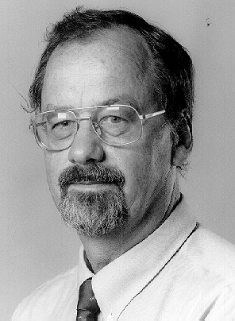
Danish Statistician and Econometrician, who is known for his research in time series analysis, in particular the theory of cointegration in collaboration with Katarina Juselius.
He is currently a professor at the Department of Econometrics, University of Copenhagen.
Soren Johansen (born in 1939 Denmark)

Slide 32
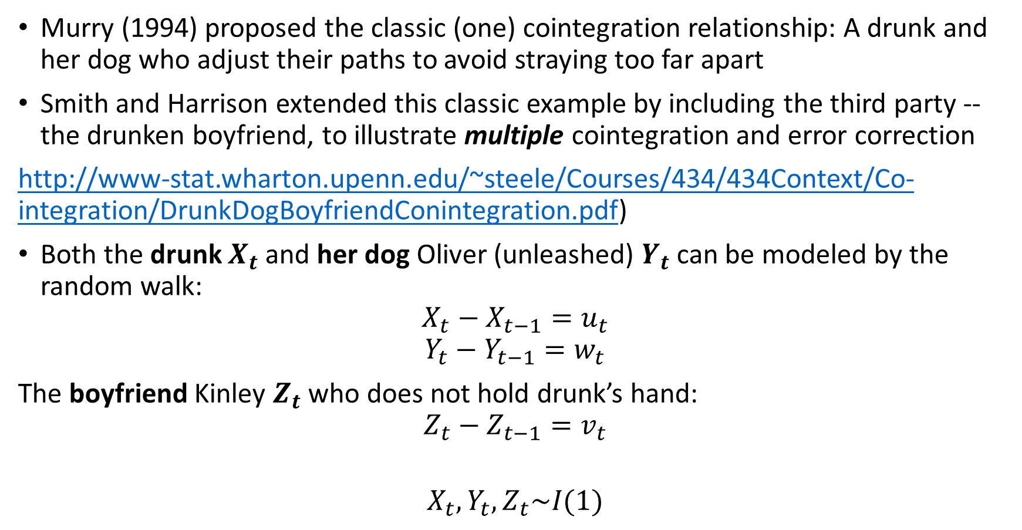
Multiple Cointegration Example - A Drunk, Her Dog and A boyfriend
Murry (1994) proposed the classic (one) cointegration relationship: A drunk and her dog who adjust their paths to avoid straying too far apart
Smith and Harrison extended this classic example by including the third party -- the drunken boyfriend, to illustrate multiple cointegration and error correction
http://www-stat.wharton.upenn.edu/~steele/Courses/434/434Context/Co-integration/DrunkDogBoyfriendConintegration.pdf)
Both the drunk $X_{t}$ and her dog Oliver (unleashed) $Y_{t}$ can be modeled by the random walk:
$$X_{t}−X_{t−1}=u_{t}$$
$$Y_{t}−Y_{t−1}=w_{t}$$
The boyfriend Kinley $Z_{t}$ who does not hold drunk’s hand:
$$Z_{t}−Z_{t−1}=v_{t}$$
$$X_{t},Y_{t},Z_{t}\sim I(1)$$

Slide 33
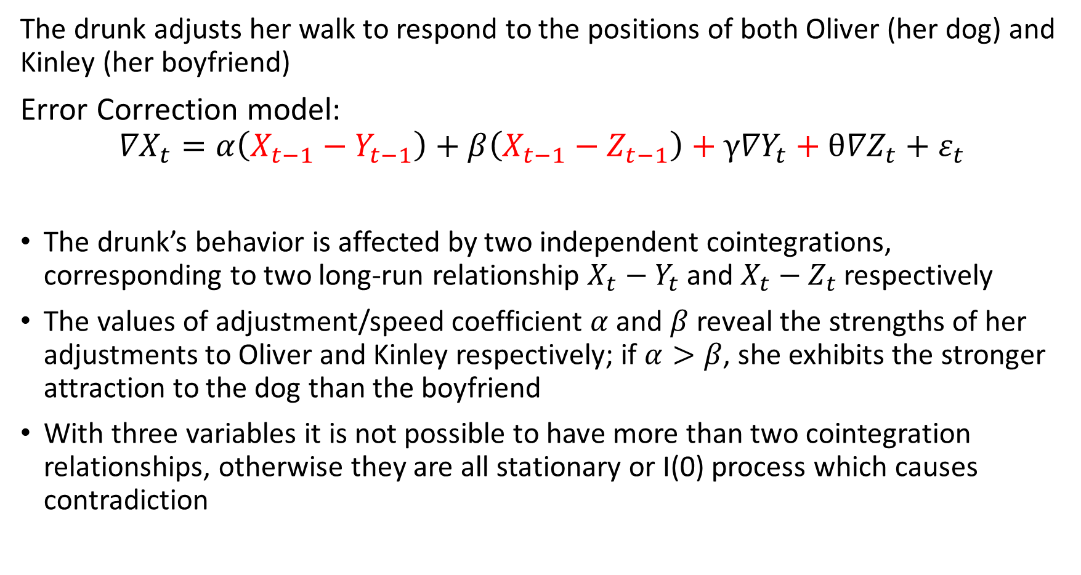
The drunk adjusts her walk to respond to the positions of both Oliver (her dog) and Kinley (her boyfriend)
Error Correction model:
$${∇X}_{t}=α\left(X_{t−1}−Y_{t−1}\right)+β\left(X_{t−1}−Z_{t−1}\right)+γ{∇Y}_{t}+θ{∇Z}_{t}+ε_{t}$$
The drunk’s behavior is affected by two independent cointegrations, corresponding to two long-run relationship $X_{t}−Y_{t}$ and $X_{t}−Z_{t}$ respectively
The values of adjustment/speed coefficient $α$ and $β$ reveal the strengths of her adjustments to Oliver and Kinley respectively; if $α>β$, she exhibits the stronger attraction to the dog than the boyfriend
With three variables it is not possible to have more than two cointegration relationships, otherwise they are all stationary or I(0) process which causes contradiction

Slide 34
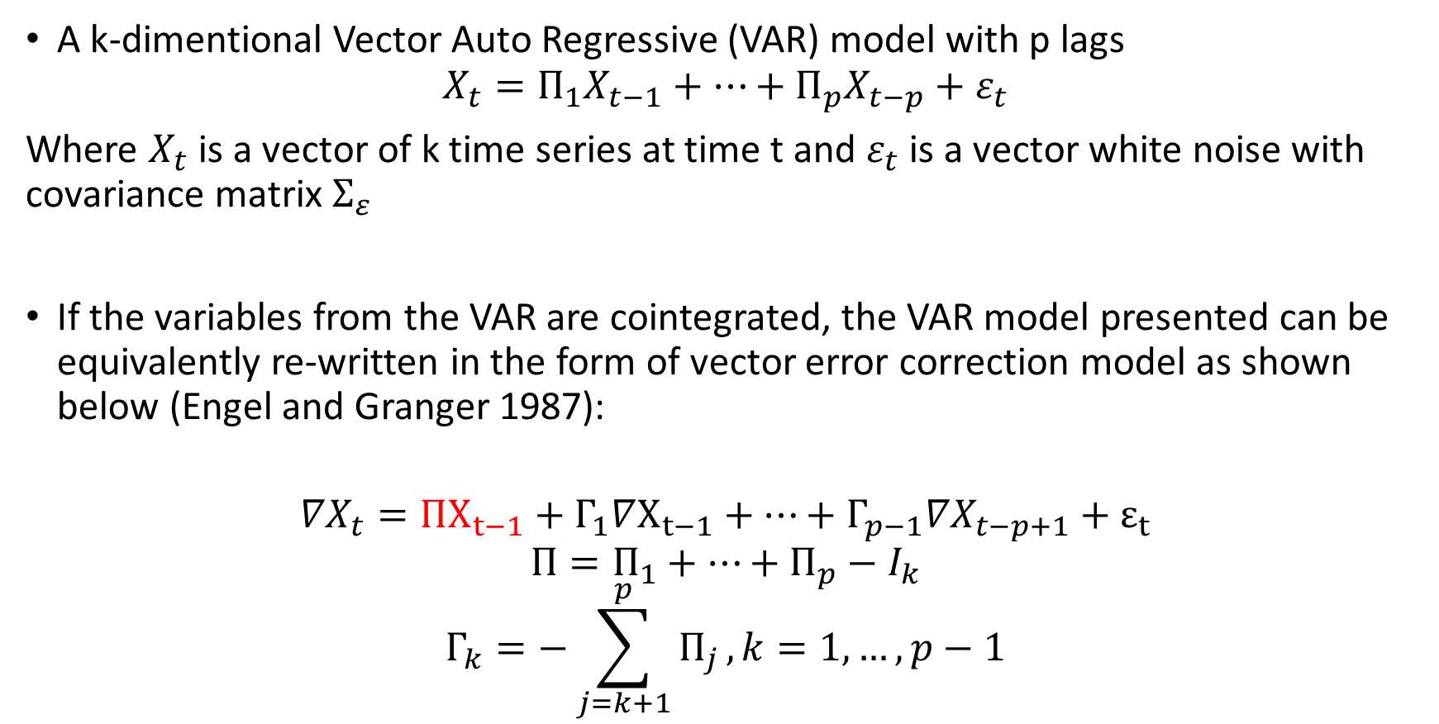
VECM
A k-dimentional Vector Auto Regressive (VAR) model with p lags
$$X_{t}=Π_{1}X_{t−1}+…+Π_{p}X_{t−p}+ε_{t}$$
Where $X_{t}$ is a vector of k time series at time t and $ε_{t}$ is a vector white noise with covariance matrix $Σ_{ε}$
If the variables from the VAR are cointegrated, the VAR model presented can be equivalently re-written in the form of vector error correction model as shown below (Engel and Granger 1987):
$${∇X}_{t}=ΠX_{t−1}+Γ_{1}∇X_{t−1}+…+Γ_{p−1}{∇X}_{t−p+1}+ε_{t}$$
$$Π=Π_{1}+…+Π_{p}−I_{k}$$
$$Γ_{k}=−\sum_{j=k+1}^{p}{Π_{j}},k=1,…,p−1$$

Slide 35
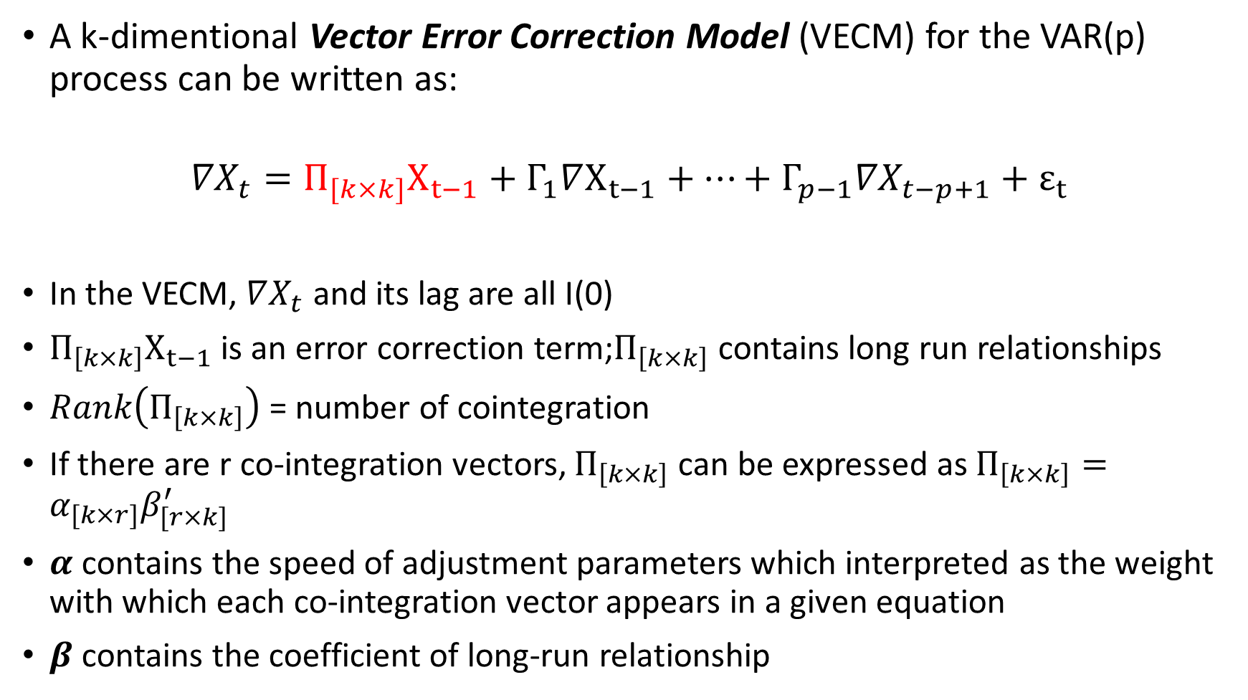
VECM
A k-dimentional Vector Error Correction Model (VECM) for the VAR(p) process can be written as:
$${∇X}_{t}=Π_{[k×k]}X_{t−1}+Γ_{1}∇X_{t−1}+…+Γ_{p−1}{∇X}_{t−p+1}+ε_{t}$$
In the VECM, $∇X_{t}$ and its lag are all I(0)
$Π_{\left[k×k\right]}X_{t−1}$ is an error correction term;$Π_{\left[k×k\right]}$ contains long run relationships
$Rank\left(Π_{\left[k×k\right]}\right)$ = number of cointegration
If there are r co-integration vectors, $Π_{\left[k×k\right]}$ can be expressed as $Π_{\left[k×k\right]}=α_{[k×r]}β_{[r×k]}^{′}$
$α$ contains the speed of adjustment parameters which interpreted as the weight with which each co-integration vector appears in a given equation
$β$ contains the coefficient of long-run relationship

Slide 36
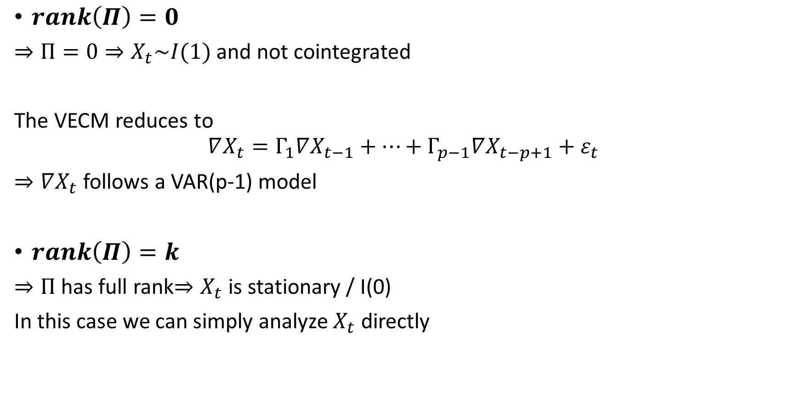
$$Rank\left(Π\right)$$
$rank\left(Π\right)=0$
$⇒Π=0⇒X_{t}\sim I(1)$ and not cointegrated
The VECM reduces to
$$∇X_{t}=Γ_{1}∇X_{t−1}+…+Γ_{p−1}∇X_{t−p+1}+ε_{t}$$
$⇒∇X_{t}$ follows a VAR(p-1) model
$rank\left(Π\right)=k$
$⇒Π$ has full rank$⇒X_{t}$ is stationary / I(0)
In this case we can simply analyze $X_{t}$ directly

Slide 37
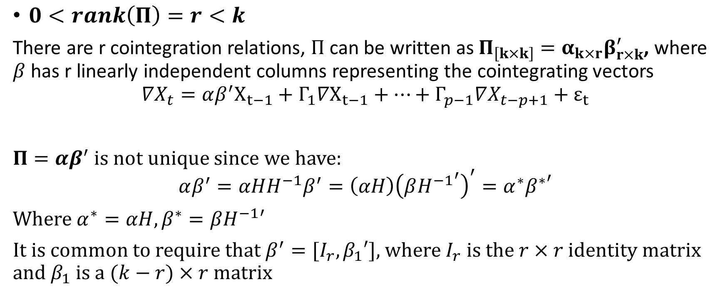
$0<rank\left(Π\right)=r<k$
There are r cointegration relations, $Π$ can be written as $Π_{\left[k×k\right]}=α_{k×r}β_{r×k}^{′}$, where $β$ has r linearly independent columns representing the cointegrating vectors
$${∇X}_{t}=αβ^{′}X_{t−1}+Γ_{1}∇X_{t−1}+…+Γ_{p−1}∇X_{t−p+1}+ε_{t}$$
$Π=αβ^{′}$ is not unique since we have:
$$αβ^{′}=αHH^{−1}β^{′}=\left(αH\right){\left(β{H^{−1}}^{′}\right)}^{′}=α^{∗}{β^{∗}}^{′}$$
Where $α^{∗}=αH, β^{∗}=βH^{−1}′$
It is common to require that $β^{′}=[I_{r},β_{1}′]$, where $I_{r}$ is the $r×r$ identity matrix and $β_{1}$ is a $(k−r)×r$ matrix

Slide 38

Determine the Number of Cointegration
The rank of the long-run impact matrix $Π$ equals the number of cointegration, and it is evaluated to determine the number of eigenvalues that are different from zero
Johansen and Juselius (1990) proposed two methods for determining the number of cointegrating relations.
  Trace Statistics based on a likelihood ratio test about a trace of the matrix
  Maximum Eigenvalue Statistics based on eigenvalues (maximum) obtained from estimation procedure
  These cointegration tests are formulated in term of the estimated eigenvalues ${\hat{λ}}_{i}$ of the matrix $Π$

Slide 39

Johansen’s Trace Statistic
The trace statistic considers whether the trace is increased by adding more eigenvalues beyond the $r^{th}$ eigenvalue
Consider the hypothesis: $\left\{\begin{aligned}H_{0}:Rank\left(Π\right)=r_{0} \\ H_{1}:Rank\left(Π\right)>r_{0}\end{aligned}\right.$
Likelihood ratio test statistics:
$$LR_{tr}\left(r_{0}\right)=−T\sum_{i=r_{o}+1}^{k}{\ln\left(1−\hat{λ_{i}}\right)}$$
Note:
If $rank\left(Π\right)=r_{0}, then$ ${\hat{λ}}_{r_{0}+1},…,{\hat{λ}}_{k}$ should all be close to zero, or $LR_{tr}\left(r_{0}\right)$should be small that we cannot reject $H_{0} as \ln\left(1−\hat{λ_{i}}\right)≈0 as i>r_{o}$
If $rank\left(Π\right)>r_{0}, then {\hat{λ}}_{r_{0}+1},…,{\hat{λ}}_{k}$ should be non-zero but less than one, and $LR_{tr}\left(r_{0}\right)$ should be large as $\ln\left(1−\hat{λ_{i}}\right)≪0 for some i>r_{0}.$

Slide 40

Johansen’s Maximum Eigenvalue Statistic
It is a sequential procedure to determine the number of cointegrations
Consider the hypothesis:$\left\{\begin{aligned}H_{0}:Rank\left(Π\right)=r_{0} \\ H_{1}:Rank\left(Π\right)=r_{0}+1\end{aligned}\right.$
Test Statistic:
$$LR_{max}\left(r_{0}\right)=−Tln(1−{\hat{λ}}_{r_{0}+1})$$
Note:
The test consists of ordering the largest eigenvalues in descending order and considering whether they are significantly different from zero.
Suppose we obtained n eigenvalues denoted $λ_{1}>λ_{2}>…>λ_{k}$, if the variables under are not cointegrated, the rank of $Π$ is zero and all the eigenvalues should be equal to zero, therefore, $\ln\left(1−\hat{λ_{i}}\right)$ equals to 0.

Slide 41
The asymptotic null distribution of both tests are not Chi-square but instead a complicated function of Brownian motion and the critical values of the test statistics are non-standard
Critical values for both statistics are provided by Johansen and Juselius (1990)

Slide 42

Maximum Likelihood Estimation of Cointegrated VECM
Once we found the $rank\left(Π\right)=r \left(0<r<n\right)$, then the cointegrated VECM can be written:
$$∇X_{t}=αβ^{′}X_{t−1}+Γ_{1}∇X_{t−1}+…+Γ_{p−1}∇X_{t−p+1}+ε_{t}$$
Where $ε_{t}$ is Gaussian white noise
Reduced rank multivariate regression
Johansen derived the maximum likelihood estimation of the parameters under the reduce rank restriction
${\hat{β}}_{mle}=\left({\hat{v}}_{1},…,{\hat{v}}_{r}\right)$, where ${\hat{v}}_{i}$ are the eigenvectors associated with the eigenvalues ${\hat{λ}}_{i}$
We first estimate $β$ using MLE, plug in $\hat{β}$ then the MLEs of the remaining parameters can be estimated by OLS (since all the variables are I(0) process):
$$∇X_{t}=α{\hat{β}}_{mle}^{′}X_{t−1}+Γ_{1}∇X_{t−1}+…+Γ_{p−1}∇X_{t−p+1}+ε_{t}$$
Note:
Johansen approach estimates $β$ using MLE instead of OLS which is used in E-G two step as if r (# of cointegration) > 1 may cause multicolinearity

Slide 43

Maximum likelihood estimation
$$∇X_{t}=αβ^{′}X_{t−1}+Γ_{1}∇X_{t−1}+…+Γ_{p−1}∇X_{t−p+1}+ε_{t}$$
Consider two multivariate regression:
$$∇X_{t}=Ω_{1}∇X_{t−1}+…+Ω_{p−1}∇X_{t−p+1}+u_{t}$$
$$X_{t−1}=Ξ_{1}∇X_{t−1}+…+Ξ∇X_{t−p+1}+w_{t}$$
Let ${\hat{u}}_{t}$ and ${\hat{w}}_{t}$ be the residuals of the two equation, Define sample covariance matrix:
$S_{00}=\frac{1}{T−p}\sum_{t=p+1}^{T}{{\hat{u}}_{t}{\hat{u}}_{t}′}$ $S_{01}=\frac{1}{T−p}\sum_{t=p+1}^{T}{{\hat{u}}_{t}{\hat{w}}_{t}′}$ $S_{11}=\frac{1}{T−p}\sum_{t=p+1}^{T}{{\hat{w}}_{t}{\hat{w}}_{t}′}$
Solving the eigenvalue :
$$\left|λS_{11}−S_{10}S_{00}^{−1}S_{01}\right|=0$$
Denote the eigenvalue and eigenvector pairs by $\left({\hat{λ}}_{i},{\hat{v}}_{i}\right),{\hat{λ}}_{1}>…>$ ${\hat{λ}}_{k}$
$${\hat{β}}_{mle}=\left({\hat{v}}_{1},…,{\hat{v}}_{r}\right)$$

Slide 44
Functions of fitting VECM and Johansen test
Matlab Johansen Procedure : [h,pvalue,~,~,mles] = jcitest(Y,'Model','H2','lags',1,'display','params')
Matlab VECM to VAR : VAR = vectovar(‘VEC’,{A0 A1},’C’,C)
R Johansen Procedure:
R VECM to VAR:
SAS Johansen Procedure : proc VARMAX;
model x y z / p=1 noint cointtest=(johansen=(TYPE=TRACE))
ecm = (rank=1)
print = (iarr estimates);
run;
fit = ca.jo(cbind(x,y,z),ecdet = 'none',K = 2,spec = 'transitory')
fit2 = vec2var(fit,r = 1)

Slide 45
VAR(p):$\left[\begin{aligned}X_{t} \\ Y_{t}\end{aligned}\right]=\left[\begin{matrix}φ_{11} & φ_{12} \\ φ_{21} & φ_{22}\end{matrix}\right]\left[\begin{aligned}X_{t−1} \\ Y_{t−1}\end{aligned}\right]+\left[\begin{aligned}ε_{x,t} \\ ε_{y,t}\end{aligned}\right]$
$X_{t}$ & $Y_{t}$ could be both $I\left(0\right)$ or both $I\left(1\right)$
Residuals are $I\left(0\right)$
Reduced form
Structural form
ARDL
Both $X_{t}$ & $Y_{t}$ are $I\left(0\right)$
Conventional stationary VAR
Both $X_{t}$ & $Y_{t}$ are $I\left(1\right)$
PCA
interpretation
Doesn’t Exist $β$, s.t. $Y_{t}−βX_{t}∼I\left(0\right)$
Spurious Regression
Exist $β$, s.t. $Y_{t}−βX_{t}∼I\left(0\right)$
Error Correction Model
Only one cointegration relation
Engle Granger test
> one cointegration relation
VECM and Johansen test

Slide 46
Linear decomposition of cointegration
Ruofeng Wen

Slide 47












The key of time series regression: Trend
Without $I(1)$, everything discussed before can be described by $VAR(1)$
And $VAR(1)$can be solved consistently and efficiently by (Generalized) Least Square, and thus have no difference with ordinary regression with possible serial correlation
Deterministic trend (e.g. $α+βt$) and stochastic trend (e.g. random walk) will cause spurious results in regression due to $I(1)$ residual.
Trend can be eliminated through differencing, but co-integration analysis provides a better alternative when applicable.
Stationary Series can be modelled with linear regression directly:
$$Y_{t}=α+βX_{t}+u_{t}$$
Series with stochastic trend can be modelled by (order $q$) differencing
$$Y_{t}=α+βX_{t}+ε_{t}$$
$$ΔY_{t}=η+γΔX_{t}+u_{t}$$
$$I(1)$$
$$I(1)$$
$$I(?)$$
$$I(0)$$
$$I(0)$$
$$I(0)$$
$$I(0)$$
$$I(0)$$
$$I(0)$$

Slide 48



$k$ variables with co-integration of rank $r$
$r$ processes of $I(0)$
$k−r$ processes of $I(1)$
a full-rank linear transform

Slide 49







So what is co-integration?
Consider Johansen Procedure of a VAR(1)
$$x_{t}=Ax_{t−1}+ε_{t}\overset{⇒}{}Δx_{t}=(A−I)x_{t−1}+ε_{t}$$
Here one unit root denotes an zero eigenvalue in $(A−I)$, or a $λ_{i}=1$ eigenvalue in $A$
For any diagonalizable* matrix $A$, its eigen-decomposition gives
$$A=Q^{−1}DQ$$
where $D=diag(λ_{1},…,λ_{n})$ contains sorted eigenvalues of $A$. Then we have
$$y_{t}=Dy_{t−1}+e_{t}$$
where$y_{t}=Qx_{t}$. Note in Johansen if the rank of co-integration is $r$, then $(A−I)$ is of rank $r$, namely the number of $λ_{i}=1$ is actually $k−r$, and others less than $1$. Thus:
*$Jordan=\left(\begin{matrix}λ_{i} & 1 & 0 \\ 0 & λ_{i} & 1 \\ 0 & 0 & λ_{i}\end{matrix}\right)$
Does not change $I(0)$ or $I(1)$ status
$$y_{t,1}=y_{t−1,i}+e_{t,1}$$
$$⋯$$
$$y_{t,n−r}=y_{t−1,n−r}+e_{t,n−r}$$
$$y_{t,n −r+1}=λ_{n−r+1}y_{t−1,i}+e_{t,n−r+1}$$
$$⋯$$
$$y_{t,n}=λ_{n}y_{t−1,n}+e_{t,n}$$
$k−r$ variables $\sim I(1)$
$r$ variables $\sim I(0)$

Slide 50


$k$ variables with co-integration of rank $r$
$r$ processes of $I(0)$
$k−r$ processes of $I(1)$
a full-rank linear transform
An $r$-dimensional subspace where VAR works like PCA
An $(k−r)$-dimensional subspace where we cannot directly model
residuals
Take difference of everything and then VAR
$$Δx_{t}=μ+αβ^{T}x_{t−1}+Γ_{p−1}Δx_{t−p+1}+⋯+Γ_{1}Δx_{t−1}+ε_{t}$$

Slide 51
Data Simulation

Slide 52


$${\left(\begin{matrix}x \\ y \\ z\end{matrix}\right)}_{t}$$

Slide 53















independent
Data generation
  $$z_{1}\left(t\right)=z_{1}\left(t−1\right)+u_{1}\left(t\right)$$
  $$z_{2}\left(t\right)=0.5z_{2}\left(t−1\right)+u_{2}(t)$$
  $$z_{3}\left(t\right)=z_{3}\left(t−1\right)+u_{3}(t)$$
ECM (E-G)
$$∇y_{t}=−\frac{1}{2}\left(\frac{2}{3}y_{t−1}−\frac{1}{3}x_{t−1}\right)+0∇y_{t−1}+ε_{2t}$$
$I(1)$
$$I(0)$$
$I(1)$
$$z_{2}(t)=\frac{2}{3}y_{t−1}−\frac{1}{3}x_{t−1}$$
$$A=\left(\begin{matrix}2 & −1 & 0 \\ 1 & 1 & 0 \\ 0 & 0 & 1\end{matrix}\right)$$
$${\left(\begin{matrix}x \\ y \\ z\end{matrix}\right)}_{t}=A{\left(\begin{matrix}z_{1} \\ z_{2} \\ z_{3}\end{matrix}\right)}_{t}$$
VAR
VECM (Johansen)
$${\left(\begin{matrix}x \\ y \\ z\end{matrix}\right)}_{t}=\left(\begin{matrix}\frac{5}{6} & \frac{1}{3} & 0 \\ \frac{1}{6} & \frac{2}{3} & 0 \\ 0 & 0 & 1\end{matrix}\right){\left(\begin{matrix}x \\ y \\ z\end{matrix}\right)}_{t−1}+{\left(\begin{matrix}ε_{1} \\ ε_{2} \\ ε_{3}\end{matrix}\right)}_{t}$$
${\left(\begin{matrix}∇x \\ ∇y \\ ∇z\end{matrix}\right)}_{t}=\left(\begin{matrix}\frac{1}{2} \\ −\frac{1}{2} \\ 0\end{matrix}\right)\left(\begin{matrix}−\frac{1}{3} & \frac{2}{3} & 0\end{matrix}\right){\left(\begin{matrix}x \\ y \\ z\end{matrix}\right)}_{t−1}+{\left(\begin{matrix}ε_{1} \\ ε_{2} \\ ε_{3}\end{matrix}\right)}_{t}$
$$cor\left(ε_{1},ε_{2}\right)≠0$$
$$cor\left(ε_{1},ε_{2}−0.2ε_{1}\right)=0$$
Structural VAR
$$y_{t}=0.2x_{t}+0.6y_{t−1}+e_{t}$$
$$\left(\begin{matrix}1 & 0 & 0 \\ −0.2 & 1 & 0 \\ 0 & 0 & 1\end{matrix}\right){\left(\begin{matrix}x \\ y \\ z\end{matrix}\right)}_{t}=\left(\begin{matrix}\frac{5}{6} & \frac{1}{3} & 0 \\ 0 & 0.6 & 0 \\ 0 & 0 & 1\end{matrix}\right){\left(\begin{matrix}x \\ y \\ z\end{matrix}\right)}_{t−1}+{\left(\begin{matrix}ε_{1} \\ ε_{2}−0.2ε_{1} \\ ε_{3}\end{matrix}\right)}_{t}$$
ARDL (ARX)
Spurious
$z_{t}=βx_{t}+{e′}_{t} → \hat{β}≠0$
$∇z_{t}=β∇x_{t}+{e′}_{t} → \hat{β}=0$

Slide 54



R analysis
Data generation
  $$z_{1}\left(t\right)=z_{1}\left(t−1\right)+u_{1}\left(t\right)$$
  $$z_{2}\left(t\right)=0.5z_{2}\left(t−1\right)+u_{2}(t)$$
  $$z_{3}\left(t\right)=z_{3}\left(t−1\right)+u_{3}(t)$$
$$A=\left(\begin{matrix}2 & −1 & 0 \\ 1 & 1 & 0 \\ 0 & 0 & 1\end{matrix}\right)$$
$${\left(\begin{matrix}x \\ y \\ z\end{matrix}\right)}_{t}=A{\left(\begin{matrix}z_{1} \\ z_{2} \\ z_{3}\end{matrix}\right)}_{t}$$
$${\left(\begin{matrix}x \\ y \\ z\end{matrix}\right)}_{t}=\left(\begin{matrix}\frac{5}{6} & \frac{1}{3} & 0 \\ \frac{1}{6} & \frac{2}{3} & 0 \\ 0 & 0 & 1\end{matrix}\right){\left(\begin{matrix}x \\ y \\ z\end{matrix}\right)}_{t−1}+{\left(\begin{matrix}ε_{1} \\ ε_{2} \\ ε_{3}\end{matrix}\right)}_{t}$$

Slide 55

R analysis
  $$z_{1}\left(t\right)=z_{1}\left(t−1\right)+u_{1}\left(t\right)$$
  $$z_{2}\left(t\right)=0.5z_{2}\left(t−1\right)+u_{2}(t)$$
  $$z_{3}\left(t\right)=z_{3}\left(t−1\right)+u_{3}(t)$$
$$A=\left(\begin{matrix}2 & −1 & 0 \\ 1 & 1 & 0 \\ 0 & 0 & 1\end{matrix}\right)$$
$${\left(\begin{matrix}x \\ y \\ z\end{matrix}\right)}_{t}=A{\left(\begin{matrix}z_{1} \\ z_{2} \\ z_{3}\end{matrix}\right)}_{t}$$
VAR
$${\left(\begin{matrix}x \\ y \\ z\end{matrix}\right)}_{t}=\left(\begin{matrix}\frac{5}{6} & \frac{1}{3} & 0 \\ \frac{1}{6} & \frac{2}{3} & 0 \\ 0 & 0 & 1\end{matrix}\right){\left(\begin{matrix}x \\ y \\ z\end{matrix}\right)}_{t−1}+{\left(\begin{matrix}ε_{1} \\ ε_{2} \\ ε_{3}\end{matrix}\right)}_{t}$$
$$cor\left(ε_{1},ε_{2}\right)≠0$$
$$cor\left(ε_{1},ε_{2}−0.2ε_{1}\right)=0$$
Structural VAR
$$\left(\begin{matrix}1 & 0 & 0 \\ −0.2 & 1 & 0 \\ 0 & 0 & 1\end{matrix}\right){\left(\begin{matrix}x \\ y \\ z\end{matrix}\right)}_{t}=\left(\begin{matrix}\frac{5}{6} & \frac{1}{3} & 0 \\ 0 & 0.6 & 0 \\ 0 & 0 & 1\end{matrix}\right){\left(\begin{matrix}x \\ y \\ z\end{matrix}\right)}_{t−1}+{\left(\begin{matrix}ε_{1} \\ ε_{2}−0.2ε_{1} \\ ε_{3}\end{matrix}\right)}_{t}$$

Slide 56

R analysis
VAR Estimation Results:
=========================
Estimation results for equation x:
==================================
x = x.l1 + y.l1 + z.l1
Estimate Std. Error t value Pr(>|t|)
x.l1 0.844866 0.019799 42.672 < 2e-16 ***
y.l1 0.297653 0.039232 7.587 7.5e-14 ***
z.l1 -0.007070 0.005301 -1.334 0.183
---
Estimation results for equation y:
==================================
y = x.l1 + y.l1 + z.l1
Estimate Std. Error t value Pr(>|t|)
x.l1 0.164695 0.012687 12.98 <2e-16 ***
y.l1 0.665679 0.025140 26.48 <2e-16 ***
z.l1 -0.003465 0.003397 -1.02 0.308
---
Estimation results for equation z:
==================================
z = x.l1 + y.l1 + z.l1
Estimate Std. Error t value Pr(>|t|)
x.l1 -0.030157 0.014928 -2.020 0.0436 *
y.l1 0.050833 0.029581 1.718 0.0860 .
z.l1 0.992239 0.003997 248.271 <2e-16 ***
---
  $$z_{1}\left(t\right)=z_{1}\left(t−1\right)+u_{1}\left(t\right)$$
  $$z_{2}\left(t\right)=0.5z_{2}\left(t−1\right)+u_{2}(t)$$
  $$z_{3}\left(t\right)=z_{3}\left(t−1\right)+u_{3}(t)$$
$$A=\left(\begin{matrix}2 & −1 & 0 \\ 1 & 1 & 0 \\ 0 & 0 & 1\end{matrix}\right)$$
$${\left(\begin{matrix}x \\ y \\ z\end{matrix}\right)}_{t}=A{\left(\begin{matrix}z_{1} \\ z_{2} \\ z_{3}\end{matrix}\right)}_{t}$$
VAR
$${\left(\begin{matrix}x \\ y \\ z\end{matrix}\right)}_{t}=\left(\begin{matrix}\frac{5}{6} & \frac{1}{3} & 0 \\ \frac{1}{6} & \frac{2}{3} & 0 \\ 0 & 0 & 1\end{matrix}\right){\left(\begin{matrix}x \\ y \\ z\end{matrix}\right)}_{t−1}+{\left(\begin{matrix}ε_{1} \\ ε_{2} \\ ε_{3}\end{matrix}\right)}_{t}$$
$$cor\left(ε_{1},ε_{2}\right)≠0$$
$$cor\left(ε_{1},ε_{2}−0.2ε_{1}\right)=0$$
$$\left(\begin{matrix}1 & 0 & 0 \\ −0.2 & 1 & 0 \\ 0 & 0 & 1\end{matrix}\right){\left(\begin{matrix}x \\ y \\ z\end{matrix}\right)}_{t}=\left(\begin{matrix}\frac{5}{6} & \frac{1}{3} & 0 \\ 0 & 0.6 & 0 \\ 0 & 0 & 1\end{matrix}\right){\left(\begin{matrix}x \\ y \\ z\end{matrix}\right)}_{t−1}+{\left(\begin{matrix}ε_{1} \\ ε_{2}−0.2ε_{1} \\ ε_{3}\end{matrix}\right)}_{t}$$

Slide 57

R analysis
  $$z_{1}\left(t\right)=z_{1}\left(t−1\right)+u_{1}\left(t\right)$$
  $$z_{2}\left(t\right)=0.5z_{2}\left(t−1\right)+u_{2}(t)$$
  $$z_{3}\left(t\right)=z_{3}\left(t−1\right)+u_{3}(t)$$
Warning message:
In SVAR(fit3, Amat = t(matrix(c(1, 0, 0, NA, 1, 0, 0, 0, 1), 3, :
Convergence not achieved after 10000 iterations.
SVAR Estimation Results:
========================
Estimated A matrix:
x y z
x 1.0 0 0
y -0.9 1 0
z 0.0 0 1
$$A=\left(\begin{matrix}2 & −1 & 0 \\ 1 & 1 & 0 \\ 0 & 0 & 1\end{matrix}\right)$$
$${\left(\begin{matrix}x \\ y \\ z\end{matrix}\right)}_{t}=A{\left(\begin{matrix}z_{1} \\ z_{2} \\ z_{3}\end{matrix}\right)}_{t}$$
$${\left(\begin{matrix}x \\ y \\ z\end{matrix}\right)}_{t}=\left(\begin{matrix}\frac{5}{6} & \frac{1}{3} & 0 \\ \frac{1}{6} & \frac{2}{3} & 0 \\ 0 & 0 & 1\end{matrix}\right){\left(\begin{matrix}x \\ y \\ z\end{matrix}\right)}_{t−1}+{\left(\begin{matrix}ε_{1} \\ ε_{2} \\ ε_{3}\end{matrix}\right)}_{t}$$
$$cor\left(ε_{1},ε_{2}\right)≠0$$
$$cor\left(ε_{1},ε_{2}−0.2ε_{1}\right)=0$$
Structural VAR
$$\left(\begin{matrix}1 & 0 & 0 \\ −0.2 & 1 & 0 \\ 0 & 0 & 1\end{matrix}\right){\left(\begin{matrix}x \\ y \\ z\end{matrix}\right)}_{t}=\left(\begin{matrix}\frac{5}{6} & \frac{1}{3} & 0 \\ 0 & 0.6 & 0 \\ 0 & 0 & 1\end{matrix}\right){\left(\begin{matrix}x \\ y \\ z\end{matrix}\right)}_{t−1}+{\left(\begin{matrix}ε_{1} \\ ε_{2}−0.2ε_{1} \\ ε_{3}\end{matrix}\right)}_{t}$$

Slide 58




SAS analysis
$$z_{1}\left(t\right)=z_{1}\left(t−1\right)+u_{1}\left(t\right)$$
$$z_{2}\left(t\right)=0.5z_{2}\left(t−1\right)+u_{2}(t)$$
$$z_{3}\left(t\right)=z_{3}\left(t−1\right)+u_{3}(t)$$
/* Vector Autoregressive*/
proc VARMAX data=simul;
model x y z / p=1 noint;
run;
$$A=\left(\begin{matrix}2 & −1 & 0 \\ 1 & 1 & 0 \\ 0 & 0 & 1\end{matrix}\right)$$
$${\left(\begin{matrix}x \\ y \\ z\end{matrix}\right)}_{t}=A{\left(\begin{matrix}z_{1} \\ z_{2} \\ z_{3}\end{matrix}\right)}_{t}$$
p=1: specify the order of VAR to be 1 since a VAR(1) is fitted here ;
noint: it indicates an intercept is not included in the model.
$${\left(\begin{matrix}x \\ y \\ z\end{matrix}\right)}_{t}=\left(\begin{matrix}\frac{5}{6} & \frac{1}{3} & 0 \\ \frac{1}{6} & \frac{2}{3} & 0 \\ 0 & 0 & 1\end{matrix}\right){\left(\begin{matrix}x \\ y \\ z\end{matrix}\right)}_{t−1}+{\left(\begin{matrix}ε_{1} \\ ε_{2} \\ ε_{3}\end{matrix}\right)}_{t}$$
VAR

Slide 59

SAS analysis output
$$z_{1}\left(t\right)=z_{1}\left(t−1\right)+u_{1}\left(t\right)$$
$$z_{2}\left(t\right)=0.5z_{2}\left(t−1\right)+u_{2}(t)$$
$$z_{3}\left(t\right)=z_{3}\left(t−1\right)+u_{3}(t)$$
$$A=\left(\begin{matrix}2 & −1 & 0 \\ 1 & 1 & 0 \\ 0 & 0 & 1\end{matrix}\right)$$
$${\left(\begin{matrix}x \\ y \\ z\end{matrix}\right)}_{t}=A{\left(\begin{matrix}z_{1} \\ z_{2} \\ z_{3}\end{matrix}\right)}_{t}$$
$${\left(\begin{matrix}x \\ y \\ z\end{matrix}\right)}_{t}=\left(\begin{matrix}\frac{5}{6} & \frac{1}{3} & 0 \\ \frac{1}{6} & \frac{2}{3} & 0 \\ 0 & 0 & 1\end{matrix}\right){\left(\begin{matrix}x \\ y \\ z\end{matrix}\right)}_{t−1}+{\left(\begin{matrix}ε_{1} \\ ε_{2} \\ ε_{3}\end{matrix}\right)}_{t}$$
VAR

Slide 60
Matlab analysis
$$z_{1}\left(t\right)=z_{1}\left(t−1\right)+u_{1}\left(t\right)$$
$$z_{2}\left(t\right)=0.5z_{2}\left(t−1\right)+u_{2}(t)$$
$$z_{3}\left(t\right)=z_{3}\left(t−1\right)+u_{3}(t)$$
Spec = vgxset('n',3,'nAR',1,'Constant',false);
estSpec = vgxvarx(Spec,Y);
vgxdisp(estSpec)
$$A=\left(\begin{matrix}2 & −1 & 0 \\ 1 & 1 & 0 \\ 0 & 0 & 1\end{matrix}\right)$$
$${\left(\begin{matrix}x \\ y \\ z\end{matrix}\right)}_{t}=A{\left(\begin{matrix}z_{1} \\ z_{2} \\ z_{3}\end{matrix}\right)}_{t}$$
vgxset: set VARMAX model specification parameters;
('n',3,'nAR',1,'Constant',false):
a 3-dimensional VAR(1) with no intercept is fitted;
vgxvarx: estimate the VAR parameters;
vgxdisp: display the fitted model parameters and statistics.
$${\left(\begin{matrix}x \\ y \\ z\end{matrix}\right)}_{t}=\left(\begin{matrix}\frac{5}{6} & \frac{1}{3} & 0 \\ \frac{1}{6} & \frac{2}{3} & 0 \\ 0 & 0 & 1\end{matrix}\right){\left(\begin{matrix}x \\ y \\ z\end{matrix}\right)}_{t−1}+{\left(\begin{matrix}ε_{1} \\ ε_{2} \\ ε_{3}\end{matrix}\right)}_{t}$$
VAR

Slide 61

Matlab analysis output
$$z_{1}\left(t\right)=z_{1}\left(t−1\right)+u_{1}\left(t\right)$$
$$z_{2}\left(t\right)=0.5z_{2}\left(t−1\right)+u_{2}(t)$$
$$z_{3}\left(t\right)=z_{3}\left(t−1\right)+u_{3}(t)$$
$$A=\left(\begin{matrix}2 & −1 & 0 \\ 1 & 1 & 0 \\ 0 & 0 & 1\end{matrix}\right)$$
$${\left(\begin{matrix}x \\ y \\ z\end{matrix}\right)}_{t}=A{\left(\begin{matrix}z_{1} \\ z_{2} \\ z_{3}\end{matrix}\right)}_{t}$$
$${\left(\begin{matrix}x \\ y \\ z\end{matrix}\right)}_{t}=\left(\begin{matrix}\frac{5}{6} & \frac{1}{3} & 0 \\ \frac{1}{6} & \frac{2}{3} & 0 \\ 0 & 0 & 1\end{matrix}\right){\left(\begin{matrix}x \\ y \\ z\end{matrix}\right)}_{t−1}+{\left(\begin{matrix}ε_{1} \\ ε_{2} \\ ε_{3}\end{matrix}\right)}_{t}$$
VAR

Slide 62



R analysis
$$y_{t}=0.2x_{t}+0.6y_{t−1}+e_{t}$$
ARDL (ARX)
Spurious
$z_{t}=βx_{t}+{e′}_{t} → \hat{β}≠0$
$∇z_{t}=β∇x_{t}+{e′}_{t} → \hat{β}=0$

Slide 63


R analysis
Call:
lm(formula = diff(z) ~ diff(x))
Residuals:
Min 1Q Median 3Q Max
-6.1030 -1.0757 0.0537 1.0641 5.0542
Coefficients:
Estimate Std. Error t value Pr(>|t|)
(Intercept) 0.018583 0.052993 0.351 0.726
diff(x) -0.002451 0.023256 -0.105 0.916
---
Call:
lm(formula = z ~ x)
Residuals:
Min 1Q Median 3Q Max
-33.145 -11.049 3.621 10.396 27.518
Coefficients:
Estimate Std. Error t value Pr(>|t|)
(Intercept) 3.45272 0.84049 4.108 4.32e-05 ***
x -0.67996 0.02298 -29.588 < 2e-16 ***
---
VAR Estimation Results:
=========================
Estimation results for equation y:
==================================
y = y.l1 + z.l1 + exo1
Estimate Std. Error t value Pr(>|t|)
y.l1 0.616969 0.022942 26.893 <2e-16 ***
z.l1 -0.002243 0.003259 -0.688 0.492
exo1 0.190141 0.011582 16.418 <2e-16 ***
---
$$y_{t}=0.2x_{t}+0.6y_{t−1}+e_{t}$$
ARDL (ARX)
Spurious
$z_{t}=βx_{t}+{e′}_{t} → \hat{β}≠0$
$∇z_{t}=β∇x_{t}+{e′}_{t} → \hat{β}=0$

Slide 64

SAS analysis
/* ARDL(ARX) - Univariate*/
proc VARMAX data=simul;
model y z = x / p=1 noint;
run;
$$y_{t}=0.2x_{t}+0.6y_{t−1}+e_{t}$$
ARDL (ARX)
/* ARDL(ARX) - Multivariate */
proc VARMAX data=simul;
model y = x / p=1 noint;
run;
y z = x : a VAR includes time series Y&Z with X as a exogenous variable is fitted;
p=1: order of the VAR model, “xlag= “ if you want to include lags of X in the model.

Slide 65


SAS analysis output
ARDL(ARX)
$$y_{t}=0.2x_{t}+0.6y_{t−1}+e_{t}$$
ARDL (ARX)

Slide 66

SAS analysis
/*Regression of two I(1) series*/
proc reg data=simul;
model dz = dx/noint;
run;
OR
proc arima data=simul;
identify var=z(1) crosscorr=x(1) ;
estimate input=x noint;
run;
/*Spurious Regression*/
proc reg data=simul;
model z = x;
run;
Spurious
$z_{t}=βx_{t}+z_{t−1}+{e′}_{t} → \hat{β}≠0$
$$∇z_{t}=β∇x_{t}+{e′}_{t} → \hat{β}=0$$
var=z(1): time series z is modeled as response, the first order diffence of z is taken;
crosscorr=x(1): x is crosscorrelated with z and the first order difference of x is included in the model;
estimate input=x: specify x is the input time series, and x must be listed in crosscorr=;
Here Proc arima did the same fit as taking the first order difference of the two I(1) time series and then conduct OLS fit on them.

Slide 67



SAS analysis output
Spurious Regression
$z_{t}=βx_{t}+z_{t−1}+{e′}_{t} → \hat{β}≠0$
$$∇z_{t}=β∇x_{t}+{e′}_{t} → \hat{β}=0$$
Spurious
Regression of two I(1) series

Slide 68

Matlab analysis
%% ARDL multivariate
Spec = vgxset('n',2,'nAR',1,'nX',2,'Constant',false);
xx = cellfun(@(x) [x,0;0,x],...
num2cell(Y(:,1)),'UniformOutput',false);
estSpec = vgxvarx(Spec,Y(:,2:3),xx,[]);
vgxdisp(estSpec)
%% ARDL univariate
Spec = vgxset('n',1,'nAR',1,'nX',1,'Constant',false);
estSpec = vgxvarx(Spec,Y(:,2),num2cell(Y(:,1)),[]);
vgxdisp(estSpec)
$$y_{t}=0.2x_{t}+0.6y_{t−1}+e_{t}$$
ARDL (ARX)
When fit a ARDL with two response variable, we need to specify the number of exogenous variables to be 2 via ('nX',2) in vgxset although we only have one exogenous variable. Then cellfun is used to create a an m-by-1 cell (m is the number of observations) to specify the exogenous variable, and j-th (j=1,…,m) cell contains a 2-by-2 diagonal matrix with j-th element of exogenous variable on the diagonal.
vgxvarx: estimate the VAR parameters;
vgxdisp: display the fitted model parameters and statistics.

Slide 69


Matlab analysis
ARDL(ARX)
$$y_{t}=0.2x_{t}+0.6y_{t−1}+e_{t}$$
ARDL (ARX)

Slide 70

Matlab analysis
%% Spurious Regression
fitlm(Y(:,1),Y(:,3))
Spurious
$z_{t}=βx_{t}+z_{t−1}+{e′}_{t} → \hat{β}≠0$
$$∇z_{t}=β∇x_{t}+{e′}_{t} → \hat{β}=0$$
%% Regression of two I(1) time series
ToEstMd = regARIMA(0,1,0);
ToEstMd.Intercept = 0;
EstMd = estimate(ToEstMd,Y(:,3),'X',Y(:,1),'Display','params');
regARIMA: build regression model with ARIMA error. In practice, it takes first order difference of the two series first and then do the model fit;
estimate: estimate the parameters of the regression model. First argument specifies the type of the ARIMA model, and follows by the response data. 'X',Y(:,1) specifies the input time series and 'Display','params‘ would show the fitted results;
fitlm: fit a linear regression model.

Slide 71



Matlab analysis
Spurious Regression
Spurious
$z_{t}=βx_{t}+z_{t−1}+{e′}_{t} → \hat{β}≠0$
$$∇z_{t}=β∇x_{t}+{e′}_{t} → \hat{β}=0$$
Regression of two I(1) series

Slide 72





R analysis
Data generation
  $$z_{1}\left(t\right)=z_{1}\left(t−1\right)+u_{1}\left(t\right)$$
  $$z_{2}\left(t\right)=0.5z_{2}\left(t−1\right)+u_{2}(t)$$
  $$z_{3}\left(t\right)=z_{3}\left(t−1\right)+u_{3}(t)$$
ECM (E-G)
$$∇y_{t}=−\frac{1}{2}\left(\frac{2}{3}y_{t−1}−\frac{1}{3}x_{t−1}\right)+0∇y_{t−1}+ε_{2t}$$
$$A=\left(\begin{matrix}2 & −1 & 0 \\ 1 & 1 & 0 \\ 0 & 0 & 1\end{matrix}\right)$$
$${\left(\begin{matrix}z_{1} \\ z_{2} \\ z_{3}\end{matrix}\right)}_{t}=A^{−1}{\left(\begin{matrix}x \\ y \\ z\end{matrix}\right)}_{t}$$
VECM (Johansen)
${\left(\begin{matrix}∇x \\ ∇y \\ ∇z\end{matrix}\right)}_{t}=\left(\begin{matrix}\frac{1}{2} \\ −\frac{1}{2} \\ 0\end{matrix}\right)\left(\begin{matrix}−\frac{1}{3} & \frac{2}{3} & 0\end{matrix}\right){\left(\begin{matrix}x \\ y \\ z\end{matrix}\right)}_{t−1}+{\left(\begin{matrix}ε_{1} \\ ε_{2} \\ ε_{3}\end{matrix}\right)}_{t}$
The $r=1$ co-integration is
$$z_{2}(t)=\frac{2}{3}y_{t}−\frac{1}{3}x_{t}\sim I(0)$$

Slide 73



R analysis
Data generation
  $$z_{1}\left(t\right)=z_{1}\left(t−1\right)+u_{1}\left(t\right)$$
  $$z_{2}\left(t\right)=0.5z_{2}\left(t−1\right)+u_{2}(t)$$
  $$z_{3}\left(t\right)=z_{3}\left(t−1\right)+u_{3}(t)$$
ECM (E-G)
$$∇y_{t}=−\frac{1}{2}\left(\frac{2}{3}y_{t−1}−\frac{1}{3}x_{t−1}\right)+0∇y_{t−1}+ε_{2t}$$
$$A=\left(\begin{matrix}2 & −1 & 0 \\ 1 & 1 & 0 \\ 0 & 0 & 1\end{matrix}\right)$$
$${\left(\begin{matrix}z_{1} \\ z_{2} \\ z_{3}\end{matrix}\right)}_{t}=A^{−1}{\left(\begin{matrix}x \\ y \\ z\end{matrix}\right)}_{t}$$
VECM (Johansen)
${\left(\begin{matrix}∇x \\ ∇y \\ ∇z\end{matrix}\right)}_{t}=\left(\begin{matrix}\frac{1}{2} \\ −\frac{1}{2} \\ 0\end{matrix}\right)\left(\begin{matrix}−\frac{1}{3} & \frac{2}{3} & 0\end{matrix}\right){\left(\begin{matrix}x \\ y \\ z\end{matrix}\right)}_{t−1}+{\left(\begin{matrix}ε_{1} \\ ε_{2} \\ ε_{3}\end{matrix}\right)}_{t}$
The $r=1$ co-integration is
$$z_{2}(t)=\frac{2}{3}y_{t}−\frac{1}{3}x_{t}\sim I(0)$$
Values of test statistic and critical value of test:
test 10pct 5pct 1pct
r <= 2 | 0.04 6.50 8.18 11.65
r <= 1 | 8.75 12.91 14.90 19.19
r = 0 | 204.86 18.90 21.07 25.75
Eigenvectors, normalised to first column:
x.l1 y.l1 z.l1
x.l1 1.000000000 1.0000000 1.000000
y.l1 -2.008998832 0.8679812 1.066943
z.l1 -0.001280153 1.4539880 -1.417780
Y[i] = 0.4918 X[i] + 0.3336 + R[i], R[i] = 0.5221 R[i-1] + eps[i], eps ~ N(0, 1.5242^2)
(0.0031) (0.7706) (0.0271)
R[1000] = -1.4247 (t = -0.800)
######################
# Johansen-Procedure #
######################
Eigenvalues (lambda):
[1] 1.855745e-01 8.725927e-03 3.742696e-05

Slide 74
SAS analysis
Data generation
  $$z_{1}\left(t\right)=z_{1}\left(t−1\right)+u_{1}\left(t\right)$$
  $$z_{2}\left(t\right)=0.5z_{2}\left(t−1\right)+u_{2}(t)$$
  $$z_{3}\left(t\right)=z_{3}\left(t−1\right)+u_{3}(t)$$
ECM (E-G)
$$∇y_{t}=−\frac{1}{2}\left(\frac{2}{3}y_{t−1}−\frac{1}{3}x_{t−1}\right)+0∇y_{t−1}+ε_{2t}$$
$$A=\left(\begin{matrix}2 & −1 & 0 \\ 1 & 1 & 0 \\ 0 & 0 & 1\end{matrix}\right)$$
$${\left(\begin{matrix}z_{1} \\ z_{2} \\ z_{3}\end{matrix}\right)}_{t}=A^{−1}{\left(\begin{matrix}x \\ y \\ z\end{matrix}\right)}_{t}$$
proc AUTOREG data = simul;
model y = x/ nlag=1 stationarity =(adf);
run;
The $r=1$ co-integration is
$$z_{2}(t)=\frac{2}{3}y_{t}−\frac{1}{3}x_{t}\sim I(0)$$
nlag=1 : specifies the order of the autoregressive error process or the subset of autoregressive error lags to be fitted;
stationarity =(adf): produces the augmented Dickey-Fuller unit root test. And if a regressor is presented, E-G test will be carried out to test the cointegration. The adf option is only available in recent SAS versions (after SAS 9.2).

Slide 75



SAS analysis
Data generation
  $$z_{1}\left(t\right)=z_{1}\left(t−1\right)+u_{1}\left(t\right)$$
  $$z_{2}\left(t\right)=0.5z_{2}\left(t−1\right)+u_{2}(t)$$
  $$z_{3}\left(t\right)=z_{3}\left(t−1\right)+u_{3}(t)$$
ECM (E-G)
$$∇y_{t}=−\frac{1}{2}\left(\frac{2}{3}y_{t−1}−\frac{1}{3}x_{t−1}\right)+0∇y_{t−1}+ε_{2t}$$
$$A=\left(\begin{matrix}2 & −1 & 0 \\ 1 & 1 & 0 \\ 0 & 0 & 1\end{matrix}\right)$$
$${\left(\begin{matrix}z_{1} \\ z_{2} \\ z_{3}\end{matrix}\right)}_{t}=A^{−1}{\left(\begin{matrix}x \\ y \\ z\end{matrix}\right)}_{t}$$
The $r=1$ co-integration is
$$z_{2}(t)=\frac{2}{3}y_{t}−\frac{1}{3}x_{t}\sim I(0)$$
Rejection of null hypothesis indicates existence of cointegration.

Slide 76

SAS analysis
${\left(\begin{matrix}∇x \\ ∇y \\ ∇z\end{matrix}\right)}_{t}=\left(\begin{matrix}\frac{1}{2} \\ −\frac{1}{2} \\ 0\end{matrix}\right)\left(\begin{matrix}−\frac{1}{3} & \frac{2}{3} & 0\end{matrix}\right){\left(\begin{matrix}x \\ y \\ z\end{matrix}\right)}_{t−1}+{\left(\begin{matrix}ε_{1} \\ ε_{2} \\ ε_{3}\end{matrix}\right)}_{t}$
VECM (Johansen)
proc VARMAX data=simul;
model x y z / p=1 noint lagmax=1
cointtest=(johansen=(TYPE=TRACE))
ecm=(rank=1)
print=(iarr estimates);
run;
p=1 specifies the order of the vector autoregressive process;
lagmax=1 specifies the maximum number of lags for which results are computed and displayed by the PRINT= option;
cointtest=(johansen=(TYPE=TRACE)) specifies johansen test to test for cointegration, here TYPE=TRACE prints the cointegration trace test which is the default and TYPE=MAX prints the cointegration maximum eigenvalue test;
ecm=(rank=1) is used to fit the VECM model after we know the number of cointegration from the johansen test, rank=1 specifies the number of cointegration is 1 in our case;
print=(iarr estimates) is used to print the reparameterized VAR coefficient matrices for the VCEM model via iarr. And estimates will print the coefficients estimates and the significance of the esitmeates.

Slide 77




SAS Output
Johansen test indicates a cointegration of order 1.
VECM in VAR form
VECM (Johansen)
${\left(\begin{matrix}∇x \\ ∇y \\ ∇z\end{matrix}\right)}_{t}=\left(\begin{matrix}\frac{1}{2} \\ −\frac{1}{2} \\ 0\end{matrix}\right)\left(\begin{matrix}−\frac{1}{3} & \frac{2}{3} & 0\end{matrix}\right){\left(\begin{matrix}x \\ y \\ z\end{matrix}\right)}_{t−1}+{\left(\begin{matrix}ε_{1} \\ ε_{2} \\ ε_{3}\end{matrix}\right)}_{t}$

Slide 78




Matlab analysis
Data generation
  $$z_{1}\left(t\right)=z_{1}\left(t−1\right)+u_{1}\left(t\right)$$
  $$z_{2}\left(t\right)=0.5z_{2}\left(t−1\right)+u_{2}(t)$$
  $$z_{3}\left(t\right)=z_{3}\left(t−1\right)+u_{3}(t)$$
$$∇y_{t}=−\frac{1}{2}\left(\frac{2}{3}y_{t−1}−\frac{1}{3}x_{t−1}\right)+0∇y_{t−1}+ε_{2t}$$
ECM (E-G)
$$A=\left(\begin{matrix}2 & −1 & 0 \\ 1 & 1 & 0 \\ 0 & 0 & 1\end{matrix}\right)$$
$${\left(\begin{matrix}z_{1} \\ z_{2} \\ z_{3}\end{matrix}\right)}_{t}=A^{−1}{\left(\begin{matrix}x \\ y \\ z\end{matrix}\right)}_{t}$$
Y_new = [Y(:,2) Y(:,1)];
[h,pvalue,stat,cValue,reg] = ... egcitest(Y_new,'test','t2','creg','nc');
table(h, pvalue, reg.coeff,... 'VariableName',{'h','pvalue','coefficient'})
The $r=1$ co-integration is
$$z_{2}(t)=\frac{2}{3}y_{t}−\frac{1}{3}x_{t}\sim I(0)$$
'test','t2': indicates z-test (t1) or t-test (t2);
'creg','nc': indicates no constant or trend in the EG test.
h = true: indicates the existence of cointegration.

Slide 79




Matlab analysis
${\left(\begin{matrix}∇x \\ ∇y \\ ∇z\end{matrix}\right)}_{t}=\left(\begin{matrix}\frac{1}{2} \\ −\frac{1}{2} \\ 0\end{matrix}\right)\left(\begin{matrix}−\frac{1}{3} & \frac{2}{3} & 0\end{matrix}\right){\left(\begin{matrix}x \\ y \\ z\end{matrix}\right)}_{t−1}+{\left(\begin{matrix}ε_{1} \\ ε_{2} \\ ε_{3}\end{matrix}\right)}_{t}$
VECM (Johansen)
[h,pvalue,~,~,mles] = ... jcitest(Y,'Model',‘H2','lags',0,...
'display',‘full')
Johansen test indicates a cointegration of order 1.
'Model',‘H2': no intercepts or trends in the cointegrating relations and there are no trends in the data. This model is appropriate if all series have zero mean;
'lags',0 : indicates the number of lagged differences in VECM. Here the original series is VAR(1), thus the number of lagged difference in VECM is 0. It’s different from the p= option when fit VECM using SAS.

Slide 80
Reference
Robert F. Engle and C. W. J. Granger (1987). Co-integration and Error Correction: Representation, Estimation, and Testing, Econometrica, 55(2), 251-76
Soren Johansen (1991). Estimation and Hypothesis Testing of Cointegration Vectors in Gaussian Vector Autoregressive Models, Econometrica, 1551-1580
Soren Johansen and Katarina Juselius (1990). Maximum Likelihood Estimation and Inference on Cointegration--With Applications to the Demand for Money, Oxford Bulletin of Economics and Statistics, 52(2), 169-210
Michael P. Murray (1994). A Drunk and Her Dog: An Illustration of Cointegration and Error Correction, The American Statistician, 48(1), 37-39
http://cran.r-project.org/web/packages/vars/vignettes/vars.pdf
https://www.tol-project.org/svn/tolp/OfficialTolArchiveNetwork/VarModel/Doc/Stability%20Analysis%20for%20VAR%20systems.pdf
http://support.sas.com/documentation/cdl/en/etsug/63939/HTML/default/viewer.htm#etsug_arima_sect019.htm
http://support.sas.com/documentation/cdl/en/etsug/66840/HTML/default/viewer.htm#etsug_whatsnew_sect022.htm
http://www.mathworks.com/help/econ/vgxvarx.html
http://www.mathworks.com/help/econ/regarima-class.html

Slide 81

Acknowledgement
This work has been revised from the original presentation in AMS 586 by my doctoral students:
Dr. Jinmiao Fu (Amazon),
Dr. Ruofeng Wen (Amazon),
Dr. Xue Hao (Amazon),
Dr. Tingjun Ruan (Affinion),
Dr. Tian Feng (Abbvie),
and Si (Wen).

