Slide 1
How to change bad news to good one

Slide 2
For U.S. Men, 40 Years of Falling Income
BLOOMBERG paper by Mark Gimein

Slide 3
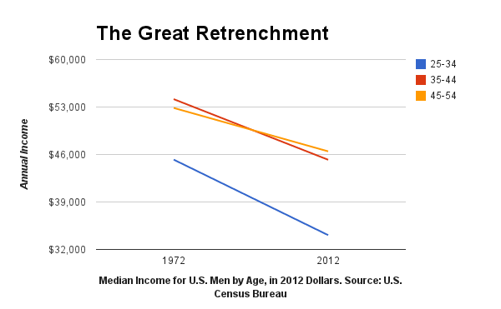
Census data to demonstrate that the median income for men (adjusted for inflation) has declined consistently over the past 30 years.

Slide 4
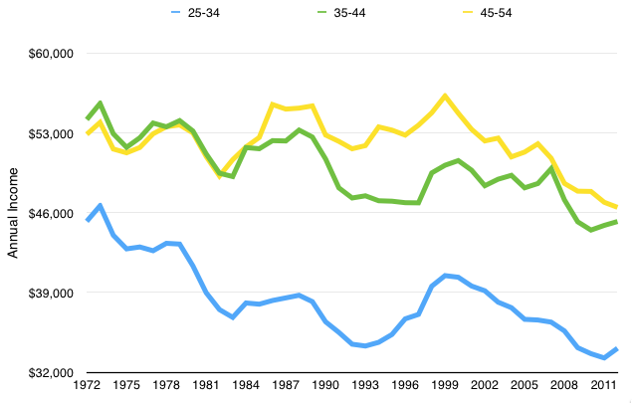
In original figure are used only two points to chart each category
What if we would use all the data points available for presented period?

Slide 5
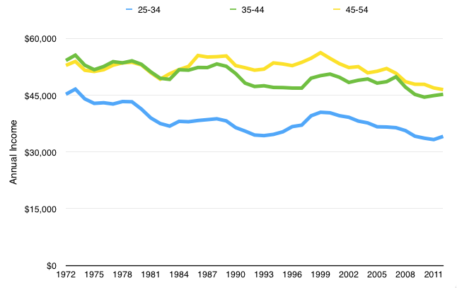
Y axis in original figure does not start at 0, what if we will fix it?

Slide 6
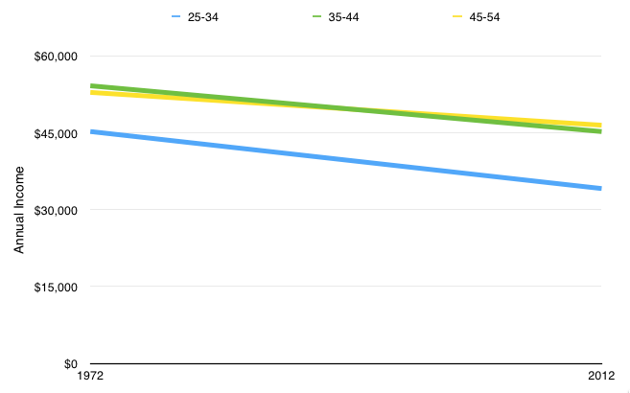
Even if we will use original method with two datapoints in chart, decline does not seem to be so dramatical

Slide 7
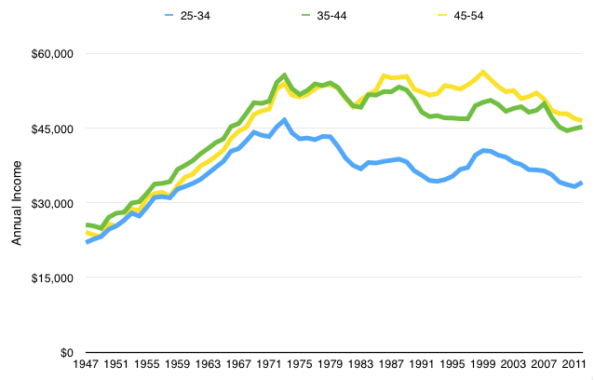
What if both original datapoints in chart were extremes?
What would happen if we would analyse longer period?

Slide 8
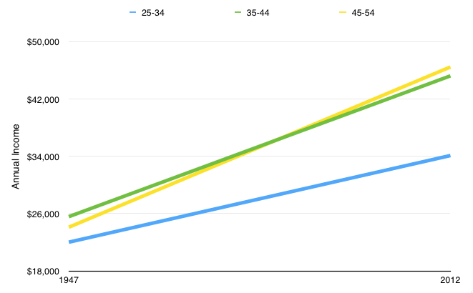
If we would return to original method with two datapoints:

Slide 9
Charts and graphs
Frequency distributions are good ways to present the essential aspects of data collections in concise and understable terms
Pictures are always more effective in displaying large data collections

Slide 10
Histogram
Frequently used to graphically present interval and ratio data
Is often used for interval and ratio data
The adjacent bars indicate that a numerical range is being summarized by indicating the frequencies in arbitrarily chosen classes

Slide 11
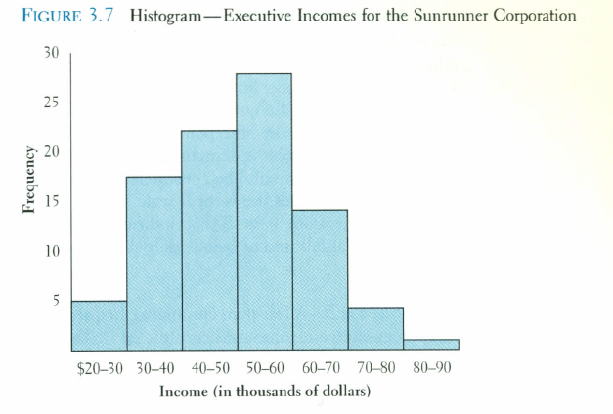

Slide 12
Frequency polygon
Another common method for graphically presenting interval and ratio data
To construct a frequency polygon mark the frequencies on the vertical axis and the values of the variable being measured on the horizontal axis, as with the histogram.
If the purpose of presenting is comparation with other distributions, the frequency polygon provides a good summary of the data

Slide 13
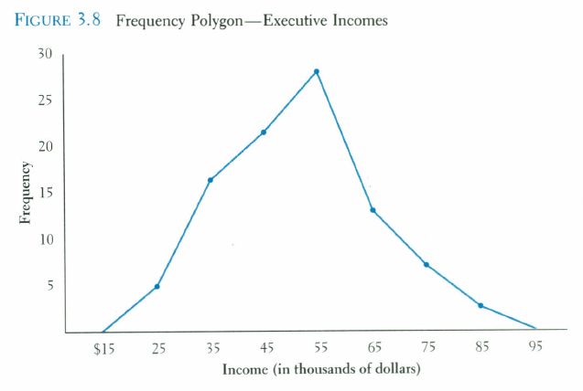

Slide 14
Ogive
A graph of a cumulative frequency distribution
Ogive is used when one wants to determine how many observations lie above or below a certain value in a distribution.
First cumulative frequency distribution is constructed
Cumulative frequencies are plotted at the upper class limit of each category
Ogive can also be constructed for a relative frequency distribution.

Slide 15
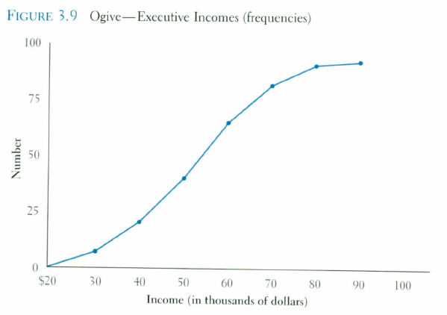

Slide 16
Pie Chart
The pie chart is an effective way of displaying the percentage breakdown of data by category.
Useful if the relative sizes of the data components are to be emphasized
Pie charts also provide an effective way of presenting ratio- or interval-scaled data after they have been organized into categories

Slide 17
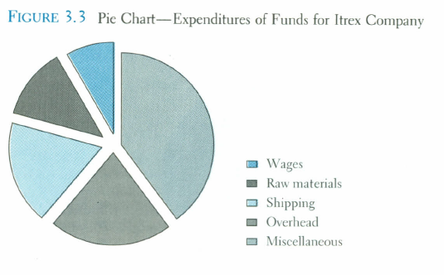
Pie Chart

Slide 18
Bar chart
Another common method for graphically presenting nominal and ordinal scaled data
One bar is used to represent the frequency for each category
The bars are usually positioned vertically with their bases located on the horizontal axis of the graph
The bars are separated, and this is why such a graph is frequently used for nominal and ordinal data – the separation emphasize the plotting of frequencies for distinct categories

Slide 19
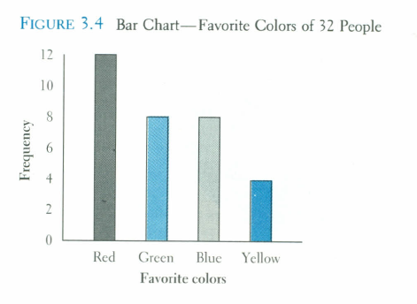

Slide 20
Time Series Graph
The time series graph is a graph of data that have been measured over time.
The horizontal axis of this graph represents time periods and the vertical axis shows the numerical values corresponding to these time periods

Slide 21
