Slide 1
MACROECONOMIC MODEL DEVELOPMENT
Prepared by: Martin Gulka

Slide 2
TASK
Our goal is to develop a predictive model („Macroeconomic model“) based on the macroeconomic factors for estimating future default rates

Slide 3
MODEL PRINCIPLE
Once the model is estimated, it can predict default rates based on macroeconomic factors
The predictions of the model depends on another predictive model (i.e., predictions of macroeconomic factors)
Predictions of the macroeconomic factors for three different scenarios (worst, baseline, best) are delivered by third party*
*e.g., Oxford Economics

Slide 4
MODEL USE
Provisions calculation – the bank should include a „forward-looking element“ into the calculation of provisions
Stress testing – the bank is required to stress risk parameters to calculate capital requirement impacts under different scenarios of economic development

Slide 5
MODEL DEVELOPMENT PROCESS
Data preparation
Preliminary data analyses
  Data quality controls
  Variables transformation
  Stationarity analysis
  Creation of lagged variables
Univariate analysis
Multivariate analysis (correlation analysis and looking for the best model)
Model tests (Multicollinearity, Heteroskedasticity, Autocorrelation, Normality tests)
Predictions calculation

Slide 6
DEPENDENT AND INDEPENDENT VARIABLES
Dependent variable – observed default rates for retail segment (not real values due to data anonymization)
Independent variables – macroeconomic factors related to Slovak economy (real values obtained from publicly available data sources)

Slide 7
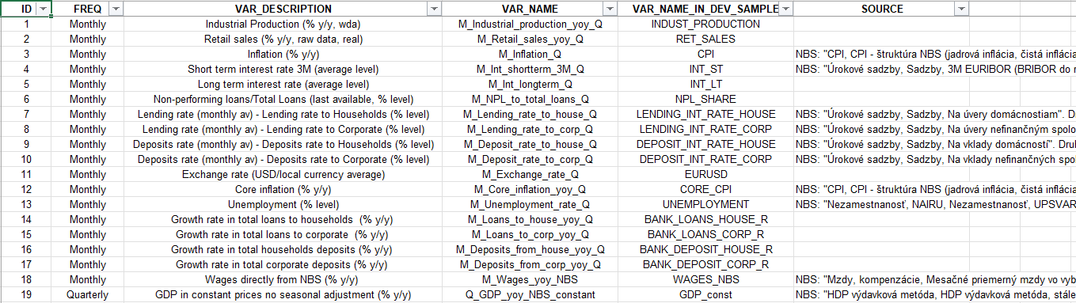
MACROECONOMIC FACTORS

Slide 8
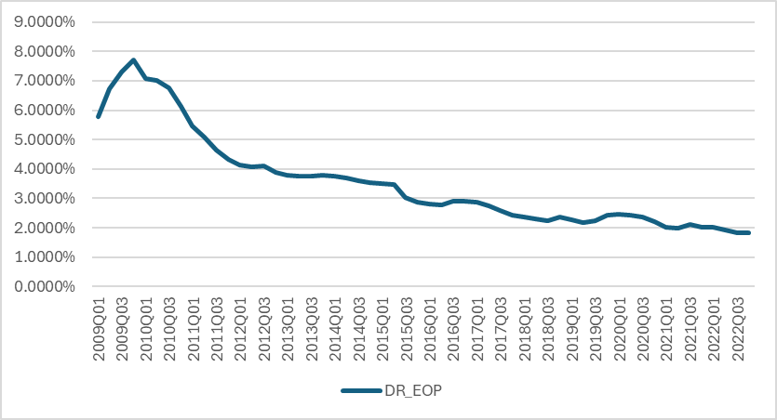
DEPENDENT VARIABLE
What is default rate (DR) and how it is calculated?
Is it needed to do something with our dependent variable?

Slide 9
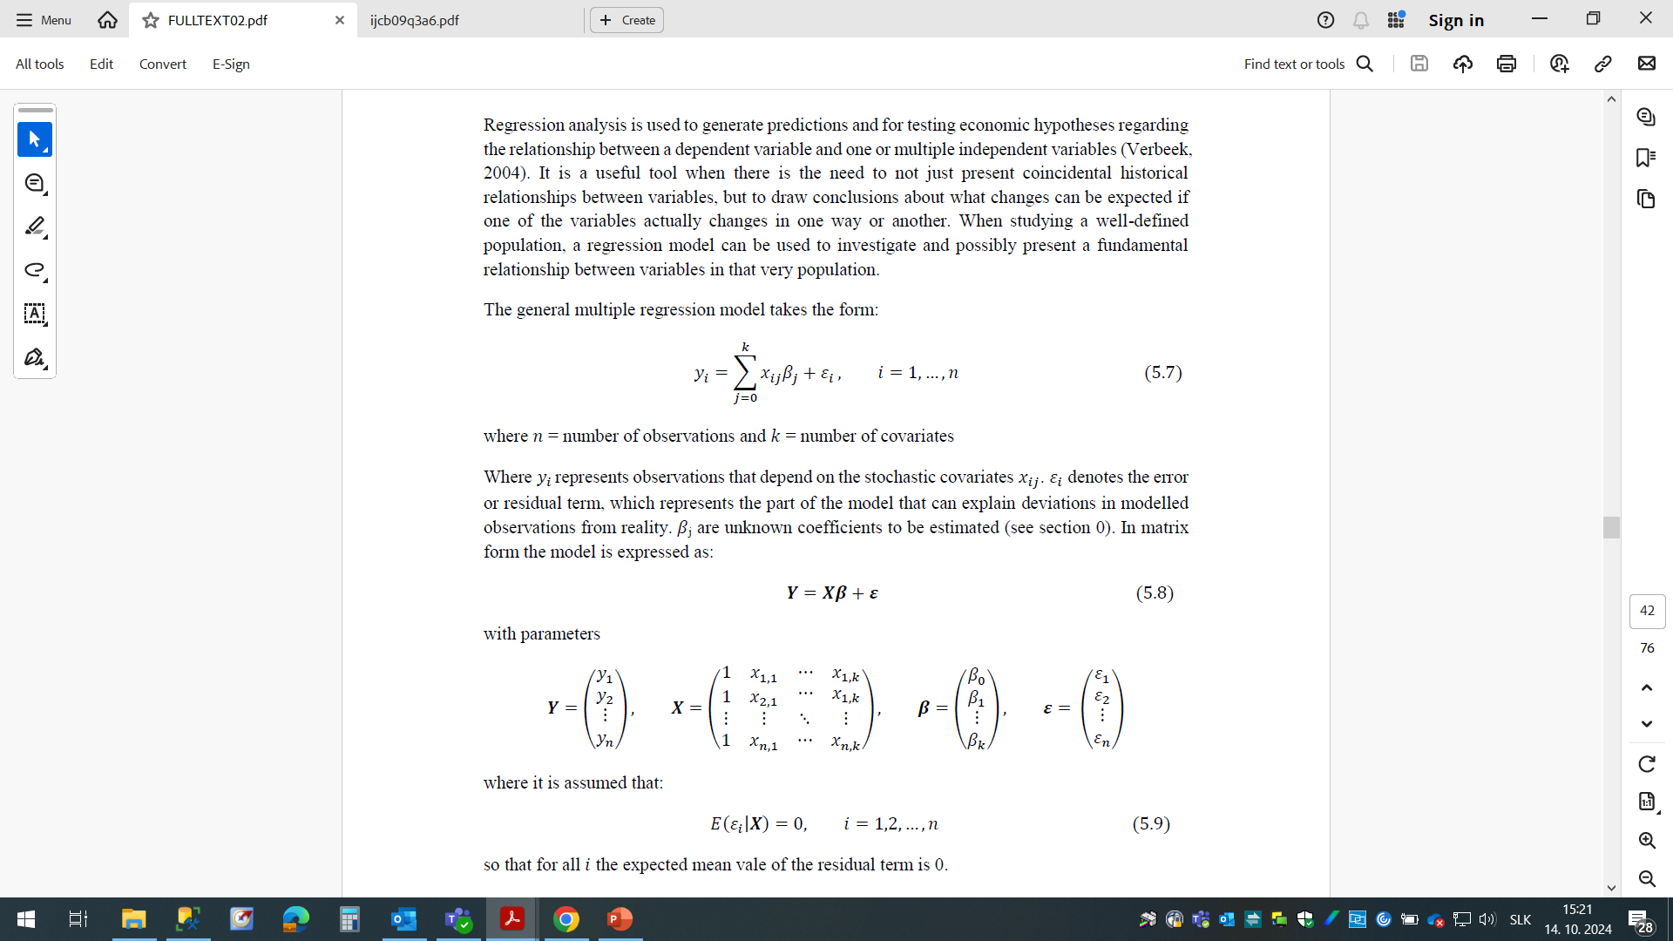
MODEL SPECIFICATION
How to define a correct relation between DR a macroeconomic factors?
Macroeconomic factors as of „ADT“ are joined to default rate observed between „ADT-1Y“ and „ADT“ (i.e., all quantities are from the same time span)
To explain the relationship, the linear regression is used:
Disclaimer: This is not the only possible solution. There are a plenty of other methods (more sophisticated) that could be used instead.

Slide 10
DATA QUALITY CONTROLS + TRANSFORMATIONS
Since the range of data is not extensive, the data quality controls are quite simple
Wherever possible, the (natural) logarithmic transformation is generally recommended*:
  The log transformation cannot be applied to the variables expressed as growth rates
  The transformation of the variables should take into account what could be their future behavior (e.g., interest rates can be negative and log transformation could not be appropriate)
* The advantages are removing non-linearity, log differences are approximations of the percentual differences, scale independence, ...

Slide 11
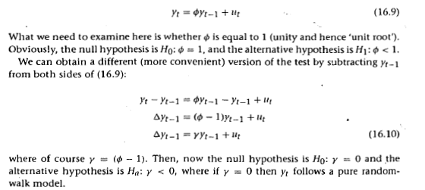
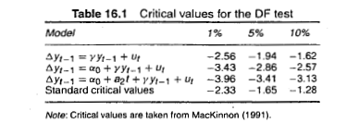
STATIONARITY OF TIME SERIES
Is the model specification DR = b1*Unemployment_rate correct?
Both time series are non-stationary – is this a spurious regression?
Stationarity in the model’s variables (both dependent and independent) is a necessary condition for least squares to produce consistent estimators
The Dickey-Fuller test is used to test null hypothesis that a time series process has a unit root
In case of non-stationarity, we perform a first-difference transformation
*Unit root process is also referred to as the random walk process.
*

Slide 12
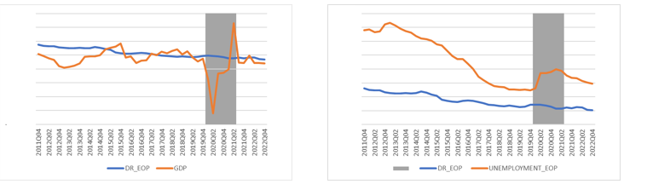
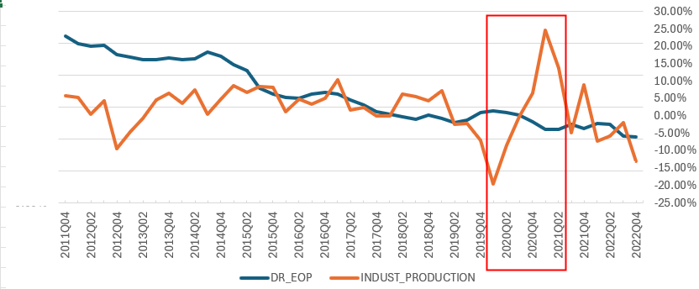
UNIVARIATE ANALYSIS
Before the Univariate analysis, we have to:
  create lagged variables (max. 4 lags)
  identify variables impacted by COVID-19 (misalignment between macro factor and DR)
The relationship between macroeconomic factors impacted by COVID-19 (GDP, Unemployment rate, Industrial production) and default rate is performed only until December 2019

Slide 13
UNIVARIATE ANALYSIS – VARIABLES REMOVAL
Expected sign: the sign of the univariate regression coefficient should be consistent with prior expectations based on economic theory. The variables, whose correlation with the dependent variable does not match expectations, is disregarded from further model development;
Statistical significance: univariate regression coefficient should be statistically significant. A threshold of 15% is employed and all variables whose coefficient is not statistically significant are disregarded from further model development;
Missing rate: variables with missing rate exceeding a predetermined threshold should be disregarded from further model development. A threshold is set at 10%;
Informativeness: variables, for which univariate regression delivers higher R2 should be preferred. A threshold of 5% is employed as a predetermined informativeness level.

Slide 14
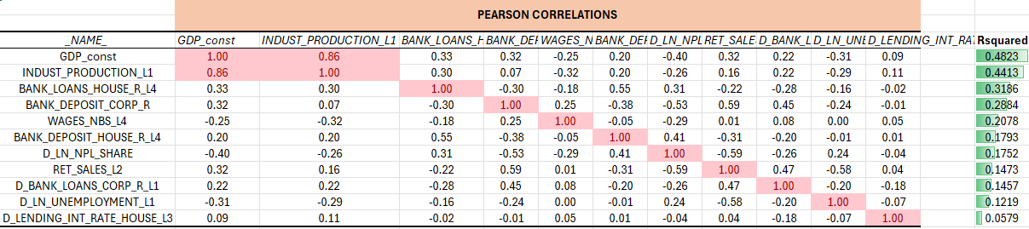
ADDITIONAL REDUCTION OF DIMENSION
Even after automatic removals performed during Univariate analysis, we still possess a high number of potentially explanatory variables
Choosing the strongest variable from its lagged alternatives could additionally reduce the variables dimension.
The correlation matrix can help us further reduce the number of variables:

Slide 15
HOW TO FIND THE BEST MODEL?
Stepwise selection
        not sure how to deal with covid dummies
Manual selection/expert-based decisions
To run all possible variables combinations
    This is the most accurate way, however technically the most difficult
    The number of possible combinations is express as 2^k (e.g., 10 variables leads to 1024 estimated models)

Slide 16
TESTING OF ASSUMPTIONS OF CLRM*
Multicollinearity – no relationships among the explanatory variables
    Variance inflation Factor (VIF)
Homoskedasticity – all disturbance terms have the same variance for all “t”
        Breusch-Pagan test
        White’s test
Serial independence (Autocorrelation) – all disturbance terms are not correlated with one another
        Durbin-Watson test
        Breusch-Godfrey test
Normality of residuals – the disturbance are assumed to be normally distributed
        Shapiro-Wilk test
        Kolmogorov-Smirnov test
* Classical Linear Regression Model (CLRM)

Slide 17
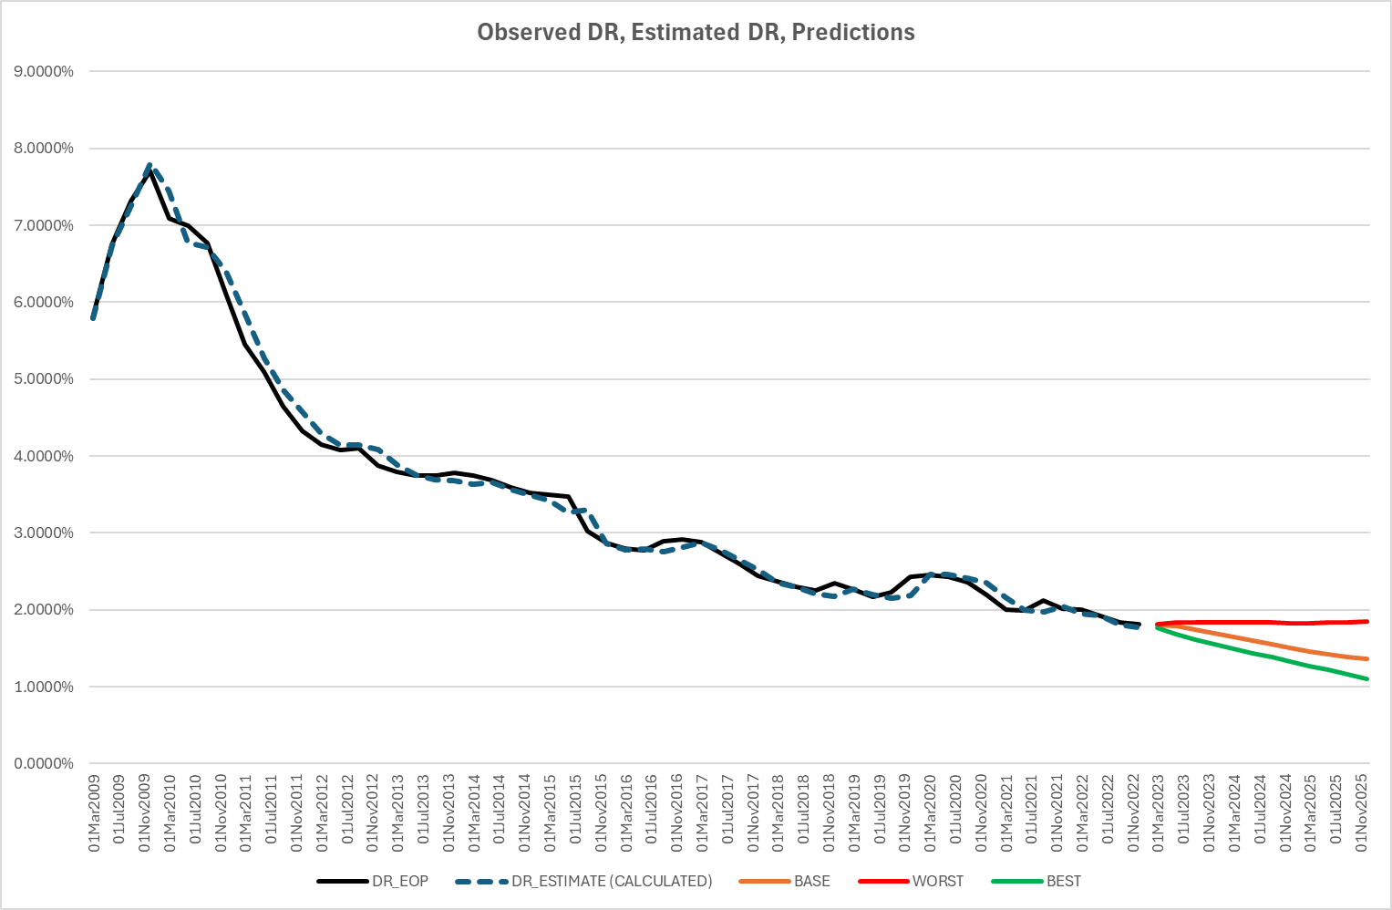
PREDICTIONS OF THE MODEL FOR THREE SCENARIOS (BASELINE, WORST, BEST)
$$∆\ln\left(\frac{p}{\left(1−p\right)}\right)=−0.731040∗GDP_{CONS}+0.706677∗GDP_{COVID}−0.146012∗BANK_DEPOSIT_CORP_L1−0.436622∗∆BANK_LOANS_CORP_R_L1$$

