Slide 1


Population development in V4 countries doc. Ing. Zuzana Poláková, PhD.
Ing. Jozef Palkovič, PhD.
Ing. Eva Matejková, PhD.
Ing. Miriam Pietriková, PhD.
„Are countries of the Visegrad Group (V4) ready for the consequences of population aging?“
Friday, May 21, 2021

Slide 2

Introduction of our research team
Slovak University of Agriculture in Nitra, Faculty of Economics and Management
Department of Statistics and Operations Research
Department guarentees the study programme Quantitative methods in Economy
Reasearch team is focused on the research in the field of demographics, sustainability, food security and market research

Slide 3
Demographic development in V4 countries

Slide 4
Demographic development in V4 countries
-Analysis of V4 countries includes period of years since 1950
Data for earlier period was not available
Analysis was based on data from National statistical offices of V4 countries, these data are different from data provided by Eurostat
- There is problem with missing data about migration in Hungary
Development was influenced by natality, mortality and migration
Migration has significant impact especially in last 6 years

Slide 5
Population – mid year population

Slide 7
Similar development (increase) in all V4 countries until 1980
After 1980 increase in CR and SR and decrease in Hu and PL
CR – continuous increase of population since 1950 with negative change in 1970, 1980, 1990, 2001 a 2010
Hu – growth until 1980 then continuous decrease, hight mortality compared to previous period
PL – high natality, but also few emigration waves (especially after entering EU in May 2004), maximum population in 2011, decrease 1980-2005 then continued population growth
SR – continuous increase since 1950 with negative changes in 1960, 1970, 1990, 2000 a 2010

Slide 8
Population change since 1950
year | CR | Hungary | Poland | SR
1 950 | 8 925 | 9 341 | 25 035 | 3 463
1 970 | 9 805 | 10 338 | 32 658 | 4 528
1 990 | 10 363 | 10 374 | 38 073 | 5 298
2 010 | 10 517 | 10 014 | 38 530 | 5 431
2 019 | 10 669 | 9 771 | 38 383 | 5 454
Index 2019/1950 | 119.5 | 104.6 | 153.3 | 157.5

Slide 9
Natality

Slide 10
Natality

Slide 11

Natality is related to number of women in reproductive age
1950-1960 decline of natality in all V4 countries
After 1989 all V4 countries changed from countries with the highest natality,to countries with the smallest natality in Europe
Crisis in 2008-2009 stoped increasing tendency of natality in V4 countries
At the end of analyzed period cca since year 2000 natality in V4 countries converged to similar values

Slide 12
Czechoslovakia – 1957 – law allowed abortion – stagnation of natality
Mid 60-ty, increase of natality as the effect of promised law about extended length of maternity leave, later it did not passed which caused decreasing trend in natality until 1968
After 1993
CR – next period, slight increase in natality, as the consequence of good age structure and propopulation policy measures
Hu – 1954 cancelation of tax childless, social changes, abolition of the abortion ban, lack of young people production age, emigration (in 1956 people's uprising) led to a decrease in birth rates
- 1960 to 1973 more abortions than live births led to decrease in population growth
PL – increase of natality after war continued for several decades
decrease of natality in 1989 due to political changes

Slide 13
Natality
Country | Count | Average | Median | Standard deviation | Minimum | Maximum | Range
Czech Republic | 70 | 13,4917 | 13,26 | 3,4189 | 8,73 | 21,47 | 12,74
Hungary | 70 | 13,0481 | 12,25 | 3,66971 | 8,83 | 23,0 | 14,17
Poland | 70 | 16,4714 | 16,3 | 6,33214 | 9,2 | 31,0 | 21,8
Slovak Republic | 70 | 16,7174 | 17,37 | 5,81168 | 9,49 | 29,33 | 19,84
Total | 280 | 14,9322 | 13,86 | 5,22454 | 8,73 | 31,0 | 22,27

Slide 14
Mortality

Slide 15
Mortality

Slide 16
Until 1950 high as the effect of the war, followed by decrease in mortality in post war period,
Positive development was the consequence of reduction of infant mortality due to improved health care
Successful treatment of infectious diseases, and tuberculosis
Mandatory vaccination of children
Controll of the epidemiological situation
At the begining of 60-ties, historically lowest values in all V4 countries
after 1989 improved healthcare, opened market, exchange of experiences, access to new medical treatments, wide availability of medicaments led to decrease in mortality

Slide 17
Mortality
Country | Count | Average | Median | Standard deviation | Minimum | Maximum | Range
Czech Republic | 70 | 11,2176 | 10,805 | 1,00655 | 9,72 | 13,12 | 3,4
Hungary | 70 | 12,5006 | 13,005 | 1,36294 | 9,6 | 14,5 | 4,9
Poland | 70 | 9,47286 | 9,7 | 1,04033 | 7,4 | 12,4 | 5,0
Slovak Republic | 70 | 9,53 | 9,705 | 0,786111 | 7,49 | 11,54 | 4,05
Total | 280 | 10,6802 | 10,2 | 1,65287 | 7,4 | 14,5 | 7,1

Slide 18
Natural Increase

Slide 19
Natural Increase

Slide 20
Natural Increase
-since 1950 similar development in all V4 countries, mostly negative
Gross mortality rate grew faster
70- ties positive change, higher natality increased faster than mortality,
Since 1980, development in V4 converge to similar level,
Since 1990 negative values in all V4 countries with several few positive swings

Slide 21
Natural Increase
Country | Count | Average | Median | Standard deviation | Minimum | Maximum | Range
Czech Republic | 70 | 2,18557 | 1,01 | 3,15707 | -2,17 | 9,54 | 11,71
Hungary | 70 | 0,550286 | -1,6 | 4,61568 | -4,7 | 12,0 | 16,7
Poland | 70 | 6,99857 | 8,05 | 6,49755 | -0,9 | 19,5 | 20,4
Slovak Republic | 70 | 7,05329 | 7,465 | 5,87719 | -0,16 | 17,97 | 18,13
Total | 280 | 4,19693 | 2,75 | 5,92327 | -4,7 | 19,5 | 24,2

Slide 22
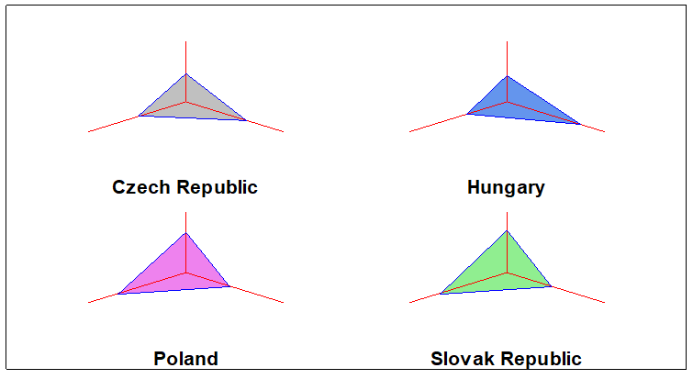
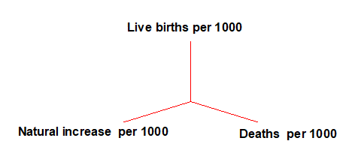
Indicators - Natural Increase – Sun ray plot

Slide 23
Migration

Slide 24
Migration
Differences between V4 countries, percentage of nett migration in V4 countries is smaller than 1%
1% increase of GDP per capita in destination country, compared to country of origin increase migration flows by cca 1,7% (in bilateral way)
Current problem in V4 countries is loss of qualified workforce withouth replacement
- Replacement of workforce from eastern countries (Russia, Ukraine)
Poland is typical emigration country, cca 2,5 mil. of people abroad
Emigration from Poland in 2004 was among the highest in the world, (in absolute values was higher only Mexico and in relative values was higher only Romania)

Slide 25
Migration
CR – new destination country for migration, 4,7% of population are from abroad (from which 22,5% come from Ukraine, 21,7% Slovak Republice and 7% from Rusia)
Increased number of women and children in case of emigration, (they are no longer just breadwinners, but whole families) - characteristic of the period after 2004 - small migration
SR – the lowest ratio of immigrants to population
Since 90ties increased imigration- foreign investments, since 2005 headquaters of few large companies were moved to Slovakia
Hu – missing long-term data, small migration rate
Natural increase is continuously substituted by migration increase of population

Slide 26
Migration
 | Migration balance
 | CR | SR | PL | HU
Mean | 1.07 | -0.57 | -0.57 | 1.60
Median | 0.62 | -0.59 | -0.45 | 1.69
Standard Deviation | 1.51 | 1.28 | 0.41 | 0.68
Coefficient of variation | 141.52 | 223.74 | 71.47 | 42.55
Kurtosis | 8.80 | 3.33 | 3.26 | 3.10
Skewness | 2.63 | -1.42 | -1.13 | 0.33
Range | 8.97 | 7.03 | 2.32 | 3.56
Minimum | -0.84 | -5.72 | -2.11 | -0.12
Maximum | 8.13 | 1.31 | 0.21 | 3.43

Slide 27
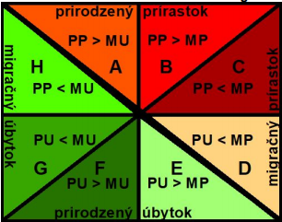
Webb diagram
Migration Dencrease
Migration Increase
Natural Increase
Natural Decrease

Slide 28
Webb diagram

Slide 29
Marriage

Slide 30
Divorce

Slide 31
Both marriage and divorce rate in V4 converge together last few years
Higher differences were recorded in divorce rate
Marriage rate continously decreasing (increase in 70-ties, and at the end of analyzed period)
in 2010 started significant increase in marriage rate in Hu
Similar rate of increase in divorce rate in V4 1950- 1986, then significant differences
In SR continued increase until 2008,

Slide 32
 | Marriage rate |  |  |  | Divorce rate
 | CR | SR | PL | HU | CR | SR | PL | HU
Mean | 7,27 | 7,11 | 7,31 | 7,08 | 2,33 | 1,27 | 1,10 | 2,17
Median | 7,62 | 7,34 | 7,10 | 7,10 | 2,53 | 1,35 | 1,10 | 2,30
Standard Deviation | 1,95 | 1,84 | 1,89 | 2,39 | 0,70 | 0,63 | 0,42 | 0,44
Coefficient of variation | 27% | 26% | 26% | 34% | 30% | 50% | 38% | 20%
Kurtosis | -1,16 | -0,83 | -1,09 | -1,36 | -1,21 | -1,27 | -0,95 | 0,19
Skewness | 0,01 | 0,30 | 0,31 | 0,08 | -0,53 | -0,10 | 0,00 | -0,86
Range | 7,02 | 6,86 | 7,20 | 8,15 | 2,17 | 2,18 | 1,60 | 1,90
Minimum | 4,14 | 4,42 | 4,70 | 3,55 | 1,07 | 0,18 | 0,30 | 0,90
Maximum | 11,16 | 11,28 | 11,90 | 11,70 | 3,24 | 2,36 | 1,90 | 2,80

Slide 33
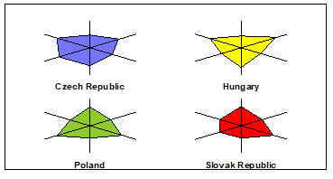
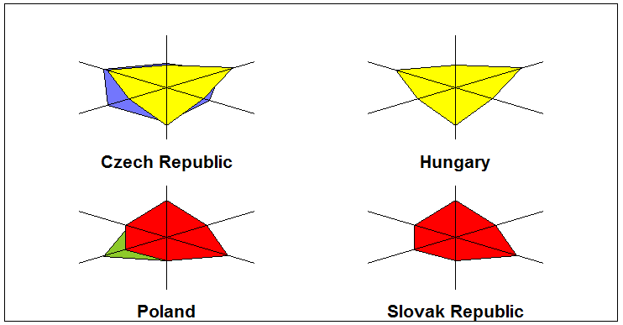
Comparation –resume – sun ray plot

Slide 34

Thank you for your attention

