Slide 1
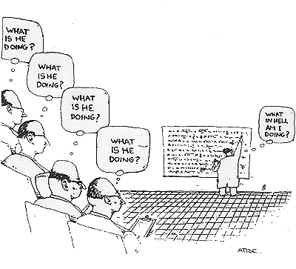
Hypothesis Testing with t Tests
Arlo Clark-Foos

Slide 2
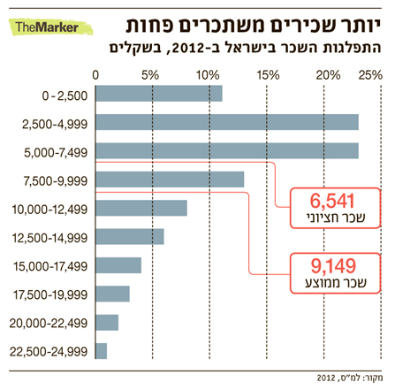
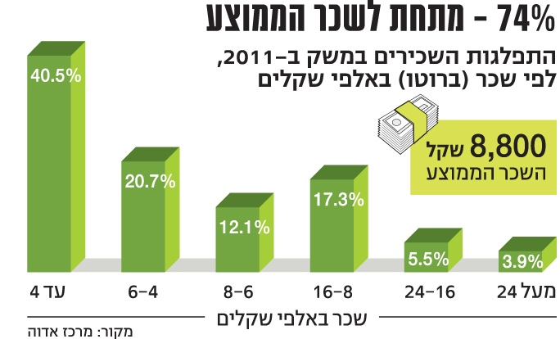
Many statistical tests assume values are normally distributed, but this is not always the case
Intel – Advanced Analytics

Slide 3
Distribution measures 1: Mean, Median, Mode
Mode (שכיח)
Good for nominal variables
Quick and easy
Median (חציון)
Robust central tendency statistics
Less sensitive to outliers and extreme values
Good for “bad” distributions
Mean (ממוצע)
Most commonly used statistic for central tendency
Generally preferred except for “bad” distribution
Based on all data in the distribution
Used for inference as well as description
best estimator of the parameter
Intel – Advanced Analytics

Slide 4
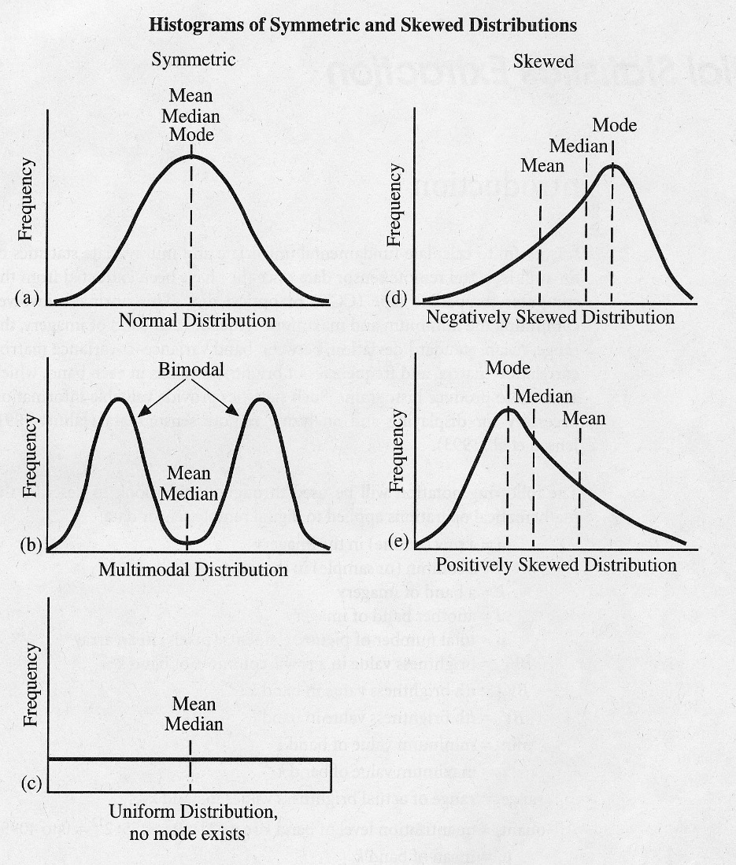
Distribution measures 1: Mean, Median, Mode
Intel – Advanced Analytics

Slide 5
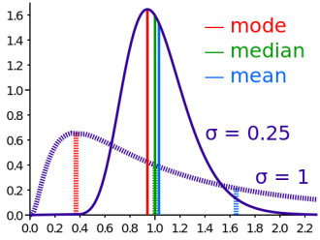
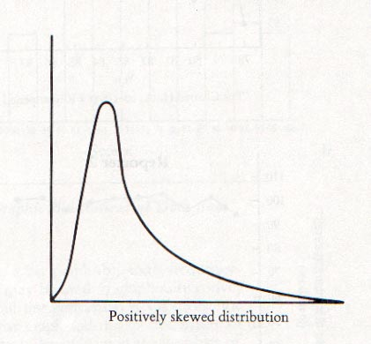
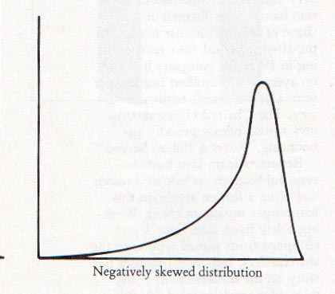
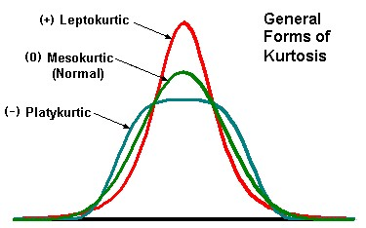
Distribution measures 2: Skewness & kurtosis
Skewness (tails)
Kurtosis (shoulders, heavy tail)
Skewness is a measure of the asymmetry of the probability distribution
$α_{3}= \frac{E\left[{\left(X−μ\right)}^{3}\right]}{σ^{3}}= \frac{μ_{3}}{σ_{3}}$
Right skew - $α_{3}>0$
Left skew - $α_{3}<0$
Symmetric - $α_{3}=0$
Kurtosis is the degree of peakedness of a distribution relative to a normal distribution
$α_{4}= \frac{E\left[{\left(X−μ\right)}^{4}\right]}{σ^{4}}−3= \frac{μ_{4}}{σ_{4}}−3$
A normal distribution is a mesokurtic distribution
A pure leptokurtic distribution has a higher peak than the normal distribution and has heavier tails.
A pure platykurtic distribution has a lower peak than a normal distribution and lighter tails.
Excess Kurtosis
Intel – Advanced Analytics

Slide 6
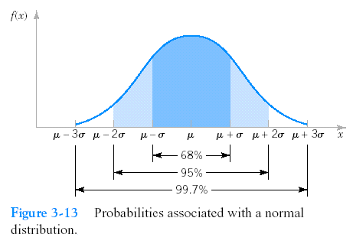
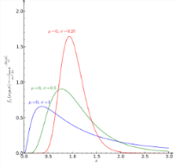
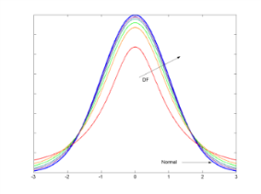
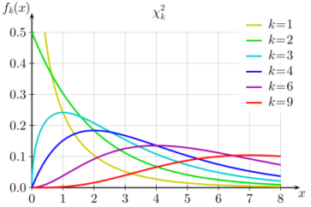
Common continuous distributions
Normal (Gaussian) Distribution
$X\sim N\left(μ,σ^{2}\right)$
$f\left(x\right)=\frac{1}{\sqrt{2πσ^{2}}}\exp\left\{−\frac{{\left(x−μ\right)}^{2}}{2σ^{2}}\right\}$
Z-score
$z= \frac{x−μ}{σ}$
The distance of
a value from the mean, measured in standard
deviations
Log-normal Distribution
$X\sim \ln{N\left(μ,σ^{2}\right)}, x=e^{z}, z\sim N\left(μ,σ^{2}\right)$
$f\left(x;μ, σ\right)=\frac{1}{x\sqrt{2πσ^{2}}}\exp\left\{−\frac{{\left(\ln{x}−μ\right)}^{2}}{2σ^{2}}\right\}$
Used to model a variable which is a product of positive i.i.d vars,
A compound return from a sequence of many trades
Measures of size of living tissue
Student’s t-Distribution (Gosset 1908)
Sampling distrib. (i.i.d measures) of
$t=\frac{\overline{x}−μ}{s/{\sqrt{n}}}$
Approaches the Gaussian distrib. when
$n>30$ or $s= σ$
Used for
Test the diff. between two sample means
Inference when $\left(μ,σ^{2}\right)$ are unknown
The $χ^{2}$Distribution with k D.F
$X\sim χ_{k}^{2}, χ_{k}^{2}=\sum_{i=1}^{k}{z_{i}^{2}}, Z\sim N\left(0,1\right)$
$f\left(x;k\right)=\frac{x^{\frac{k}{2}−1} e^{−\frac{x}{2}}}{2^{k}Γ\left(\frac{k}{2}\right)}$
Heavily used in statistics
Estimating variance
Goodness-of-fit test
Intel – Advanced Analytics

Slide 7
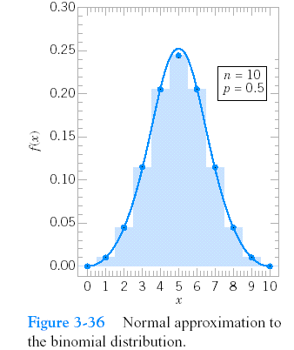
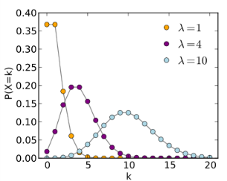
Common discrete distributions
Bernoulli Distribution
Bernoulli trial
A trial with only two possible outcomes
Bernoulli Distribution
Represents success/failure (e.g. accuracy of prediction)
$X∈\left[0,1\right]\sim Bernoulli(p)$
$f\left(x;p\right)=p^{x}{\left(1−p\right)}^{x}$
( $\operatorname{Pr}\left[X=1\right]=p$ )
Binomial distribution
Number of success in n independent trials
$K\sim B\left(p,n\right), K=\sum_{i=1}^{n}{z_{i}}, Z\sim Bernoulli\left(p\right)$
$f\left(k;n,p\right)= \left({n \atop k}\right)p^{k}{\left(1−p\right)}^{n−k}$
If n is large, then:
$Z\sim N\left(np,np\left(1−p\right)\right)$
is a good approximation
for $K\sim B\left(p,n\right)$
Multinomial Distribution
Categorical Distribution
A trial with k possible outcomes
$f\left(x_{1},…,x_{k};p_{1},…,p_{k}\right)=\prod_{i=1}^{k}{p_{i}^{x_{i}}}$
where $x_{i}∈\{0,1\}$and $\sum_{i=1}^{k}{p_{i}}=1, p_{i}∈[0,1]$
Multinomial Distribution
Number of occurrences of k categories in n independent trials
$f\left(n_{1},…,n_{k};n,p_{1},…,p_{k}\right)=\frac{n!}{n_{1}!⋯n_{k}! }p_{1}^{n_{1}}⋯p_{k}^{n_{k}}$
where $n_{i}∈ℕ,\sum_{i=1}^{k}{n_{i}=n}$
Poisson Distribution
Number of events occurring within a fixed time interval (or space)
$λ$ , the shape param., indicates the average number of events in the given time interval
$K\sim Pois\left(λ\right), K∈ ℕ, λ>0$
$f\left(k;λ\right)=\frac{λ^{k}}{k!}{e^{−λ}}$
If $λ$ is large, then $Z\sim N\left(λ,λ\right)$ is a good approximation for $K\sim Pois\left(λ\right)$
Intel – Advanced Analytics

Slide 8
Comparing distributions
Examples of commonly used distribution tests
Q-Q plot:
Compare distributions based on quantiles
Kolmogorov–Smirnov (KS) test
Compare distributions based on the cumulative density function
Shapiro's test for normality
Check if data is normally distributed
Two derivatives of KS that also compare 2 distributions
Cramér–von Mises criterion
Anderson–Darling test
Intel – Advanced Analytics

Slide 9
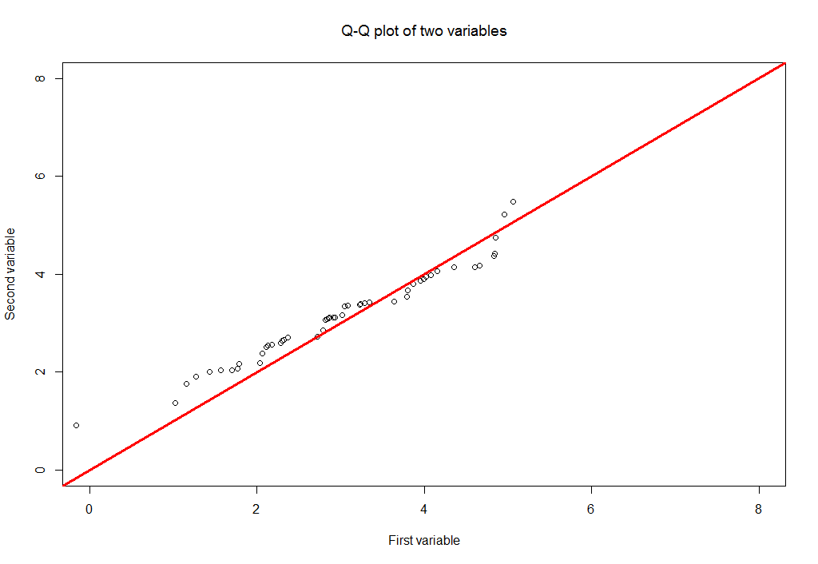
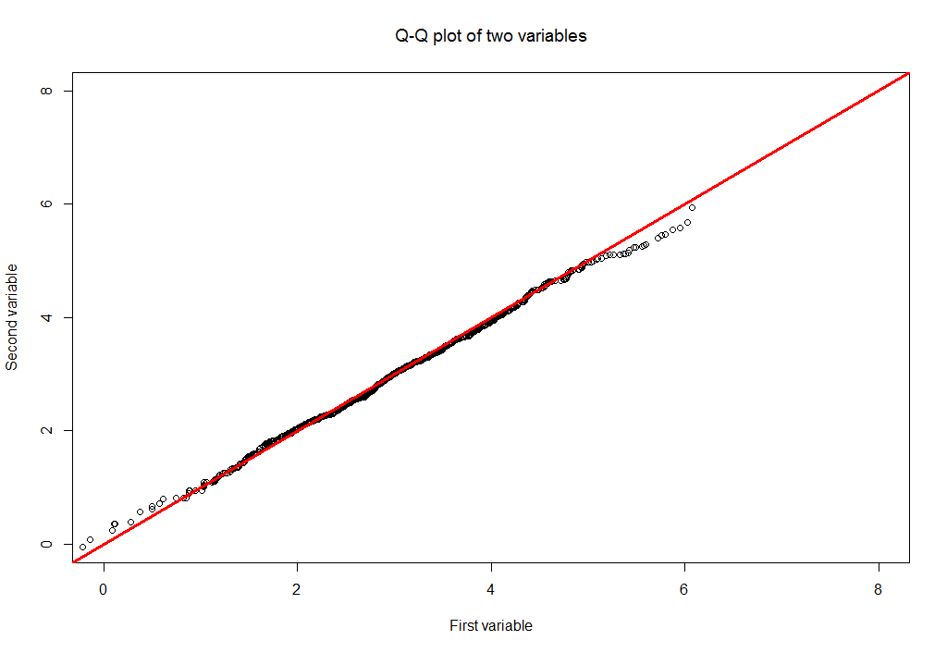
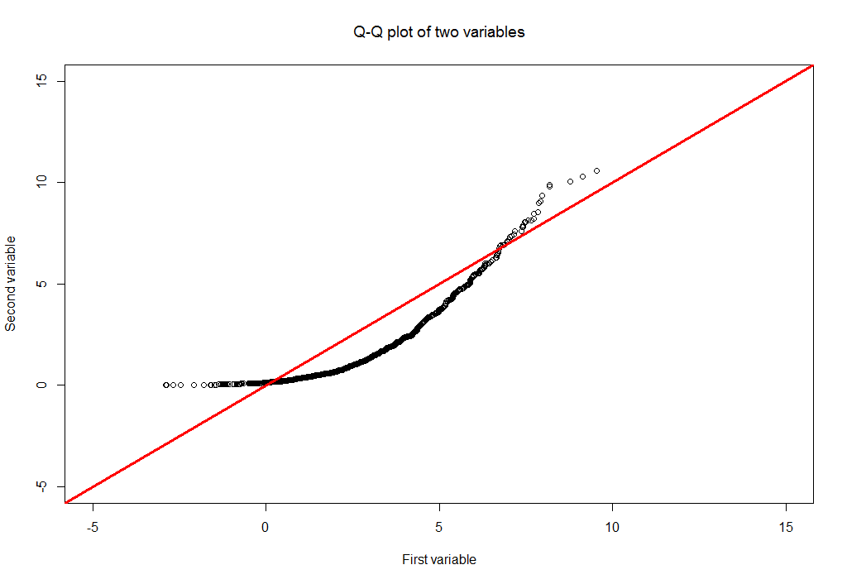
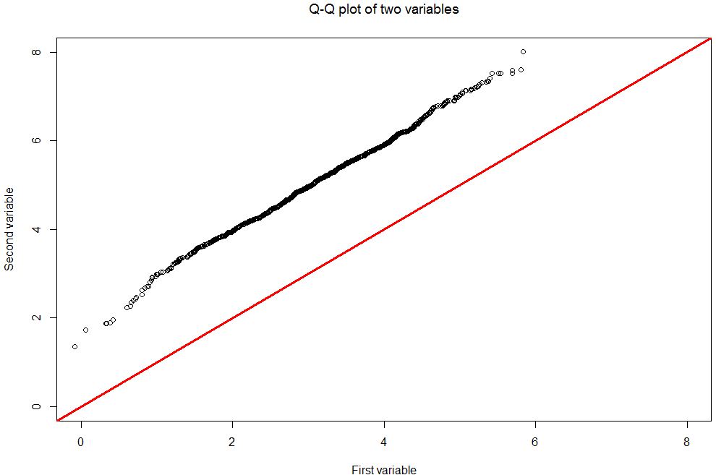
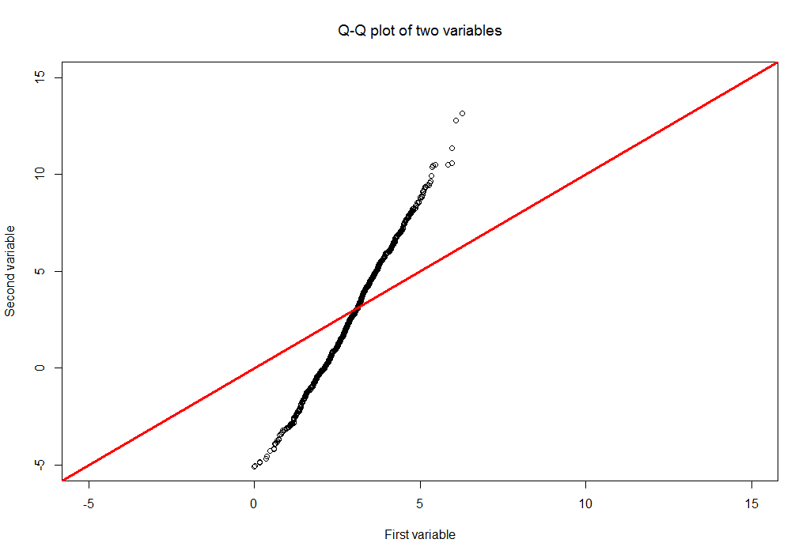
Q-Q plot
A plot of the quantiles of the first data set against the quantiles of the second data set
Data sets sizes don’t have to be equal
The greater the departure from the 45 deg. reference line, the greater the evidence for the conclusion that the two data sets have come from populations with different distributions
Intel – Advanced Analytics

Slide 10
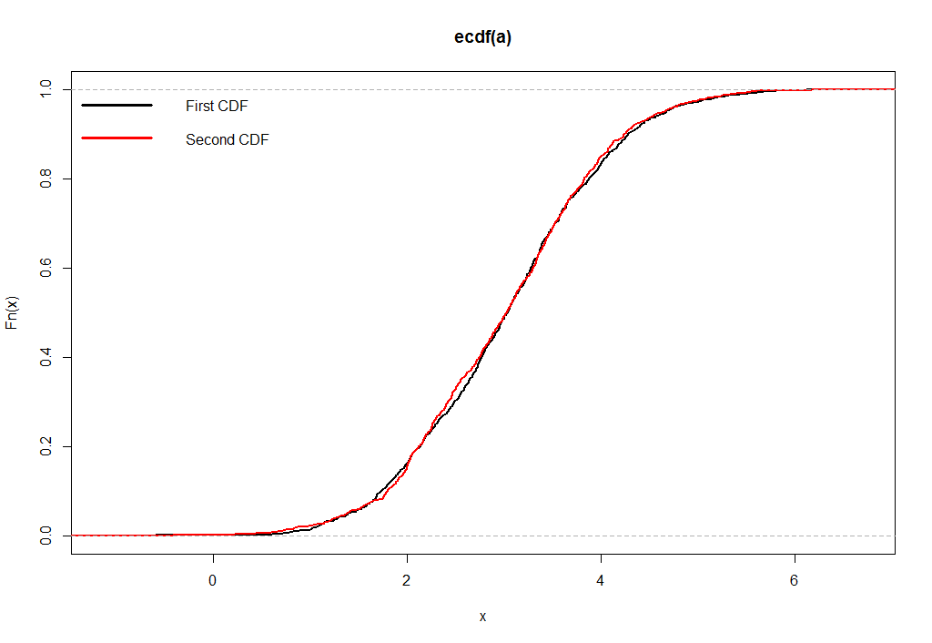
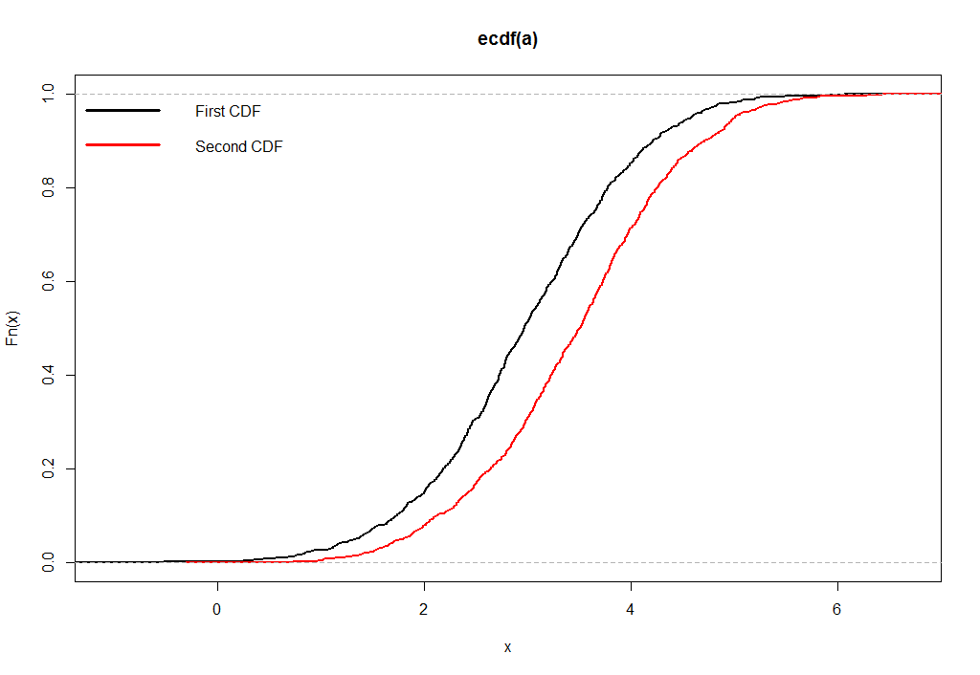
Kolmogorov–Smirnov test
A non-parametric test for the equality of continuous, one-dimensional probability distribution
Can be applied to test a dataset distribution against a known distribution OR against another dataset distribution
The K-S statistics is defined as:
H₀: | The data follow a specified distribution
H₁: | The data do not follow the specified distribution
Intel – Advanced Analytics

Slide 11
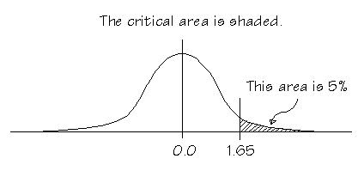
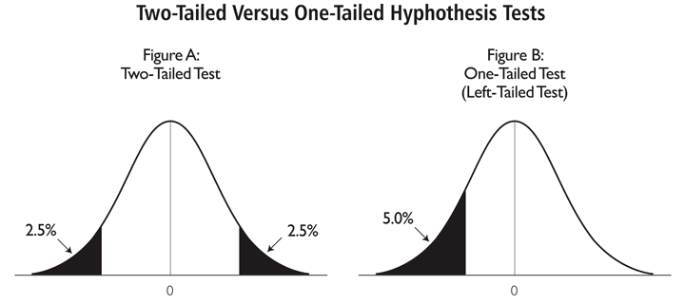
What have we done so far?
Hypothesis Testing & Inferential Statistics
alpha levels, cut-offs, p-value
One-tailed vs. Two-tailed tests
Goal: Estimate likelihood of obtaining sample mean given some known population parameters (μ and σ)
What if we didn’t know all of the population parameters?

Slide 12
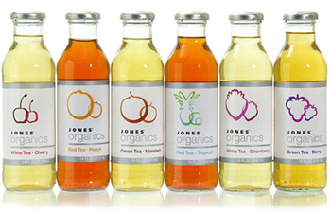
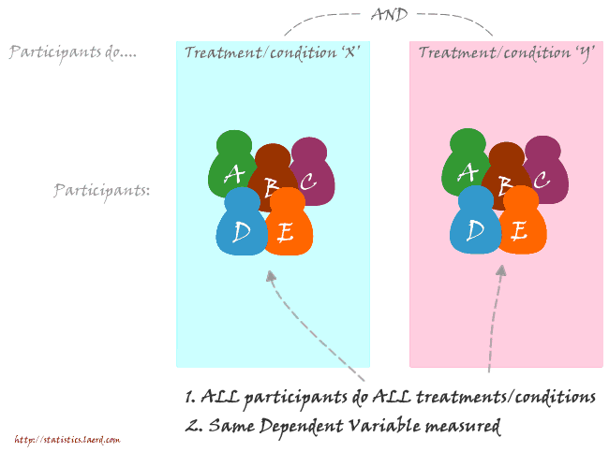
The many flavors of tea
Single sample t
One sample, compared with known population mean
Goal: Is our sample different from population?
Independent Samples t
Different (independent) samples of participants
experience each level of IV
Are our samples from different
populations?
Paired/Dependent Samples
Same or related (dependent) samples
of participants experience each level of IV
Are our samples from different
populations?

Slide 13
Degrees of Freedom
Necessary when making estimates…
The number of scores that are free to vary when estimating a population parameter from a sample
df = N – 1 (for a Single-Sample t Test)
Example: I decide to ask 6 people how often they floss their teeth and record their average = 2 (times per week)
Eventual goal: Estimate population parameters (population variability).
How many scores are free to vary and can still produce an average of 2?
3 | Free | 2
5 | Free | 1
1 | Free | 0
0 | Free | 0
2 | Free | 0
1 | LOCKED | 9
Average = 2 |  | Average = 2

Slide 14
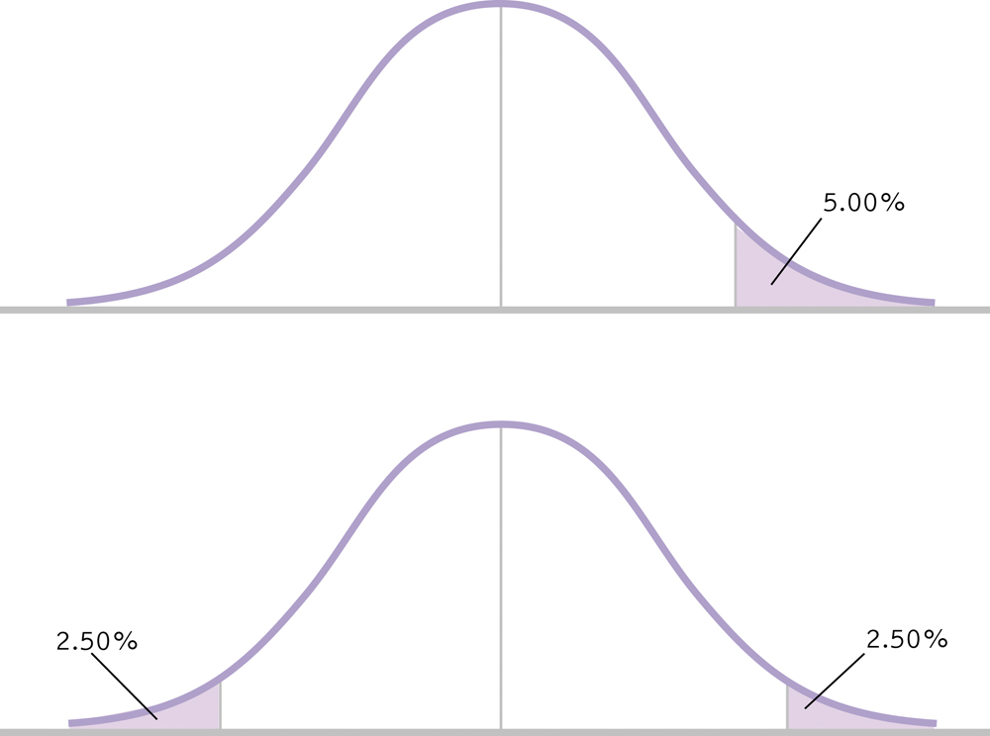
One Tailed vs. Two Tailed Tests

Slide 15
Six Steps for Hypothesis Testing
1. Identify
2. State the hypotheses
3. Characteristics of the comparison distribution
4. Critical values
5. Calculate
6. Decide
old hat

Slide 16
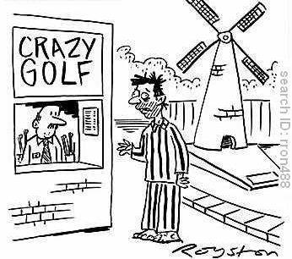
Single-Sample t Test: Attendance in Therapy Sessions
Our Counseling center on campus is concerned that most students requiring therapy do not take advantage of their services. Right now students attend only 4.6 sessions in a given year! Administrators are considering having patients sign a contract stating they will attend at least 10 sessions in an academic year.
Question: Does signing the contract actually increase participation/attendance?
We had 5 patients sign the contract and we counted the number of times they attended therapy sessions
Number of Attended Therapy Sessions
6
6
12
7
8

Slide 17
Single-Sample t Test: Attendance in Therapy Sessions
Identify
Populations:
Pop 1: All clients who sign contract
Pop 2: All clients who do not sign contract
Distribution:
One Sample mean: Distribution of means
Test & Assumptions: Population mean is known but not standard deviation → single-sample t test
Data are interval
Probably not random selection
Sample size of 5 is less than 30, therefore distribution might not be normal

Slide 18
Single-Sample t Test: Attendance in Therapy Sessions
State the null and research hypotheses
H₀: Clients who sign the contract will attend the same number of sessions as those who do not sign the contract.
H₁: Clients who sign the contract will attend a different number of sessions than those who do not sign the contract.

Slide 19
Single-Sample t Test: Attendance in Therapy Sessions
Determine characteristics of comparison distribution (distribution of sample means)
Population: μ_{M} = μ = 4.6times
Sample: M = ____times, s = _____, s_{M} = ______
7.8
2.490
1.114
# of Sessions (X)
6
6
12
7
8
M_{X} = 7.8
X-M
-1.8
-1.8
-4.2
-0.8
0.2
(X-M)²
3.24
3.24
17.64
0.64
0.04
SS_{X} = 24.8

Slide 20
Single-Sample t Test: Attendance in Therapy Sessions
μ_{M} = 4.6, s_{M} = 1.114, M = 7.8, N = 5, df = 4
Determine critical value (cutoffs)
In Behavioral Sciences, we use p = .05 (5%)
Our hypothesis (“Clients who sign the contract will attend a different number of sessions than those who do not sign the contract.”) is nondirectional so our hypothesis test is two-tailed.
df = 4

Slide 21
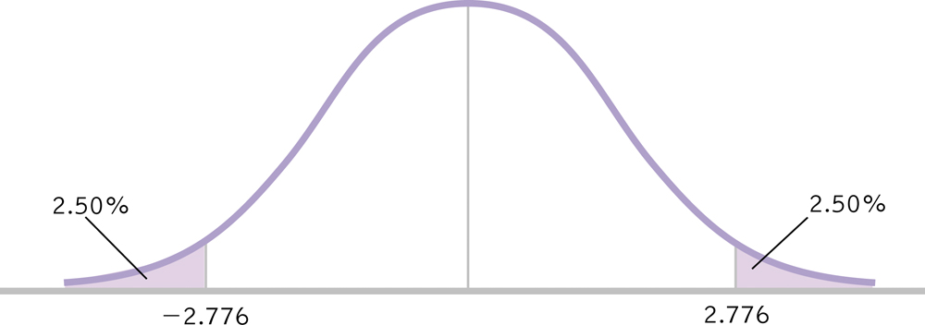
Single-Sample t Test: Attendance in Therapy Sessions
μ_{M} = 4.6, s_{M} = 1.114, M = 7.8, N = 5, df = 4
Determine critical value (cutoffs)
t_{crit} = ± 2.76

Slide 22
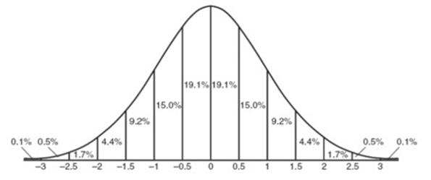
Single-Sample t Test: Attendance in Therapy Sessions
μ_{M} = 4.6, s_{M} = 1.114, M = 7.8, N = 5, df = 4
Calculate the test statistic
Make a decision
-2.76
+2.76

Slide 23
Single-Sample t Test: Attendance in Therapy Sessions
μ_{M} = 4.6, s_{M} = 1.114, M = 7.8, N = 5, df = 4
Make a decision
t = 2.873 > t_{crit} = ±2.776, reject the null hypothesis
Clients who sign a contract will attend more sessions than those who do not sign a contract,
t(4) = 2.87, p < .05.
2.873

Slide 24
Reporting Results in APA Format
Write the symbol for the test statistic (e.g., z or t)
Write the degrees of freedom in parentheses
Write an equal sign and then the value of the test statistic (2 decimal places)
Write a comma and then whether the p value associated with the test statistic was less than or greater than the cutoff p value of .05 (or report exact p value).
t(4) = 2.87, p < .05

Slide 25
Another example? A Tale of a Tail
The citizens of several Georgia towns are worried that a fiberglass insulation plant is polluting the local environment. A doctor at one hospital, Our Sister of the Failing Mercy, noted 3 babies born with a coccycx (tailbone) in the past year. Digging deeper she read a report in Human Pathology (Dao & Netsky, 1984) that between 1884 and 1984 only 23 babies were born with tails. She believes her hospital data to be unusual but she also writes to doctors at 8 other hospitals to determine how often they had seen this birth defect in the past year (these data are below).
Hospital | # of Tails
North Shore | 2
Town Center | 0
St. Mary | 0
University | 1
Failing Mercy | 3
South Central | 1
Oakmont | 0
Bellevue | 1
East Valley | 0
∑ = 8
N = 8
M = 1
“between 1884 and 1984 only 23 babies were born with tails…”
23 babies in 100 years (µ ) = .23

Slide 26
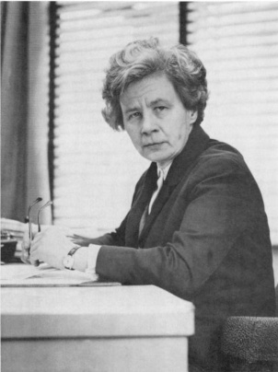
Rolling Kegs for Fun and Profit
Making the perfect handmade cask
Not too big (too much beer, lower profits)
Not too small (not enough beer, fewer clients)
Expectation: High rejection of poorly sized casks
Data: Little-to-no rejections…why?
Visit workstation for employee making rejections.
Conditions must be equal in order to make a fair comparison.
“how impossible it is to find human beings without biases, without prejudices, and without the delightful idiosyncrasies which make them so fascinating.” (Cunliffe, 1976, p.5)
Stella Cunliffe

Slide 27
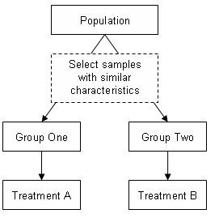
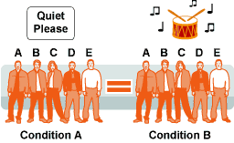
Studies with Two Samples
Independent
What is it?
Pros
Cons
Paired (Dependent)
What is it?
Pros
Cons
Hypothetical Beer Tasting Experiment
What is the ideal design for this study?

Slide 28
Paired Samples t Test
Two Related (dependent) samples

Slide 29
Paired-Samples t Test
Used to compare 2 means for a within-groups design, a situation in which every participant is in both samples (paired/dependent)
New Terminology
Distribution of Mean Differences
Difference Scores: X₁ – Y₁, X₂ – Y₂, …
Let’s walk through an example…

Slide 30
Six Steps for Hypothesis Testing
1. Identify
2. State the hypotheses
3. Characteristics of the comparison distribution
4. Critical values
5. Calculate
6. Decide
old hat

Slide 31
Paired Samples t Test: Does Studying in the Exam Room Help?
I have a debate with a research assistant about context effects in studying for exams. She believes that she does far better when she studies for an exam in the same room as she later takes the exam. I told her that I could see it either hurting or helping students. We agreed to have a group of 5 participants complete two highly similar math exams. Half of these participants studied for and completed the exams in the same room while the other half were in different rooms, order counterbalanced*. Data for SAME and DIFFERENT rooms are below.
Difference Score X-Y
-11
-15
-14
-4
-11
SAME (X) | DIFFERENT (Y)
122 | 111
131 | 116
127 | 113
123 | 119
132 | 121
M = -11

Slide 32
Paired Samples t Test: Does Studying in the Exam Room Help?
Identify
Populations:
Pop 1: Exam grades when studying and testing are in the same room.
Pop 2: Exam grades when studying and testing are in different rooms.
Distribution:
Mean of Difference Scores: Distribution of Mean Differences
Test & Assumptions: One group of participants that is studied at two time points, paired-samples t test
Data are interval
Probably not random selection
Sample size of 5 is less than 30, therefore distribution might not be normal

Slide 33
Paired Samples t Test: Does Studying in the Exam Room Help?
State the null and research hypotheses
H₀: Studying and testing in the same room will result in the same grade as studying and testing in different rooms.
H₁: Studying and testing in the same room will result in a different grade than studying and testing in different rooms.

Slide 34
Paired Samples t Test: Does Studying in the Exam Room Help?
Determine characteristics of comparison distribution (distribution of mean differences)
Population: μ_{M} = 0 (i.e., no mean difference)
Sample(s): M = 11, s = 4.301, s_{M} = 1.923
Difference Score X-Y
-11
-15
-14
-4
-11
M = -11
Deviation Score (Score - Mean)
0
-4
-3
7
0
Squared Deviation (Score - Mean)²
0
16
9
49
0
SS_{X} = 74

Slide 35
Paired Samples t Test: Does Studying in the Exam Room Help?
μ_{M} = 0, s_{M} = 1.923, M = -11, N = 5, df = 4
Determine critical value (cutoffs)
In Behavioral Sciences, we use p = .05 (5%)
Our hypothesis (“Studying and testing in the same room will result in a different grade than studying and testing in different rooms.”) is nondirectional so our hypothesis test is two-tailed.
df = 4

Slide 36
Paired Samples t Test: Does Studying in the Exam Room Help?
μ_{M} = 0, s_{M} = 1.923, M = -11, N = 5, df = 4
Determine critical value (cutoffs)
t_{crit} = ± 2.76

Slide 37
Paired Samples t Test: Does Studying in the Exam Room Help?
μ_{M} = 0, s_{M} = 1.923, M = -11, N = 5, df = 4
Calculate the test statistic
Make a decision
-2.76
+2.76

Slide 38
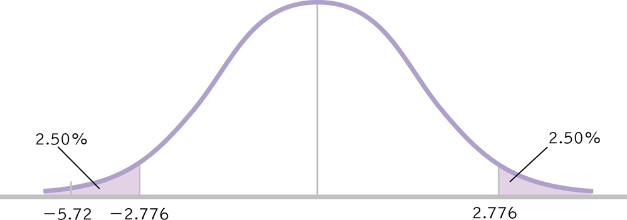
Paired Samples t Test: Does Studying in the Exam Room Help?
μ_{M} = 0, s_{M} = 1.923, M = 11, N = 5, df = 4
Make a decision
t = -5.720 > t_{crit} = ±2.776, reject the null hypothesis
People studying and testing in different rooms performed worse than … in the same rooms,
t(4) = 5.72, p < .05.

Slide 39
Paired Samples: Ideal Design?
Given the simple calculations and low cost (time and participants), why wouldn’t we always use paired/dependent/within subjects designs?
Back to the hypothetical beer tasting experiment…

Slide 40
Independent Samples t Test
Two Unrelated (unpaired) samples

Slide 41
My Father’s “Chinese Lock”
Does teaching someone a strategy decrease the amount of time it takes to solve the puzzle?
How do you design this study?
Paired Samples option #1: No Strategy → Strategy
Paired Samples option #2: Strategy → No Strategy

Slide 42
Independent Samples t Test
Used to compare 2 means for a between-groups design, a situation in which each participant is assigned to only one condition.
New Statistics & Terminology:
Distribution of Differences Between Means
df_{X} , df_{Y} , df_{Total}
Pooled Variance
Standard Error of the Difference

Slide 43
Six Steps for Hypothesis Testing
1. Identify
2. State the hypotheses
3. Characteristics of the comparison distribution
4. Critical values
5. Calculate
6. Decide
old hat

Slide 44
Independent Samples t Test: Gender Differences in Humor Appreciation
I tend to believe that very few differences exist between males and females in cognitive abilities but there is some evidence that there are gender differences in, for example, humor appreciation.

Slide 45
Independent Samples t Test: Gender Differences in Humor Appreciation
In this hypothetical study we ask: what percentage of cartoons do men and woman consider funny? We recruited 9 people from the psychology subject pool and asked them to view a cartoon. After the cartoon, each participant gave us a humor rating of the cartoon, from 0-100 (100 being the funniest possible). Here are those data.
Women (X) | Men (Y)
84 | 88
97 | 90
58 | 52
90 | 97
 | 86

Slide 46
Independent Samples t Test: Gender Differences in Humor Appreciation
Identify
Populations:
Pop 1: Women exposed to the cartoon
Pop 2: Men exposed to the cartoon
Distribution:
Difference Between Means: Distribution of Differences Between Means
Not Distribution of Mean Differences
Test & Assumptions: One group of participants that is studied at two time points, paired-samples t test
Data are interval
Random selection
Sample size of 9 is less than 30, therefore distribution might not be normal

Slide 47
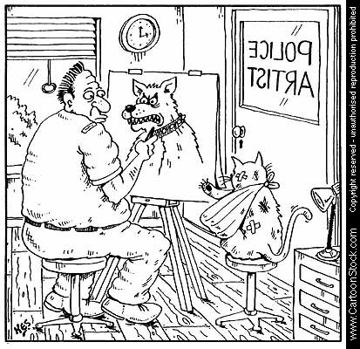
Independent Samples t Test: Gender Differences in Humor Appreciation
State the null and research hypotheses
H₀: Women will categorize the same number of cartoons as funny as will men.
H₁: Women will categorize a different number of cartoons funny than will men.

Slide 48
Independent Samples t Test: Gender Differences in Humor Appreciation
Determine characteristics of comparison distribution (distribution of differences between means)
Population: μ₁ = μ₂ (i.e., no difference between means)
What the @#$% ?

Slide 49
Independent Samples t Test: Gender Differences in Humor Appreciation
Determine characteristics of comparison distribution
S_{Difference}
Standard Error of the Difference:
Calculate variance for each sample
Pool variances, accounting for sample size
Convert from squared standard deviation to squared standard error
Add the two variances
Take square root to get estimated standard error for distribution of differences between means.

Slide 50
Calculating s_{Difference}
Calculate variance (s²) for each sample
Women (X) | X-M | (X-M)²
84 | 1.75 | 3.063
97 | 14.75 | 217.563
58 | -24.25 | 588.063
90 | 7.75 | 60.063
M_{X} = 82.25
SS_{X} = 868.752
Men (Y) | Y-M | (Y-M)²
88 | 5.4 | 29.16
90 | 11.4 | 129.96
52 | -30.6 | 936.36
97 | 14.4 | 207.36
86 | 3.4 | 11.56
M_{Y} = 82.6
SS_{Y} = 1314.4

Slide 51
Independent Samples t Test
New Types of Samples Means…
New Degrees of Freedom
df_{X} = N – 1 = 4 – 1 = 3
df_{X} = 3
df_{Y} = N – 1 = 5 – 1 = 4
df_{Y} = 4
df_{Total} = df_{X} + df_{Y} = 3 + 4 = 7
df_{Total} = 7
Women (X)
84
97
58
90
N = 4
Men (Y)
88
90
52
97
86
N = 5

Slide 52
Pooled Variance
Pool variances, accounting for sample size
Weighted average of the two estimates of variance – one from each sample – that are calculated when conducting an independent samples t test.

Slide 53
Independent Samples t Test: Gender Differences in Humor Appreciation
Convert from squared standard deviation to squared standard error
Add the two variances
Take square root to get estimated standard error for distribution of differences between means.

Slide 54
Independent Samples t Test: Gender Differences in Humor Appreciation
Determine critical value (cutoffs)
In Behavioral Sciences, we use p = .05 (5%)
Our hypothesis (“Women will categorize a different number of cartoons funny than will men.”) is nondirectional so our hypothesis test is two-tailed.
t = ± 2.365
df_{Total} = 7

Slide 55
Independent Samples t Test: Gender Differences in Humor Appreciation
Determine critical values
df_{Total} = 7 p = .05 t = ± 2.365
Calculate a test statistic

Slide 56
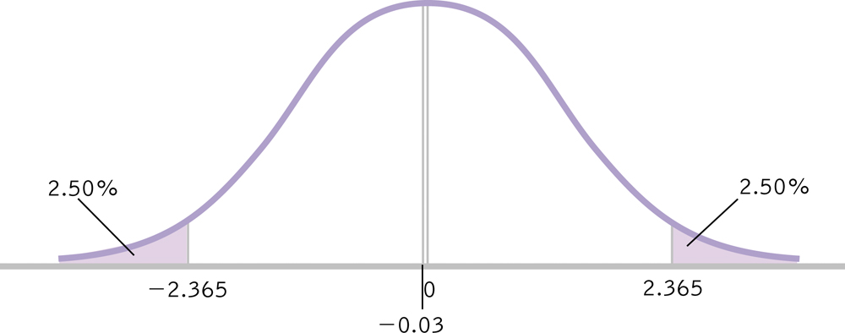
Independent Samples t Test: Gender Differences in Humor Appreciation
Make a decision
Fail to reject null hypothesis
Men and women find cartoons equally humorous, t(7) = .03, p > .05

Slide 57
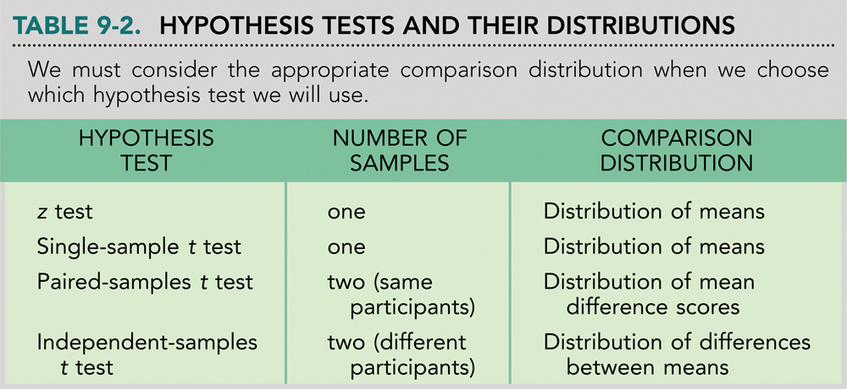
Summary

Slide 58
When to use which statistical test?
Using the correct statistical test, and correcting for multiple hypotheses are recurrent issues in data science
Data comparisons you are making | Data are normally distributed | Data are not normally-distributed, or are ranks or scores | Data are Binomial (Possess 2 possible values)
Compare one set of data to a hypothetical value | One-sample t-test | Wilcoxon test | χ² test
Compare two sets of independently-collected (unpaired) data | Unpaired t-test | Mann-Whitney test | χ² test or Fisher test
Compare two sets of data from the same subjects under different circumstances (paired) | Paired t-test | Wilcoxon test | McNemar’s test
Compare three or more sets of data | One-way ANOVA | Kruskal-Wallis test | χ² test
Look for a relationship between two variables | Pearson Correlation coefficient | Spearman correlation coefficient | Contingency Correlation coefficients
Look for a linear relationship between two variables | Linear regression | Nonparametric linear regression | Simple logistic regression
Look for a non-linear relationship between two variables | Non-linear regression | Nonparametric non-linear regression
Intel – Advanced Analytics

