Slide 1
DATA MINING TECHNIQUES
(DECISION TREES )
Presented by:
Shweta Ghate
MIT College OF Engineering

Slide 2
What is Data Mining ???
Data Mining is all about automating the
process of searching for patterns in the
data.
Data mining is the discovery of hidden
knowledge, unexpected patterns and new rules in large databases..

Slide 3
Data Mining Techniques
Key techniques
Association
Classification
Decision Trees
Clustering Techniques
Regression

Slide 4
Classification
Classification is a most familiar and most popular data mining technique.
Classification applications includes image and pattern recognition, loan approval, detecting faults in industrial applications.
All approaches to performing classification assumes some knowledge of the data.
Training set is used to develop specific parameters required by the technique.
The goal of classification is to build a concise model that can be use to predict the class of records whose class label is not know.

Slide 5
Classification
Classification consists of assigning a class label to a set of unclassified cases.
1. Supervised Classification
The set of possible classes is known in advance.
2. Unsupervised Classification
Set of possible classes is not known. After classification we can try to assign a name to that class. Unsupervised classification is called clustering.

Slide 6
Decision tree
Classification scheme
Generates a tree and a set of rules
Set of records divide into 2 subsets
  -training set (deriving the classifier)
  - test set (measure the accuracy of classifier)
Attributes are divided into 2 types
-numerical attribute
-categorical attribute

Slide 7
Decision tree
Decision tree
  A flow-chart-like tree structure
  Internal node denotes a test on an attribute
  Branch represents an outcome of the test
  Leaf nodes represent class labels or class distribution or rule.
Use of decision tree: Classifying an unknown sample
  Test the attribute values of the sample against the decision tree

Slide 8
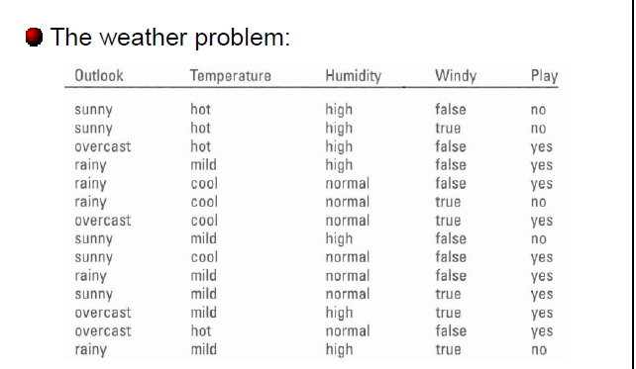
Training Dataset

Slide 9
Output: A Decision Tree
OUTLOOK
sunny
rain
overcast
HUMIDITY
PLAY
WINDY
<=75
>75
true
false
PLAY
NO PLAY
PLAY
NO PLAY

Slide 10
Extracting Classification Rules from Trees
Represent the knowledge in the form of IF-THEN rules
One rule is created for each path from the root to a leaf
Each attribute-value pair along a path forms a conjunction
The leaf node holds the class prediction
Rules are easier for humans to understand

Slide 11
  RULE 1: If it is sunny and the humidity is not above 75% then play.
  RULE 2: If it is sunny and the humidity is not above 75% then play.
  RULE 3:If it is overcast , then play
  RULE 4:If it is rainy and not windy , then play.
  RULE 5:If it is rainy and windy, then don't play.
OUTLOOK
sunny
rain
overcast
HUMIDITY
PLAY
WINDY
<=75
>75
true
false
PLAY
NO PLAY
PLAY
NO PLAY
Output: A Decision Tree whether to play a golf

Slide 12
Example
The classification of an unknown input vector is done by traversing the tree from the root node to the leaf node.
e.g: outlook= rain, temp=70,humidity=65,
and weather=true…..then find the value of Class attribute?????

Slide 13
Tree construction Principle
Splitting Attribute
Splitting Criterion
3 main phases
-construction Phase
-Pruning Phase
-Processing the pruned tree to improve the understandability

Slide 14
The Generic Algorithm
Let the training data set be T with class-labels{C1,C2….Ck}.
T he tree is built by repeatedly partitioning the training data set
The process continued till all the records in partition belong to the same class.

Slide 15
T is homogenous
-T contains cases all belonging to a single class Cj. The decision tree for T is a leaf identifying class Cj.
T is not homogeneous
-T contains cases that belongs to a mixture of classes.
-A test is chosen ,based on single attribute, that has one or more mutually exclusive outcomes{O1,O2,….On}.
-T is partitioned into subset T1,T2,T3…..Tn.
where Ti contains all those cases in T that have the outcome Oi of the chosen set.
-The decision tree for T consist of decision node identifying the test, and one branch for each possible outcome.

Slide 16
-The same tree building method is applied recursively to each subset of training cases.
- n is taken 2,and a binary decision tree is generated.
T is trivial
- T contains no cases.
- The decision tree T is a leaf ,but the class to be associated with the leaf must be determined from information other than T.

Slide 17
Decision Tree Construction Algorithms
CART(Classification And Regression Tree)
ID3(Iterative Dichotomizer 3)
C4.5

Slide 18
Advantages
Generate understandable rules
Able to handle both numeric and categorical attributes
They provide clear indication of which fields are most important for prediction or classification.

Slide 19
Weaknesses
Some decision trees can only deal with binary-valued target classes
Others can assign records to an arbitrary number of classes ,but are error-prone when the number of training examples are class gets small.
Process of growing a decision tree is computationally expensive.

Slide 20
References
http://www.ibm.com/developerworks/opensource/library/ba-data-mining-techniques/index.html
Data Mining: Concepts and Techniques (Chapter 7 Slide for textbook), Jiawei Han and Micheline Kamber, Intelligent Database Systems Research Lab, School of Computing Science, Simon Fraser University, Canada
Data Mining Techiques: Second edition by Arun K. Pujari.

Slide 21
Thank You

