Slide 1
Lecture 2

Slide 2
Review: Frequency table – discrete variable
No. of family members | Bin | ni | fi | Ni | Fi
1 | 1 | 4 | 6% | 4 | ----
2 | 2 | ---- | 17% | 16 | 22%
3 | 3 | 17 | 24% | ---- | 46%
4 | 4 | 23 | ---- | 56 | 78%
5 | More | 16 | 22% | 72 | 100%
 |  | 72 | 100%
Fill the missing values and interpret them.

Slide 3
Review: Frequency table – continuous variable
LL | UP | Bin | ni | fi | Ni | Fi
154 | 159 | 159 | 4 | 6% | 4 | 6%
159 | 164 | 164 | 8 | 11% | 12 | 17%
164 | 169 | 169 | ---- | 11% | 20 | 28%
169 | 174 | 174 | 12 | 17% | 32 | 44%
174 | 179 | 179 | 8 | ---- | 40 | 56%
179 | 184 | 184 | 18 | 25% | 58 | 81%
184 | 189 | 189 | 10 | 14% | ---- | 94%
189 | 194 | 194 | 2 | 3% | 70 | ----
194 | 199 | More | 2 | 3% | 72 | 100%
 |  |  | 72 | 100%
Fill the missing values and interpret them.

Slide 4
Describing Data: Numerical
Figures won´t lie, but liars will figure

Slide 5
Why is descriptive statistics important to managers?
managers should know how to use the numerical descriptive measures that provide very brief and easy-to understand summaries of a data collection.
categories into which these measures fall: measures of location, measures of variability, measures of skewness and measures of kurtosis.

Slide 6
Topic Goals
After completing this topic, you should be able to compute and interpret the:
Measures of location, dispersion, variability, and shape
(Arithmetic) Mean, median, mode, geometric mean
Quartiles
Five number summary and box-and-whisker plots
Range, interquartile range, variance and standard deviation, coefficient of variation
Symmetric and skewed distributions
Flat and peaked distribution

Slide 7
Describing Data Numerically
Describing Data Numerically
Location
Variation
Arithmetic Mean
Range
Median
Interquartile Range
Mode
Variance
Geometric Mean
Standard Deviation
Quartiles
Coefficient of Variation

Slide 8
What Is Central Tendency?
A measure of central tendency is a single value that describes the way in which a group of data cluster around a central value. To put in other words, it is a way to describe the center of a data set. There are three most important measures of central tendency: the mean, the median, and the mode.
Measures of central tendency (location) could be used only for numerical data. It does not make sence to compute them for a nominal or ordinal scaled data (except mode).

Slide 9
Why is central tendency important?
It groupes the data set to one representative value, which is useful when you are working with large amounts of data.
Could you imagine how difficult it would be to describe the central location of a 1000-item data set if you had to consider every number individually?
It allows you to compare one data set to another.
For example, let's say you have a sample of girls and a sample of boys, and you are interested in comparing their heights. By calculating the average height for each sample, you could easily draw comparisons between the girls and boys.

Slide 10
Why is central tendency important?
Central tendency is also useful when you want to compare one piece of data to the entire data set.
Let's say you received a 60% on your last math test, which is usually in the D range. You go around and talk to your classmates and find out that the average score on the test was 43%. That means that your score was significantly higher than those of your classmates. Since your teacher grades on a curve, your 60% becomes an A.

Slide 11
Measures of Location – Central tendency
Overview
Location
Mean
Median
Mode
Arithmetic average
Midpoint of ranked values
Most frequently observed value

Slide 12
Arithmetic Mean
The most important numerical measure of location.
The arithmetic mean of a collection of numerical values is the sum of these values divided by the number of values.
If the data are from a population, the mean is denoted by Greek letter µ (mu).
If the data are from a sample, the mean is denoted by $\overline{x}\text{ (}\text{x}\text{−}\text{bar}\text{)}$.
A population parameter is any measurable characteristic of a population.
A sample statistic is any measurable characteristic of a sample.

Slide 13
Arithmetic Mean
For a sample of size n:
Where n represents the number of items in the sample.
In this formula, the numerator is the sum of the n data values, that is $\sum{x_{i}=x_{1}}+x_{2}+…+x_{n}$, where the Greek letter Σ is the summation sign.
Observed values
Absolute frequencies
Sample size

Slide 14
Calculation Example: Arithmetic Mean
In order to illustrate the computation of an arithmetic mean, let us following class-size data for a sample of five college classes:
46 54 42 46 32
Using the notation $x_{1}, x_{2},x_{3}, x_{4}, x_{5 }$to represent the number of students in each of the five classes, we have:
$x_{1}$=46 $x_{2}$=54 $x_{3}$=42 $x_{4}$=46 $x_{5 }$=32
Thus to compute the sample mean, we can write:
$\overline{x}=\frac{\sum{x_{i}}}{n}=\frac{x_{1}+x_{2}+x_{3}+x_{4}+x_{5}}{5}=\frac{46+54+42+46+32}{5}=44$
For the five classes sampled, the mean class size is 44 students.

Slide 15
Count the average hight in your class

Slide 16
Arithmetic Mean
For a population of N values:
Absolute frequencies
Population values
Population size

Slide 17
Characteristics of the arithmetic mean
l. Every data set measured on an interval or ratio scale has a mean.
2. The mean has valuable mathematical properties that make it convenient to use in further calculations.
3. The mean is sensitive to extreme values.
4. The sum of the deviations of the numbers in a data set from the mean is zero.
5. The sum of the squared deviations of the numbers in a data set from the mean is a minimum value.

Slide 19
Geometric Mean
The geometric mean is the most common measure of location for rates (growth rates, interest rates, etc.)
For N values:
Population values
Population size

Slide 20
Arithmetic Mean
(continued)
The most common measure of location.
Mean = sum of values divided by the number of values.
Affected by extreme values (outliers) !!!
0 1 2 3 4 5 6 7 8 9 10
0 1 2 3 4 5 6 7 8 9 10
Mean = 3
Mean = 4

Slide 21
Median
The numerical value in the middle when data set is arranged in order (50% above, 50% below).
Not affected by extreme values!
0 1 2 3 4 5 6 7 8 9 10
0 1 2 3 4 5 6 7 8 9 10
Median = 3
Median = 3

Slide 22
Finding the Median
The location of the median:
If the number of values is odd, the median is the middle number when all data is arranged in ascending order.
If the number of values is even, the median is the average of the two middle numbers when all data is arranged in ascending order.
Note that is not the value of the median, only the position of the median in the ranked data.

Slide 23
Calculation Example: Median, when the number of values is odd
Let us apply the definition of median to compute the median class size for the sample of five college classes. Arranging the five data values in ascending order provides the following rank-ordered list.
32 42 46 46 54
Since n=5 is odd, the median is a middle item in the rank-ordered list. Thus the median is 46 students.
Even thought there are two values of 46, each value is treated as a separate item.

Slide 24
Calculation Example: Median, when the number of values is even
Compute the median starting salary for the business college graduates.
Firstly we have to arrange the 12 items in ascending order:
1910 1955 2050 2080 2080 2090 2120 2140 2150 2250 2330 2525
Graduate | Monthly Salary | Graduate | Monthly Salary
1 | 2050 | 7 | 2090
2 | 2150 | 8 | 2330
3 | 2250 | 9 | 2140
4 | 2080 | 10 | 2525
5 | 1955 | 11 | 2120
6 | 1910 | 12 | 2080
Middle two values

Slide 25
Calculation Example: Median, when the number of values is even
Since n=12 is even, we have identified middle two items.
The median is the average of these two values:
$Median=\frac{2090+2120}{2}=2105$

Slide 27
Mode
A measure of location.
Value that occurs most often in the data set.
Not affected by extreme values.
Used for numerical and also categorical data.
There may be no mode.
There may be several modes – data are multimodal.
Mode = 9
No Mode
0 1 2 3 4 5 6 7 8 9 10 11 12 13 14
0 1 2 3 4 5 6
Can you give me an example of multimodal data set?

Slide 28
Calculation Example: Mode
To illustrate the identification of the mode, let us following class-size data for a sample of five college classes:
46 54 42 46 32
The only value that occurs more than once is 46.
This value has the greatest frequency, so it is the mode.

Slide 29
Review Example: Summary Statistics
House Prices: €2,000,000
500,000 300,000 100,000 100,000
Sum 3,000,000
Mean: (€3,000,000/5)
= €600,000
Median: middle value of ranked data = €300,000
Mode: most frequent value = €100,000

Slide 30
Excercises
1. Consider the sample of size 5 with data values as follows:
10 20 12 17 16
Compute the mean and median.
2. Consider the sample of size 6 with data values as follows:
10 20 21 17 16 12
Compute the mean and median.
3. A bowler has the following scores for six games:
182 168 184 190 170 174
Compute the mean, median, and mode.
4. Japanese export quotas for each of the 12 months of 1998 are shown below:
145 135 100 220 170 145 190 155 210 200 205 180
What are the mean, median and mode for the quota data?

Slide 31
Which measure of location is the “best”?
Mean is generally used, unless extreme values (outliers) exist.
Then median is often used, since the median is not sensitive to extreme values.
Example: Median home prices may be reported for a region – l
ess sensitive to outliers.

Slide 32
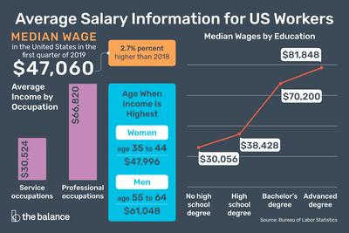
Some real examples

Slide 33
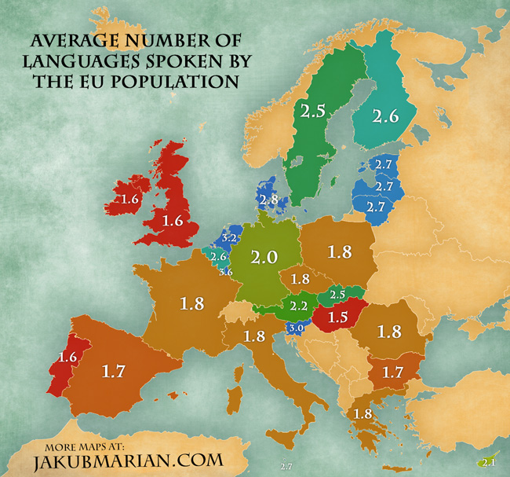
Some real examples

Slide 34
Quartiles
Quartiles split the ranked data into 4 segments with an equal number of values per segment.
25%
25%
25%
25%
Q1
Q2
Q3
The first quartile, Q₁, is the value for which 25% of the observations are smaller and 75% are larger.
Q₂ is the same as the median (50% are smaller, 50% are larger).
Only 25% of the observations are greater than the third quartile.

Slide 35
Quartile Formulas
Find a quartile by determining the value in the adequate position in the ranked data, where
First quartile position: Q₁ = 0.25(n+1)
Second quartile position: Q₂ = 0.50(n+1)
(the median position)
Third quartile position: Q₃ = 0.75(n+1)
where n is the number of observed values.

Slide 36
Quartiles
Example: Find the first quartile
Sample Ranked Data: 11 12 13 16 16 17 18 21 22
(n = 9)
Q₁ = is in the 0.25(9+1) = 2.5 position of the ranked data
so use the value half way between the 2nd and 3rd values,
so Q₁ = 12.5

Slide 37
Excercise:
The Nielsen organization provides data on television viewing in the United States. A study reported that the mean number of hours of television viewing per week was increasing. Suppose that the following data provide the hours of television viewing per week for a sample of 16 college students.
14 9 12 4 20 26 17 15 18 15 10 6 16 15 8 5
Compute the mean, median, and mode.
Compute first and third quantiles.

Slide 38
Thank you! We will continue with measures of variaton, skewness and kurtisus on the next lecture. Have a nice day!

