Slide 1
Tests about proportions

Slide 2

Interval estimate of proportion
If sample size is sufficient, test statistic has a normal probability distribution N(0,1) and can be calculated according following formula:
Where:
p – point estimate of population proportion
π- population proportion
$$σ_{p} is a standard error of proportion, calculated using given formula:$$

Slide 3
Interval estimate of proportion
f(u)
1 - α

Slide 4
Example: Proportion of expenditures for alcohol and cigarettes point and interval estimate and 95 % confidence interval
n=400
x=315
p=0,79
Excel... NORMSINV(0.975)
Δ = 1.96 * 0,02 = 0,04
0,79 – 0,04 < π < 0,79 + 0,04, t.j P(0,75 < π < 0,83)=95
With 95% probability, proportion of expenditures for alcohol and cigarettes will be between 75% and 83%.

Slide 5
Tests concerning proportions
One sample test about proportion
Two sample test about proportions

Slide 6
A. One sample test about proportion
Assumption: alternative variable with binomial distribution can be approximated to normal distribution
Hypothesis:
H0: π = π₀
H1: π ≠ π₀

Slide 7
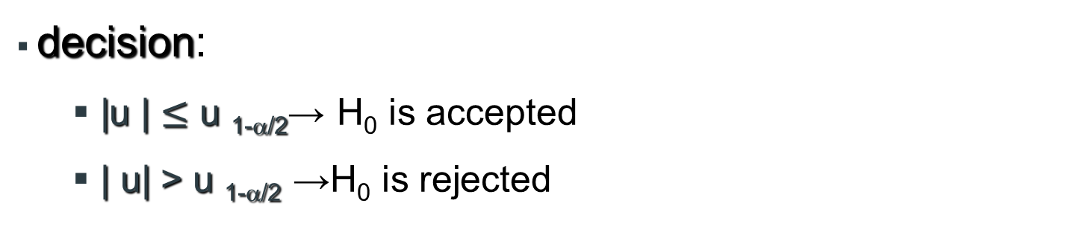
One sample test about proportion
Test statistics
u has Ν(0,1) distribution
decision:
  |u | $≤$ u _{1-α/2}→ H₀ is accepted
  | u| > u _{1-α/2} →H₀ is rejected

Slide 8
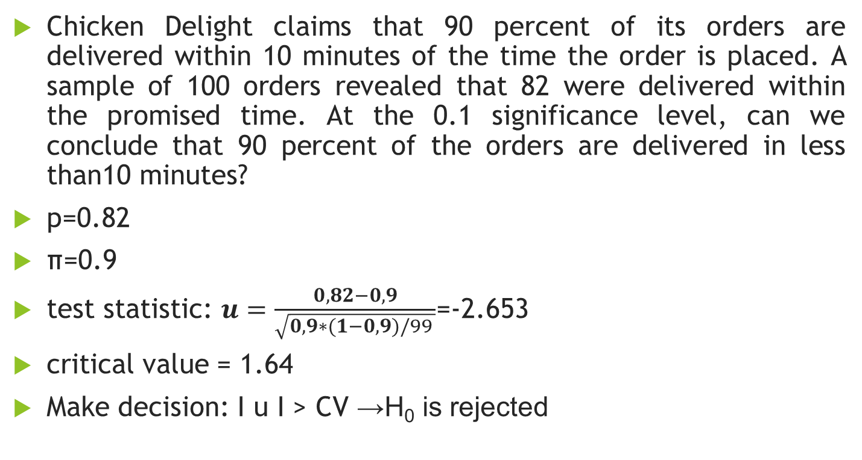
Example
Chicken Delight claims that 90 percent of its orders are delivered within 10 minutes of the time the order is placed. A sample of 100 orders revealed that 82 were delivered within the promised time. At the 0.1 significance level, can we conclude that 90 percent of the orders are delivered in less than10 minutes?
p=0.82
π=0.9
test statistic: $u=\frac{0,82−0,9}{\sqrt{0,9∗(1−0,9)/99 }}$=-2.653
critical value = 1.64
  Make decision: I u I > CV →H₀ is rejected

Slide 9
B. Two sample test about proportions
Assumption: alternative variable with binomial distribution can be approximated to normal distribution
Hypothesis
H0: π1 = π2
H1: π1 ≠ π2

Slide 10

Two sample test about proportions
Test statistics
u má Ν(0,1) rozdelenie
Decision:
if |u | $≤$ u _{1-α/2}→ H₀ is accepted
if | u| > u _{1-α/2} →H₀ is rejected

Slide 11
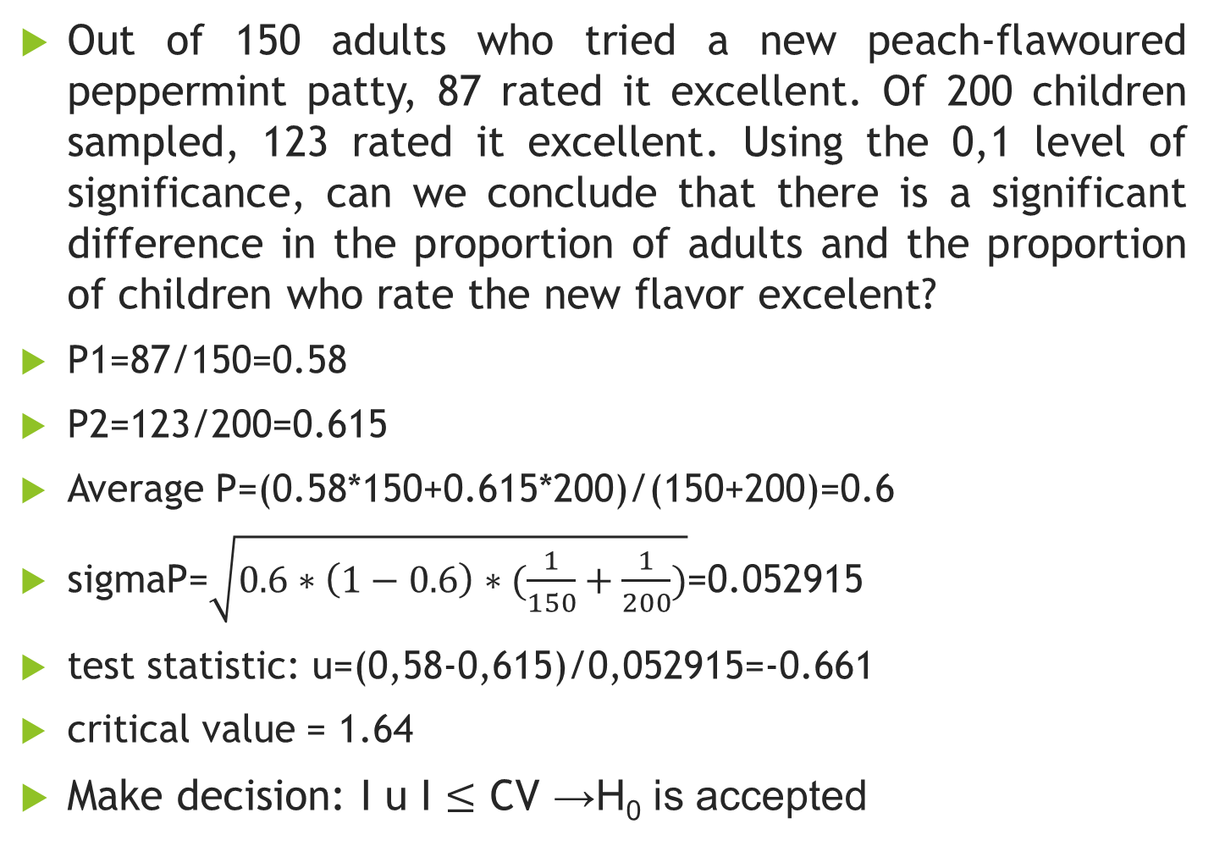
Example
Out of 150 adults who tried a new peach-flawoured peppermint patty, 87 rated it excellent. Of 200 children sampled, 123 rated it excellent. Using the 0,1 level of significance, can we conclude that there is a significant difference in the proportion of adults and the proportion of children who rate the new flavor excelent?
P1=87/150=0.58
P2=123/200=0.615
Average P=(0.58*150+0.615*200)/(150+200)=0.6
sigmaP=$\sqrt{0.6∗\left(1−0.6\right)∗(\frac{1}{150}+\frac{1}{200})}$=0.052915
test statistic: u=(0,58-0,615)/0,052915=-0.661
critical value = 1.64
  Make decision: I u I $≤$ CV →H₀ is accepted

